Slide 1
The Story of Dryope

Slide 2
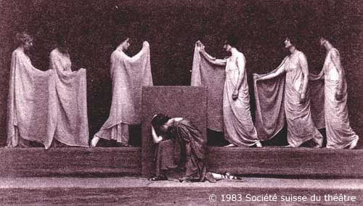
Iole and Alcmena
Iole, Dryope’s sister, tells the story of Dryope to Alcmena.
Alcmena is lamenting the fate of her loyal servant girl, Galanthis.

Slide 3
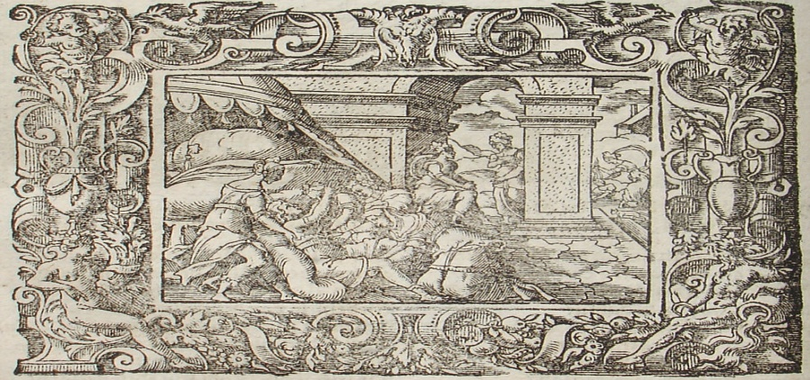
Alcmena and Lucina
Because Alcmena had been seduced by Zeus disguised as her husband, when Alcmena is giving birth to Hercules, Juno convinces the goddess of childbirth, Lucina, to keep Alcmena from having her son.
Stubbornly the goddess clasps her hands together, making it impossible for Alcmena to have her child.

Slide 4
Alcmena and Zeus

Slide 5
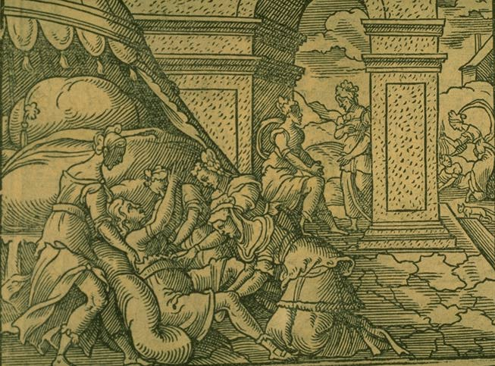
Alcmena and Lucina
For seven days Lucina makes Alcmena labor, until finally Galanthis goes to the angry goddess and tell her that her mistress had her son.
Lucina jumps up in shock, loosening her hands, which allows Alcmena to give birth to Hercules.

Slide 6
Birth of Hercules

Slide 7
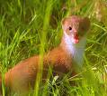
Alcmena and Lucina
Furious, Lucina seizes Galanthis, yanks her hair and makes forelegs out of her arms, turning her into a weasel.
Although a weasel, Galanthis still haunts her mistress’s house in devotion.
It is said that since Galanthis’s mouth helped Alcmena give birth, the weasel gives birth to her young through her mouth.

Slide 8
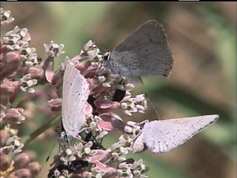
The Beginning
After Alcmena finishes her story and cries for Galanthis, Iole tells her the tale of her sister.
In Ovid, Dryope was the most beautiful of all the Oechalian girls, her mother’s only daughter, whose half-sister was Iole.

Slide 9
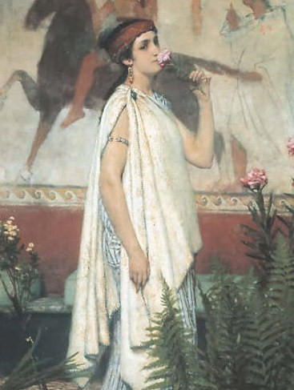
Dryope
By some accounts, Dryope was the daughter of King Dryops (which means “oak-man”), or by others, Eurytus. Ovid, says that Eurytus was Dryope’s father, and she was the only child her mother bore.
According to Ovid, Dryope had a half-sister, Iole, from a different mother.

Slide 10
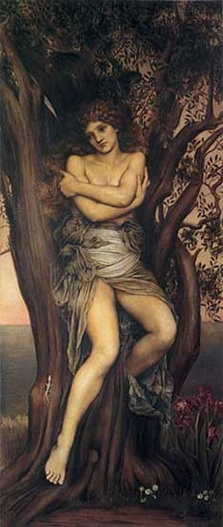
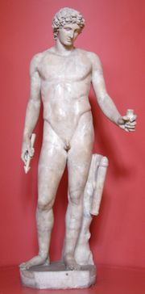
Dryope
As Ovid says, Dryope was the most beautiful of all the Oechalian girls. Thus, because of her beauty, Apollo rapes her, taking her virginity. Even though she has been defiled, Andraemon makes Dryope his wife, and all his people think he is lucky.
According to Antoninus Liberalis’s book, Collection of Transformations, Dryope played with the hamadryads on Mount Oeta. There Apollo saw the girl, followed her, and turned himself into a tortoise, which Dryope took as a pet.

Slide 11
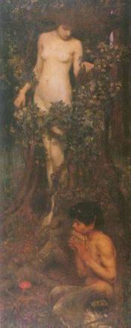
Hamadryads
Hamadryads are a type of dryad
which are born bonded to a
certain tree.
If the tree dies, so does the
hamadryad

Slide 12
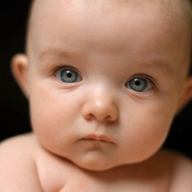
Antoninus Liberalis's Dryope
Dryope takes the tortoise and plays with it in her lap. Suddenly, Apollo changes from a tortoise into a snake.
Dryope tries to flee from the snake, but Apollo, in snake form, twines around her legs and arms to prevent her from escaping. The nymphs forsake Dryope and Apollo rapes her.
Dryope gives birth to a son, Amphissus, and then marries Andreaemon

Slide 13
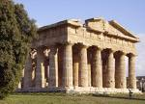
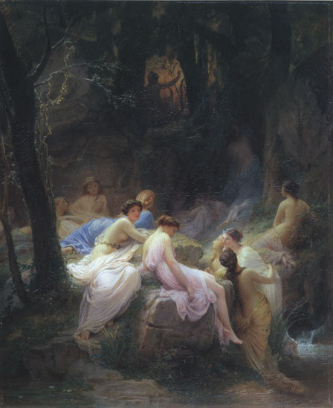
Antoninus Liberalis's Dryope
Antoninus Liberalis then says that Amphissus founds the city of Oeta and builds a temple to his father, Apollo.
Dryope becomes a priestess of the temple, and the nymphs come to converse with her.
One day, while at a spring, Apollo returns to Dryope as a snake. The snake coils around her and Apollo turns Dryope into a poplar tree.

Slide 14
Ovid's Transformation of Dryope
In Ovid’s Metamorphosis, Dryope goes to a lake shore with her sister, Iole, and son, Amphissos, to give offerings and prayers to the nymphs.
Dryope sees a crimson water lotus blooming near the lake shore. Seeking to please her infant son, she picks the flowers for him to play with.
As she picks the flower, bloody drops fall from the stem and the plant shudders. Too late, Iole remembers the story of Lotus and Priapus.

Slide 15
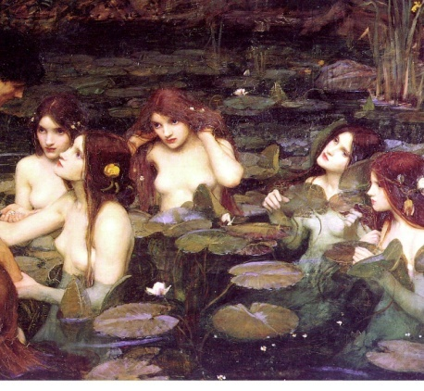
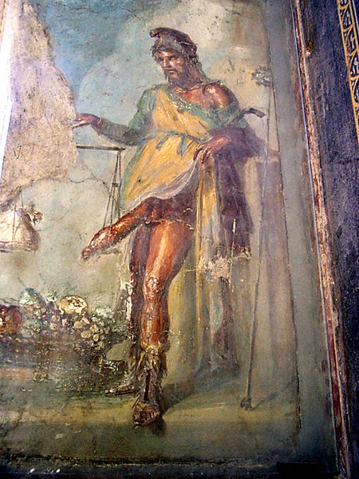
Lotis and Priapus
Lotis is a nymph.
She is the daughter of either Poseidon or Nereus
Priapus is a minor fertility god, protector of livestock, fruit plants, gardens, and male genitalia.
Priapus is the child of Venus and Dionysus, Hermes, or Adonis

Slide 16
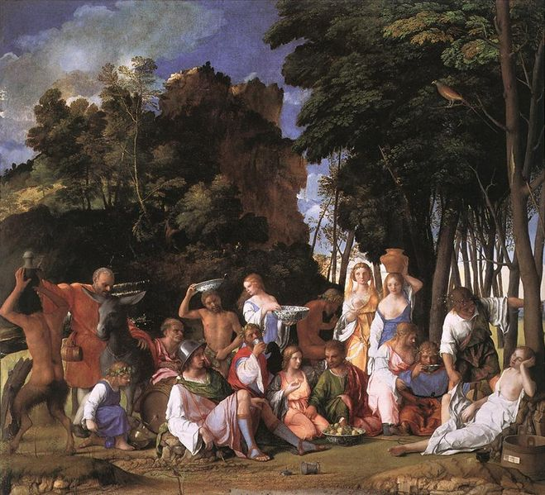
Lotis and Priapus
Lotis flees Priapus’s lust. To protect her from the god, she is changed into a lotus tree.

Slide 17
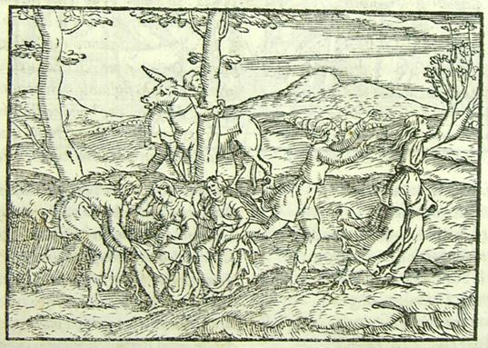
Ovid's transformation of Dryope
Frightened, Dryope tries to back away, but her feet are rooted to the ground. Slowly, bark creeps over her skin and her hair turns to leaves.

Slide 18
Ovid’s Transformation of Dryope
Dryope’s father and husband come down to the lake and ask
Iole where her sister is. Iole, in her grief, points to the tree.
Distraught, Andraemon and Eurytus cling to the roots of
the tree and kiss the wood.
Only Dryope’s face is not yet covered by bark. Through her
tears she swears to the gods that her fate was not her fault. Then
she turns to her family and begs that her son be brought to drink
milk under her boughs and learn to say “Here my mother hides.”
In her sorrow she also requests that her son never be allowed to
pick flowers, but think that all are goddesses.

Slide 19
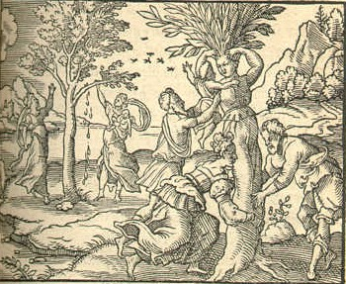
Ovid's Transformation of Dryope
Finally, right before the bark closes over her face, she begs her husband to protect her tree and kiss her.

Slide 20
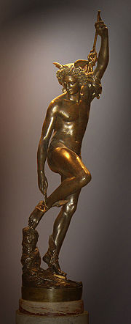
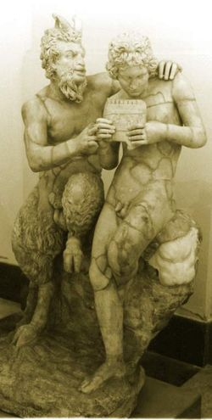
Other tales of Dryope
In some accounts, Hermes impregnates Dryope, who gives birth to the satyr, Pan.
This story does not make sense chronologically, because the Pan deity is older than the Hermes deity.

Slide 21
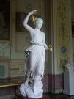
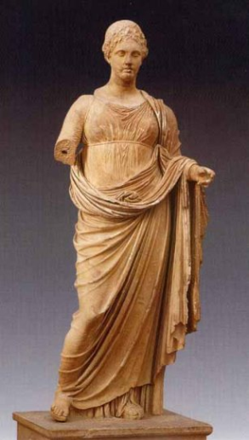
Hebe and Iolaus
Once Iole finishes her story, she and Alcmena are interrupted by Iolaus, who was a grown man, but is now aboy again.
Iolaus had begged his wife Hebe to give him youth.
Hebe, the daughter of Juno, had granted him his wish, and was about to swear never to do it again, but was stopped by the goddess Themis.

Slide 22
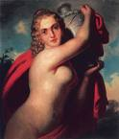
Hebe

Slide 23
Themis’s Warning
Themis warns Hebe that there is civil war in Thebes. She says Zeus will fight Capaneus, brother will fight brother, and the earth will open wide so that man will meet his ghost.
Themis continues to say that Callirhoe will ask Jove years for her infant sons, and he will speed the growth of babies to manhood.

Slide 24
Argument of the Gods
Upon hearing Themis’s speech, all the gods want to renew the life of their favorite mortal, and argue as to which mortal should be given youth.
Jove ends this bickering, saying that no god shall have that power, or he would increase the lives of his mortal children, especially Minos.

Slide 25
Argument of the Gods

Slide 26
Minos and Miletus
Minos, now old and feeble, is being threatened by Miletus, Apollo’s son by Deione.
Although Minos does not banish him, Miletus flees to Asia, founds his city, and impregnated Cyane, the river god Maeander’s daughter.
Cyane gives birth to Caunus and Byblis.

Slide 27
The End

