Slide 1
Lecture Notes – The Market for Medical Care: Demand & Supply

Slide 2
I. Demand for Medical Care
Possible public policy considerations of interest:
Why does medical care (M.C.) utilization differ from state to state or amongst different types of individuals? → We need to know the factors that affect D and to what extent
Time lag in medicine → Knowing D allows forecasting so that we can meet ↑D as it comes
Suppose we want to↑ usage of M.C. for a particular group → How? We need to know the factors that are important
Testing D & S theories using empirical data

Slide 3
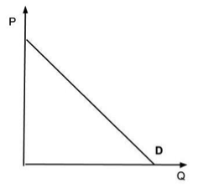
What we want to know are →
What does D look like? i.e. its relationship between P & Q or elasticity

Slide 4
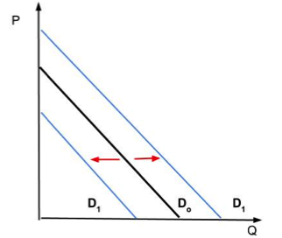
How does D change as other factors change?
Examples include things like
Age
Income
Education
→ What is their impact on M.C. (i.e. elasticities)?

Slide 5
(1) What is need?
Demand verses “Need”
Need is estimated by health professionals
Examples
Physicians/capita
Hospital beds/capita
Nurses/capita
Etc.
→ Basically, the need analysis looks at inputs into the medical care production function and tries to estimate the right mix. i.e. But do not do it on cost minimizing basis (at least not necessarily)

Slide 6
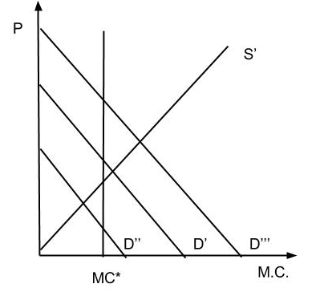
Lets assume need analysis results in MC= MC* i.e. need based M.C. (which it probably doesn’t)
→ get as long as D=D’ & S=S’ → no problem
→ Suppose D=D’’ or D=D’’’ → Excess D or excess S

Slide 7
Therefore, plan according to “need” may result in a misallocation of resources especially since usually done only according to population
→ Q. What can be done?
A. Plan according to D analysis not need

Slide 8
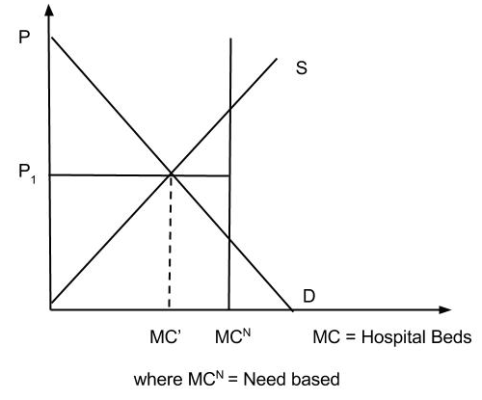
Suppose the following situation
→ Look only at hospital beds in graph below

Slide 9
Observe
1. If allow free market to work P=P1 and MC=MC1 <MC_{N} → may want to conclude that too few hospital beds but it is important to understand why Q_{D} is lower than “need” at P=P1
Possible reasons why Q_{D} < need →
Low income levels
Optimal input mix is different
Age differences in the population
Home healthcare
- What impact do all these have upon “need”? In other words, should “need” be an absolute (as medical professionals think) or relative measure?

Slide 10
2. If do make the supply of hospital beds = MC_{N} → at P1 - Excess Supply. So the only way to get rid of excess supply is to ↓ price. But – the supply curve says in the long-run that price does not generate MC = MC_{N} (firms exit the industry) → only way to keep MC=MC_{N} in the long-run is gov’t intervention of some kind (like a subsidy)
3. Disregarding D factors is likely to result in a waste of resources

Slide 11
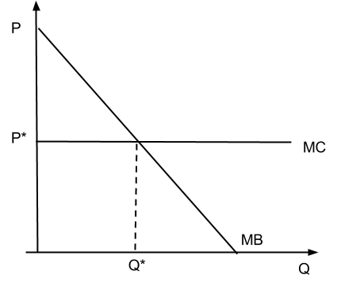
Which is the Best Way?
A free market → Individuals make choices based upon their own individual marginal benefit curves & prices on how much to buy verses gov’t intervention.
Pro
Individuals are best able to judge their benefit
Efficiency considerations both allocative (consumption) and technological (productive) efficiency (producing at least cost) are generally achieved in free markets.
Con
Externalities → May want to have gov’t intervention

Slide 12
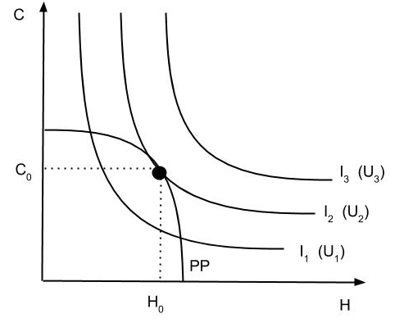
Deriving D for M.C.
Another utility analysis→ PP curve is a production possibility curve, max utility at tangency between PP and I₂.

Slide 13
We add a production possibility curve which represents the maximum amount the consumer can “buy” of C & H. Recall that H must be produced since H=f(MC, …) → They “buy” MC and use it produce health. Has the concave shape due to ↓MP of M.C.
→ M.C. gives the consumer utility because it produces health → Can construct indifference curves which reflect both
The utility obtained from medical care (since it affects health)
The impact of the production function on that process

Slide 14
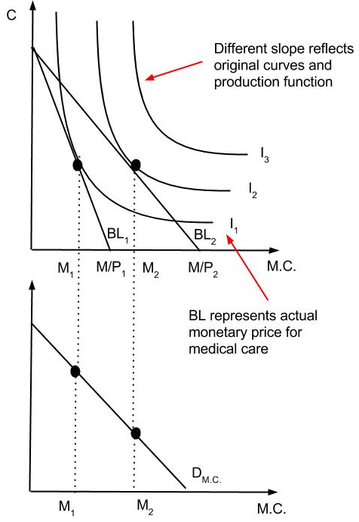
We have derive D for M.C. graphically below:

Slide 15
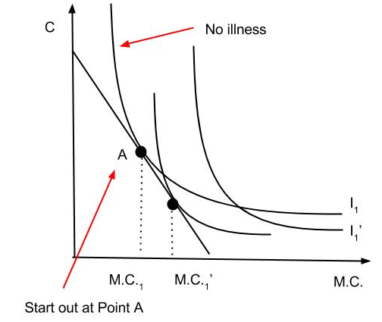
(2)What happens when you get sick?
When you get an illness what happens to indifference curves?
They rotate downward to reflect higher utility for M.C. & Also shift out → Worse off w/ illness than without. An individual can’t be at same utility level but given constraint he/she will choose more M.C.
Note: Might also lose income due to sickness → M.C. might actually fall.

Slide 16
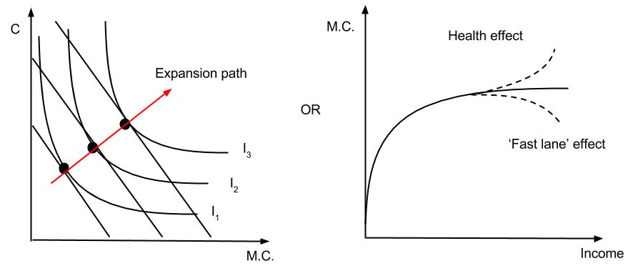
(3) What is the effect of income?
Effect of income graphically →

Slide 17
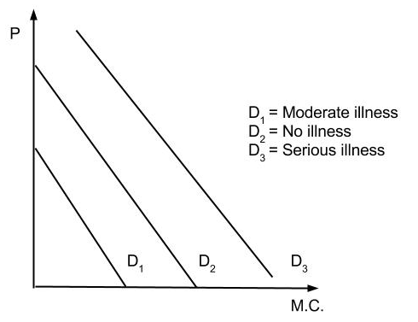
(4) Illness events & demand?
Illness events & Demand →

Slide 18
(5) What is aggregate demand?
How do you get Aggregate or Market D?
→ Illness events?

Slide 19
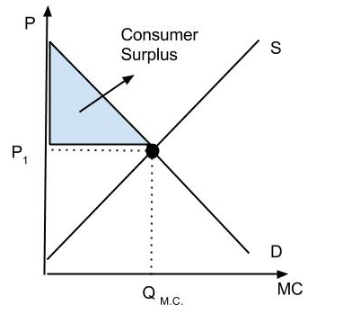
(6) Consumer Surplus
Consumer surplus is a measure of consumer satisfaction. It is the difference between what he/she was willing to pay for the product and what the consumer actually paid for the product.

Slide 20
(7) Other Impacts on D for M.C.
Other impacts on D for M.C.
Recall D_{MC} derived from D for health
Q. Why D health?
A. Possible Answers below:
Consumption - makes you feel better
Investment - health determines time available and time is valuable

Slide 21
→ What are the implications?
1. - First effect:↑in age →↑rate of depreciation of health → Result in↑D for M.C.
- Second effect:↑in age →↓return to health (since less time to enjoy health) → Result in↓D for M.C.
→ Empirical results suggest that the first effect dominates
2. ↑in wage →↑Demand for medical care → Result in↑D for M.C. because the value of healthy time is increased and the person will substitute less time intensive inputs (like M.C.) for more time intensive inputs (like home production)

Slide 22
3.↑in education→↓D for M.C.
Why? ( These hypotheses do not follow directly from theory)
- more educated more efficient in producing health in other ways → less time intensive for producing health
- information – have better information about preventative care ( the 2 are tied together)
Determinants of D for M.C.
Assumes both patient and Dr. have choices available →
Patient can choose substitutes for producing health
Dr. can choose substitutes for producing medical care
→ 2 factors that are important
- Knowledge
- Availability of substitutes at each stage

Slide 23
Patient D for treatment
3 general factors of importance here:
Incidence of illness
Cultural/demographics
Economic variables
→ 1 and 2 stems from the patient’s view of a medical problem & how efficient they view M.C. in treating the problem
→ 3 Once they’ve decided to enter the mkt → Economic variables matter like price, income, etc. According to the idea of utility max subject to income constraints

Slide 24
Now look at all 3
Incidence of illness & cultural demographic factors may be random for an individual but not for a population (probabilities change for individuals in the same way)
Age
Illnesses increase
Patterns change →acute care becomes more of a problem → expect more heart disease and less accidents

Slide 25
Sex
Differences especially at older ages due to child birth, obstetrics & gynecology ( note: not the same for all services)
Martial Status (# of individuals in family)
Single → ↑ D for M.C. – Why? Less alternatives
↑# → ↑Home care but also has ↓y per capita
Education
↑Efficiency in production
↑information→ ↑use of cheap preventative services – for example, educated, smoke-less, exercise more

Slide 26
Economic Factors
Income (Y)
Supposedly as Y↑→ Expenditure or M.C.↑ - But by how much? (M.C. is a normal good)
After correcting for the possible biases our estimates center around Y elasticity of D = 1 → a 10%↑in Y results in a 10%↑in M.C.
Prices
We know that P↑→ Q_{D}↓ - But by how much?

Slide 27
1st - Again price elasticity of D = η =?
= |(%ΔQ_{D})/(%ΔP) |
Remember elasticity is a measure of responsiveness or, in other words, it measures how responsive D is for a good to ΔP of that good
Q. How Responsive is Q_{D} to changes in prices?
If little → Subsidies of any kind will have little effect on the amount of care received by poor individuals. This is because the price expansion path is basically fixed or even at zero for certain low income individuals (refer to graph on next slide).
→ η determines how effective subsides are in↑Q_{D} for M.C. especially for low income individuals.

Slide 28
2nd – What is P of M.C.?
The full price of M.C. includes 3 things:
1. Monetary price
2. Value of time
Predictions
As $ price decreases → Demand for M.C. becomes more responsive to value of time → May result in rationing care by waiting (i.e., paying in more time, this is the system used in the UK)
If society determines that certain individuals should be subsidized → Should also subsidize by decreasing time involved – How?
All costs should be included in efficiency calculations
3. Expected accident losses – recall = Prob of accident * accident losses
This has to do with medical malpractice
*All 3 must all be taken into account to obtain accurate price!

Slide 29
(8)Doctor as the Agent
Does the Doctor always act in the patient’s interest?
Look at the argument closer and suppose we have the following situation to the extent that they are substitutes:
Physicians are reimbursed on a fee-for-service basis – that is they are paid a flat fee for each service provided.
Some areas, like surgery, have much higher fees than others, like office visits.
→ We can expect to see an efficient mix if physicians act solely as agents

Slide 30
However, suppose doctors preferences/income matters
→ We can expect to see more surgeries & fewer office visits
→ Doctors self- interest may cause him/her not to do what is best for the patient
This results in what is known as induced demand
Empirical Observation - ↑ # of physicians in an area→ ↑Q of medical service & ↑P of medical services
Q. Why?
A. Consider the following possibility:
Each physician has an optimal amount of time spent in working
→ w/ a small # of physicians → you give each patient what they really need, but ↑S → doctors hours may fall below optimal → Induces demand due to his role as an agent
*Note: There is also a problem with input mix aggregate

Slide 31
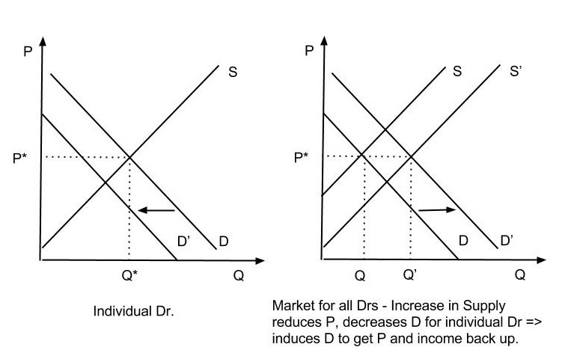

Slide 32
↑ in # of other drs →↓D for any particular dr (shown in the first panel of the previous graph) → if dr has a target income or hours level he/she has an incentive to increase his D by ordering extra procedures for each particular patient assuming patients have lack of info. ( i.e. costly for patients to fully determine) – shown in second panel.
Predictions if this is true:
↑ in D mostly on small rather than large items: Tests vs. Surgery – Why? This is because patients have a greater incentive to gain info on large items than small (benefits larger but costs are about the same)
Physicians locate where there is large D for treatment (for whatever reason – population, epidemic, etc)

Slide 33
(9) How does insurance affect D_{MC}?
Discussed concept earlier – Brief review
Impact =↓Price to consumers →↑ Q_{D}
Actual impact = Depends on type of insurance
Copayment – 2 Types
Coinsurance: Insurance pays a fixed % of the price
Let C = % Consumers pay
1 – C = % Insurance pays
What does D look like if C = Ø ?
What does D look like if C > Ø ?

Slide 34
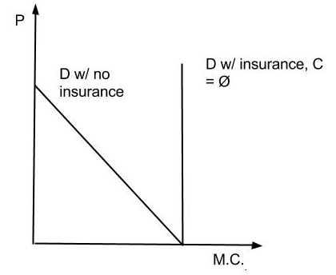
What does D look like if C = Ø ?

Slide 35
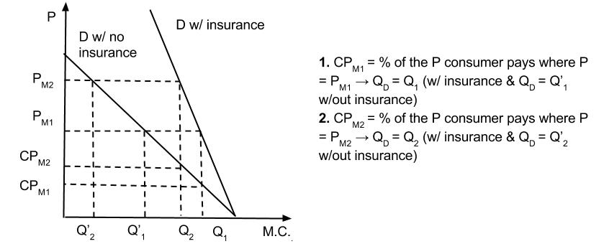
But what would D look like if C > Ø ?

Slide 36
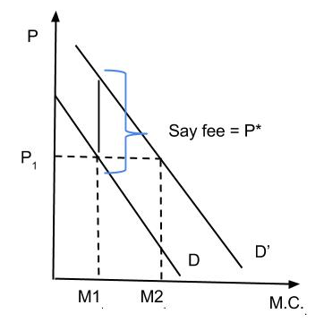
Indemnity insurance
→ patient pays a flat fee for each occurrence or use

Slide 37
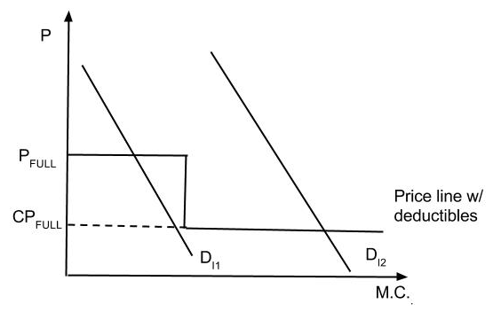
Deductibles
→ has a large impact on large illnesses not small ones
Problem: Deductibles accumulate over illnesses – P_{full} = price without insurance, once hit the deductible, price falls to C*P_{full}. Notice the different impact if small illness (D_{I1}) vs large (D_{I2}).

Slide 38
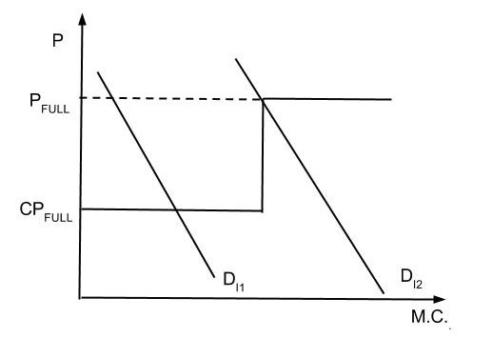
Maximum payment limits
→ uninsured with major events (note illegal under Affordable Care Act)

Slide 39
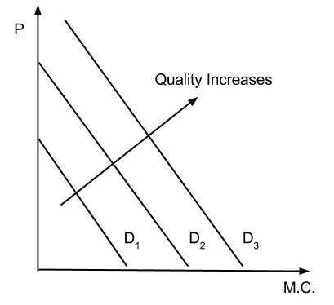
(10) Quality
As quality↑→ D↑(but at a↓ rate?)
Information problems
What is quality?

Slide 40
(11) Empirical - estimating elasticities
Problems with empirical estimates
Time costs → need to include or distorts results but are rarely included in studies.
Income → difficult to measure permanent income
Aggregation problems
Data/bases (statistical problems)

Slide 41
Results – all price elasticities are in absolute value
*Note: Little empirical work exists for cross elasticities
Variables | Elasticity Coefficient
Hospital | < 1 (price) - inelastic
Physician services | < 1 (price) – inelastic
Time = Price | ≤ 1 (price) - inelastic
Income (medical care) | = 1 (10 % ↑ in Y => 10 % ↑ in MC)
Nursing home | 2 (price) - elastic
Y (Nursing home) | > 2 – income elastic

Slide 42
Random HIS - “Lab” study where individuals where randomly assigned to 6 plans over time
Full coverage (C = Ø)
C = 0.25
C = 0.50
C = 0.50 for dental/mental & C = 0.25 for all other
Deductible $150/$450 for ambulatory care & C = Ø otherwise
C = 0.95 until a catastrophic cap had been reached which varied dependent upon income
Individuals paid no insurance premium
Enrolled for 3 to 5 years
Enrollees actually paid a lump sum to participate = Maximum possible amount of their losses
All had catastrophic coverage

Slide 43
Results?
Look at Table 5.1 on page 117
M.C. does respond to change in price as expected
But relatively inelastic
Also found → Look at tables on next page/pages
Hospital & out-patient care is complementary not substitutes
Initial effect of a deductible is large but marginal effect is small as it↑until it gets very large
Found income elasticity of D ≈ 0.20 or less
Found some (but very weak evidence) that enrollees with higher coverage chose ↑ quality

Slide 44
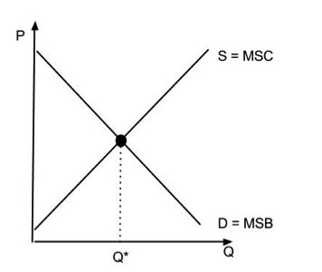
Now conclusions on allocative efficiency
Result→

Slide 45
But this ‘Result’ in M.C. does not happen often – Why?
Insurance ↓price of M.C. to consumers but not to society because they buy too much M.C.
Induced D and some evidence for this is that too much care is produced
Consumer misperception of risk – Expected accident losses should be included and may not be i.e. malpractice tried to do this
Variations in practice patterns → Inefficiencies possible (may get it right on average buy still inefficiencies)
Mitigating factors
Changing incentives for physicians
Consumer information may not be as big of a problem

Slide 46
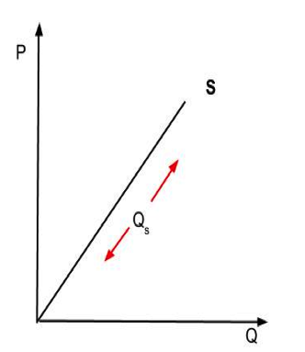
II. Supply for Medical Care
Deriving a supply curve
How do you do it for a firm? → S = MC
How do you do it for the industry? → S = Σ(MC)

Slide 47
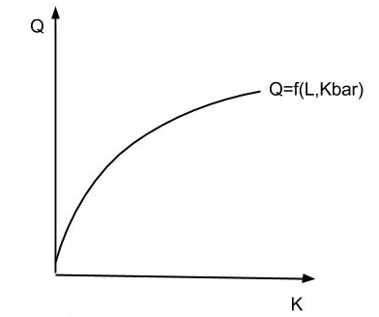
Isoquants/ Isocosts (see pg. 39 – 42 for review)
Recall one way to look at production function

Slide 48
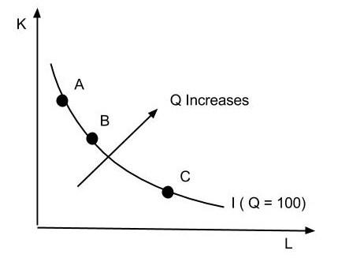
Another way is by developing isoquants (= “the same quantity”) That is rather than holding K constant as above we hold Q constant & look at different combinations of L & K to produce a constant Q. Points A, B, and C below all produce Q = 100.
Isoquants are similar (but note the same) to indifference curves.

Slide 49
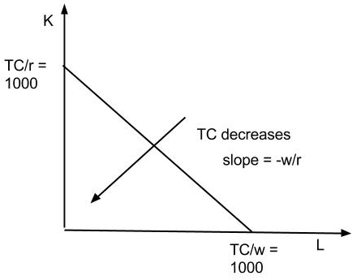
Isocosts are similar to the budget lines. An isocost line shows different combinations of L & K where TC is the same.
Total cost = wL + rK
w = wage rate or price of labor
r = interest rate or price of K
Example: Graph above shows with w = r = 1 and TC = 1000; as costs ↓ the isocost curves shift down as shown.

Slide 50
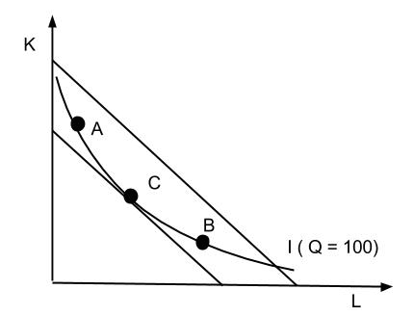
Put isocosts and isoquants together to find cost minimizing method of production given Q=100
Example: If at A or B → Produce Q = 100 but cost is higher than needed
Lowest cost is found at tangency because on lowest isocost at point C.
→ C is technologically efficient. A & B are not tech. efficient.

Slide 51
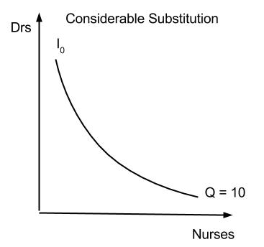
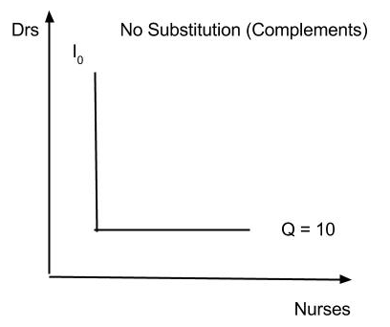
Why do we care? How does this help us analyze the supply side of the market? → In several ways.
Substitution between H.C. inputs
Recall that the slope of an isoquant tells us about how substitutes are the inputs – look at the 2 extreme example below:

Slide 52
How much substitution?
Drs and nurses are at least partial substitutes
Elasticity of substitution
Factor input ratio = (# of Drs)/(# of Nurses)
Factor price ratio = (Wages of Drs)/(Wages of Nurses)
→ Essentially factor price ratio changes factor input ratio if some substitutability exists
ES = (%Δ Factor input ratio)/(%Δ Factor input ratio)
if Ø = no substitution
if > 0 = substitutable
Look at Table 6.1 on pg. 109 – What does it mean?
→ All inputs are substitutable to some degree but some more than others ( e.g. nurses and residents)

Slide 53
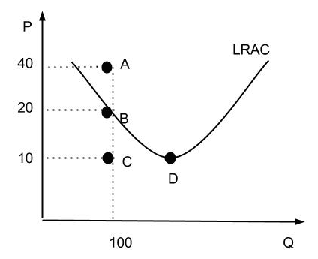
Cost Functions
Average cost = Total Cost/Q = ATC + AFC
Example: Suppose Q = 100 → 3 types of AC
Point C is below the cost curve and we can’t be there. Point A is possible but it is above the cost curve. Point B is the best choice because B has the minimum AC.

Slide 54
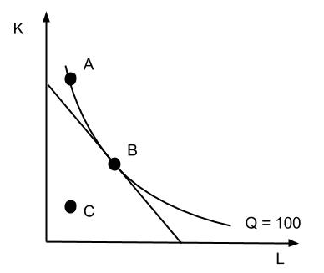
Relate isocost/isoquant graph here to LRAC above: Again must be on isoquant to produce Q = 100; can do that at points A or B but not at C (even though costs are lower here). At A, though, costs are higher => B is the lowest cost alternative in both graphs.

Slide 55
2 kinds of technological efficiency:
Firm technological efficiency are at point B
Industry technological efficiency – Are we taking advantage of economies of scale? Are we producing at economies of scope (point D) in LRAC graph?
Why might firms not want to minimize costs?
Reimbursement for inputs may not reflect true costs due to subsidies and/or monopoly power increasing price of inputs
Legal restrictions which limit substitution among inputs

Slide 56
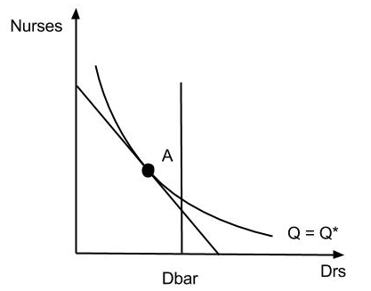
Example of 2: Suppose cost minimization is at Point A but legal rules require that Drs = Dbar
→ Costs must be higher – Why?

Slide 57
Why might firms not want to minimize costs? Continued…
Not all firms are Π – maximizers
Empirical examples:
Hospital cost studies – show slight economies of scale.
Look at Table 13.2 for doctor group studies - We can see ↓in solo/dual practice and an ↑in group practice → Again evidence of economies of scale

Slide 58
Going forward we will evaluate Secondary & Tertiary Markets (Hospitals, Drs, Health Insurance, etc.)
For each look at
Level of competition in the market – As competition grows, there is more of an incentive for firms to produce efficiently
To increase performance we can do 1 of 2 things
Make the market more competitive – can’t always due to economies of scale
Regulate market to overcome problems brought about by monopoly (Think about natural monopoly & economies of scale) *Note: Regulation may be the cause

Slide 59
Look at the theory - inefficiencies if intent is to decrease competition
Recall in a competitive industry:
Each firm produces at minimum cost or is driven from the industry
The # of firms in the industry is determined by demand and economies of scale → the market (mkt) results in enough firms each producing at the minimum cost to supply market D at the mkt price
The competitive market is also results in allocative efficiency assuming no externalities because it produces where MSC = MSB. Also firms respond to increase in D in short-run by changing output.

Slide 60
→ Evaluate all secondary and tertiary markets in light of the competitive ideal are:
Firms minimizing costs?
→ Firm technological efficiency
Firms taking advantage of economies of scale?
→ Industry technological efficiency
Responding to D to be allocatively efficient?
→ Allocative efficiency

