Slide 1
Lecture Notes – Overview of the Medical Care Market

Slide 2
Important (although not unique) Aspects of the Health Care Market:
Government Intervention
Examples of broad areas of government intervention include:
Licensure
Health Insurance
Legal Issues
Dumping
Loss of life/ Assisted suicide
Price Controls
Diagnostic Related Groups (DRGs)
Managed Care
CON laws for hospitals + Expensive equipment
Educational support
Research &Development (R&D)
Drug regulation
Affordable Care Act

Slide 3
Uncertainty
How do people make decisions under uncertainty?
Patients face uncertainty with reference to illness and treatment plus its efficacy
Physicians face uncertainty about treatment and medical malpractice
Asymmetric Information
One party has more or better information than the other and can lead to adverse selection, moral hazard and market failure.
For example, a used car salesman selling a lemon to an uninformed buyer or a collector buying an invaluable painting at a used thrift store.

Slide 4
Information only the patient has:
Symptoms
His/her own efforts to treat the issue
Information only the physician has:
Treatment of diseases
His/her own efforts to treat the issue
Shirking may be a problem
What incentives exist for both physician and patient?

Slide 5
Why are we concerned about information & asymmetry?
Moral Hazard - the lemon principle causes high quality cars not to be sold- relies on information asymmetry where knowledge about quality of the car is only known by seller. The buyer knows only average quality → buyer is only willing to pay for average quality not high quality → causing high quality cars not to be sold.
Adverse selection in health insurance (more later)
Agency = with incomplete information it is common for consumers (patients) to have an agent to make decisions.

Slide 6
Consumer information and prices
Reputation goods - rely on information provided by acquaintances. If the number of providers increase it becomes more difficult to get information and as a result price increases.
Informed buyers
Some patients may be informed or uninformed buyers, if doctor can’t tell which it makes the market work more efficiently.
Quality
Doctors have varying specialties, years of experience, and certification, etc. if a patient is uninformed cost increases.

Slide 7
Incentives by physician and patient
Mitigating Factors
Reputation
Repeat dealings ( i.e. long-term relationships)
Medical malpractice
Second opinions
Self-help books
Second opinion “shops”

Slide 8
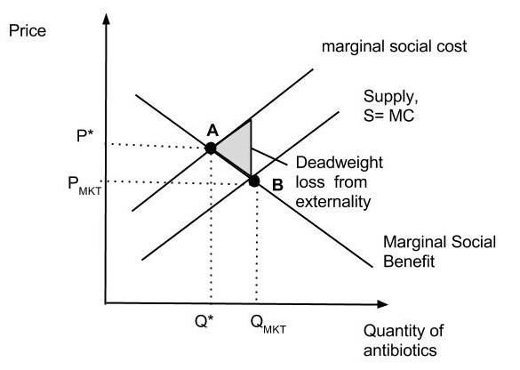
Externalities
Example: Increased resistance to antibiotics – my use of antibiotics increases the probability that they will not work for you.
Thus, the actual marginal social cost (MSC) is higher than the private MC.
The market is at point B but it is efficient for the market to be at point A, with a higher price and lower Q.
The shaded area represents the deadweight loss from this market failure. Why?
A negative externality is a cost imposed on a third party.

Slide 9
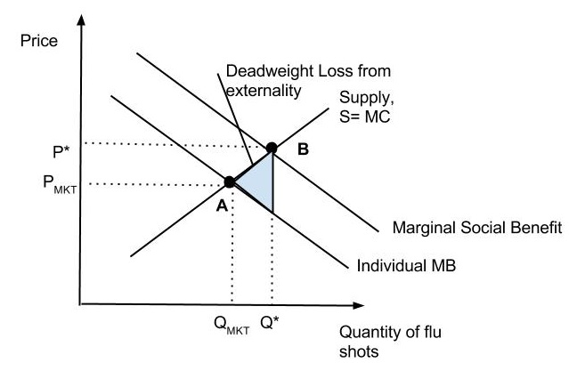
A positive externality is a benefit imposed on a third party.
Vaccinations like flu shots benefit third parties because they reduce the threat of infection.
Notice that the MSB is higher than the private benefit.
The market is at point A but it is efficient for the market to be at point B, with a higher price and Q.
The shaded area represents the deadweight loss from this market failure. Why?

Slide 10
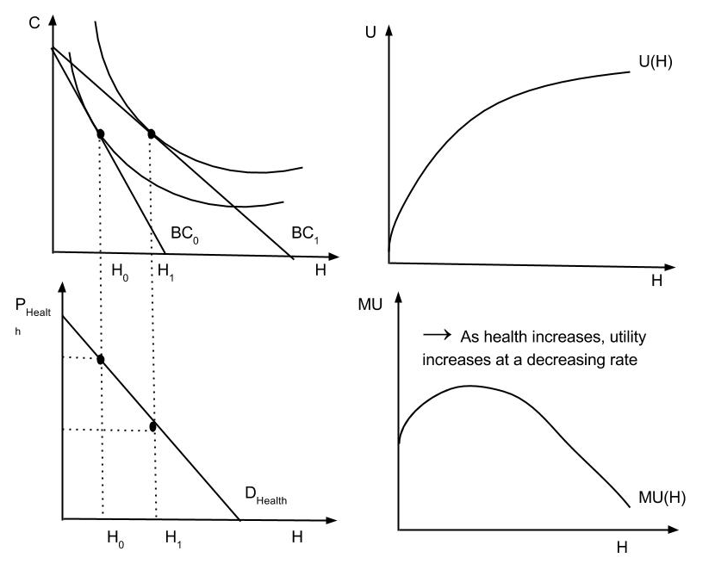
Modeling Health & Health Care
Demand for health → Demand for health because it give us utility ( i.e. happiness)

Slide 11
How Do We Produce Health?
Assume a production function with health as the output:
H= f( M.C., EDUC, …)
*But this is only for a specific person with a specific illness
Assume medical care (M.C.) as the output of a production function with the components of medical care( doctor visits, hospital services, etc) are all used as inputs to produce medical care:
M.C. = f(DS, HS, etc)
This one is more appealing in some sense because:
Doctor is an agent
Derived demand from medical care.

Slide 12
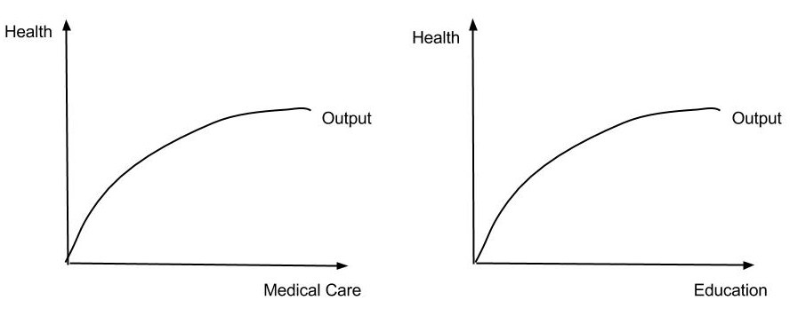
The Production of Health
Now use the same theory to look at a health production function:
Health=H=f(M.C., + other demographics)

Slide 13
In the function we may want to ↓ M.C. and increase funding for education (& not just health)
How can we tell?
Microeconomic theory shows how to make the decisions based upon marginal product (MP) and marginal cost (MC).
Suppose we have a given amount to spend on health care in the U.S… look at the production function again.

Slide 14
First look back at the production function and the derive MP of both inputs
Now look back at the costs and assume cost of M.C. = w₁ and cost of EDUC = w₂ →
Next assume price of output = 1 to allocate resources so MP_{MC} = w₁ and MP_{EDUC} = w₂
If w₂ decreases or w₁ increases → use more education
If w₂ increases or w₁ decreases → use more medical care

Slide 15
Long - Run Production
To minimize costs we must produce so that
MP1/w1 = MP2/w2 = MP3/ w3 = …
where 1, 2, 3, … are inputs
MP falls as usage increases
Look at 2 inputs in production of health say EDUC & M.C.
MP_{E}/ w_{E} = MP_{MC}/w_{MC} for technological efficiency.
If w_{E} decreases or w_{MC} increases → use more EDUC and less MC (and the reverse)
If MP_{E} increases or MP_{MC} decreases → use more EDUC and less MC (and the reverse)

Slide 16
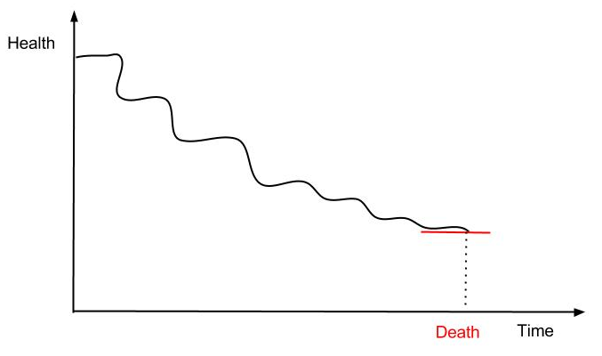
Two important issues:
How do we efficiently produce M.C.?
How do we efficiently produce health?
→ Use micro analysis to answer both issues!
Health life cycle
Use idea that ‘stock’ of health depreciates over time

Slide 17
Life style and health
If we take a look at the production function we can see that there are both positive inputs and negative inputs→
H= f( M.C., X_{B}, X_{G} )
(+) (-) (+)
Average productivity vs. marginal productivity of M.C. :
Average productivity (AP) - the quantity of product used per unit of output or quantity of m.c. used per unit of health
Marginal productivity (MP) - the additional output a firm can produce by using an additional unit of an output (holding use of other input constant) → MP (which we often see) may be quite low or even while AP may still be quite high

Slide 18
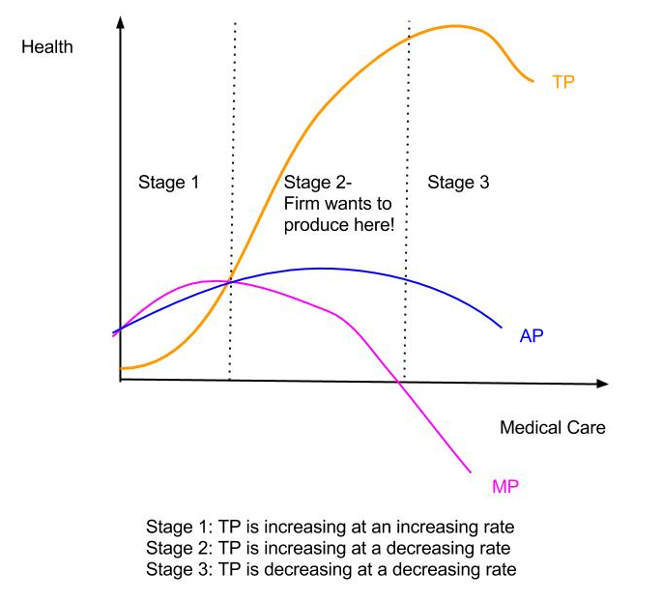
The graph below helps illustrate total productivity with marginal productivity and average productivity:

Slide 19
Intensive vs. extensive changes in productivity of M.C.
2 ways to apply high levels of M.C.
Intensively → increase use of M.C. for one individual patient or group of patients ( i.e. types of treatment)
Extensively → increase use of M.C. by increasing extent of treatment
Choice may effect the productivity of M.C.
Education
Increase EDUC → Increase Health
Self-selection – people who are healthy are more likely to be educated
Demand- Increased education then to be more efficient producers of health (i.e. better technology)
Empirical evidence tends to support 2nd theory although not always

Slide 20
Now look at empirical examples of health production functions:
Auster et al. findings measure health by death rate
Expenditures on medical care increases health by 1 % ( or decrease death rate by 1%)
Elasticity w.r.t. education = - 0.20 ( twice as large)
Cigarette consumption
The table below illustrates that education and income have a bigger impact on health than medical care:
Elasticity coefficient
Medical Care | -0.1
Education | -0.2
Cigarette | +0.1
Income | +0.2

Slide 21
Other results
Impact on Age Adjusted Death Rates
PI | +
Education | -
HMO Effect | No significant impact
Cigarette Consumption | +
Alcohol | -
% Non-white | No significant impact
Medical Care | + and highly significant
Notes:
The problem with these results is that medical care

Slide 22
My results continued…
Impact on Medical Care (PHCE or HOSEXP)
Demographics
PI | +
Education | -
HMOs | Increasing M.C. in short-run (at decreasing rate) but Decreasing M.C. in long-run
Inputs MDs/POP | -
% MDs General Practice | -
Hospital Occupancy Rate | + (Hospexp)/ - (PHCE)
Support Personnel/ Capita | + and quite large

Slide 23
Measurement problems in health care
Unlike other types of production, it is often difficult to measure items in health care markets. We will discuss three main types of problems. How do we measure:
Health
Medical care output
Prices of Medical Care

Slide 24
Measuring Health
Recall our health production function:
Health = f(MC, Educ, Income, etc.)
Need to know how to measure health to estimate production functions and determine efficiency.
What are the alternatives?
Death Rate
Usually use Age Adjusted Death Rates = death rates that would occur if every jurisdiction had the same age distribution.
Advantages = objective, easy to measure/obtain
Disadvantages = does not entirely measure the concept of “health”, i.e., it’s a dichotomous measure with bad health = death; good health = alive; we actually think health is more than just this.

Slide 25
Survey data – e.g, simply survey individuals and ask them about their health – a common way to do this is ask a survey question like “In the past month, how many days have you missed from work due to illness?” or “On a scale of 1 to 5, with 1 being the worst and 5 being the best, rate your average health in the past month”.
Advantages = more precise measure of health than death rates.
Disadvantages = subjective, open to interpretation (and lies/misinterpretation – this is a common problem with survey data.)

Slide 26
Morbidity Data = incidence of illnesses/disease. Notice that this requires that the different illnesses/diseases be aggregated to get an overall measure, which requires researches to weight (i.e., decide importance) of each illness/disease. This is called a weighted average.
Advantages = more precise, seemingly objective (i.e., the incidences of each illness/disease is objective).
Disadvantages = actually subjective because the importance of each illness/disease (the weights) are decided subjectively.
This gives you an idea of the problems. Other possibilities exist, all with advantages and disadvantages. There is not an easy answer.

Slide 27
How to measure Medical Care
Recall that our medical care production function is given by: MC = f (hospital care, physician services, HMOs, etc.)
Again there are many possibilities of measuring MC including:
Medical Care Expenditures = $ spent on Medical Care Services; may be adjusted for price changes
Advantages = objective, relatively easy to measure

Slide 28
Disadvantages are many
actually measures $ spent on the inputs in the production function above. If one measures the output by the inputs used then one cannot test whether the inputs are used efficiently (major problem).
Expenditures vary as both Q of the good consumed changes and as P of the good changes. We only want Q so must deflate (i.e., subtract the influence of prices – how to do this will be discussed below.)
Health Outcomes – a common method is to measure the outcome of treatment; does the patient get better from illness/disease – notice this is measuring patient’s health.
Advantages – not measuring inputs anymore, also more precise measure.
Disadvantages – other factors affect health besides MC => may have good or bad health outcomes for other reasons. Recall that health is not easily measured and, more importantly, we can’t measure the impact of MC on Health if MC = Health.

Slide 29
Measuring MC Prices
Recall we are interested in prices partially so we can deflate measures like MC expenditures. Interesting public policy issues include:
What percent of the increase in MC expenditures is due to increasing prices of MC services?
Are prices for MC services increasing at a slower or faster rate than prices in general?
How do we measure prices? Luckily this is a relatively straightforward issue that has a standard answer:

Slide 30
What is a price index? A measure of changes in average prices for a given basket of commodities. How is the index constructed? 4 steps include
Choose a bundle of goods whose prices are of interest. The CPI (Consumer Price Index) chooses goods that consumers buy the PPI (Producer Price Index) chooses goods that producers buy.
Determine how much of each good will be bought. These weights do not change over time, while prices do change.
Calculate how much it would cost to purchase the same bundle (a given quantity of each good) in each year at that year’s prices.
Choose a base year and divide each year’s cost (from 3) by the base year’s cost multiplied by 100. Notice that this means that the base year’s price index is = 100 (often the base year is identified by saying “2014 = 100”). Index numbers > 100 mean that prices have risen on average while index numbers < 100 mean that prices have fallen on average.

Slide 31
How are price indices used?
Measuring inflation rates = the percentage change in average prices.
Suppose we want to measure the inflation rate between 1984 and 2013 using the CPI
Look up the CPI on the BLS web site:
http://www.bls.gov/cpi/#data (Note you must make some choices here – pick CPI-U, top picks, next screen choose U.S. city average)
1984 CPI = 103.9; 2013 CPI = 232.957
The inflation rate = ((CPI₁₃ – CPI₈₄)/CPI₈₄)*100 = (129.057/103.9)*100 = 124.2
Prices on average have risen by 124.2% since 1984.
Notice that Medical Care Prices (same BLS web site only now use the Medical Care price index) have gone from 106.8 to 425.134 over the same time period, or an increase of 298% since 1984.

Slide 32
Deflating = Subtracting the influence of prices.
A nominal variable is one measured in the actual dollars of the time period.
A real variable is deflated, i.e., subtracting the influence of prices.
Real V_{t} = (Nominal V_{t})/((Price index_{t})/100)
For example, nominal MC expenditures in 2001 = 1,264,099,000,000 ($1.26 trillion). The CPI-U in 2001 = 177.1
Hence, Real MC expenditures = $1,264,099,000,000/1.771 = $713,776,962,168 = $714 billion.

Slide 33
Overview of the Medical Care Industry
The medical care market is a complex market to discuss. Why?
Medical care depends upon the market for health
The market for medical care creates demand for medical inputs which in turn creates demand for education
Health insurance impacts the demand for health
In fact, when we examine the medical care industry we will see several inter-related markets.

Slide 34
What affects the demand for medical care?
Illness events
As group size increases → less impact
Systematic factors
Age
Sex
Etc.
Beliefs
Efficacy of regular medicine
Efficacy of alternatives
Doctor as agent
Income
Education
Full price of medical care
$ Price
Value of time
Expected accident cost = P * A, where P = probability of accident and A = $ losses

Slide 35
What affects the supply for medical care?
Input costs
Production function
Doctor as agent ( i.e. doctor makes decisions but the doctor is not the one supplying output) → Incentive problems may exist
Laws/Regulations
Licensing
CON – Certificate of Need Regulation
Organizational structure affects S
Not-for-profit vs. For- profit institutions
Prices
Why not one price?
Quality
Asymmetric info

Slide 36
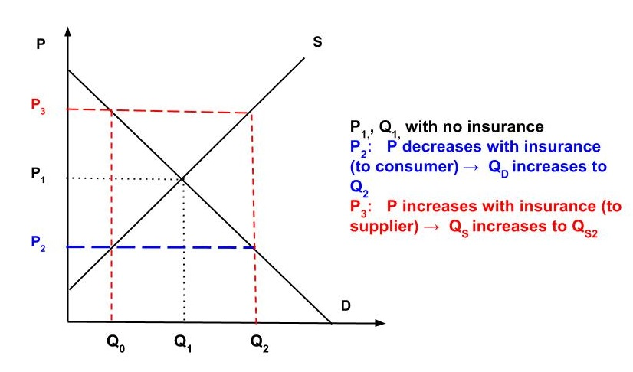
How does the health insurance market affect the medical care market? → By on its impact on prices
Notice that insurance pays the difference between P₃ (providers price) and P₂(consumer’s price). After insurance Q_{d} = Q_{s} = Q₂.

Slide 37
What affects the D for health insurance?
Risk or decisions made under uncertainty
Price of insurance to consumers
Price of insurance =
Premium – Expected Benefits > 0
This price is often referred to as loading
Loading > 0 so insurance firm can pay for costs of running business.
Tax laws
Health insurance is tax free → What is the impact?

Slide 38
What affects the S for health insurance?
Input costs
Loading fees arise since production of insurance is costly.
Premium = (1 + LF) * EB
where LF = Loading Fee
EB = Expected Benefits to be paid out
→ The health insurance market affects D for medical care, but what about other markets?

Slide 39
Demand and Supply framework for the medical care market includes:
D & S for health
D & S for medical care
D & S for institutional care (i.e. hospital, physician services, output patient care, nursing home, home care, etc)
D & S for inputs ( i.e. nurses, physicians, technicians, capital, etc)
D & S for education

Slide 40
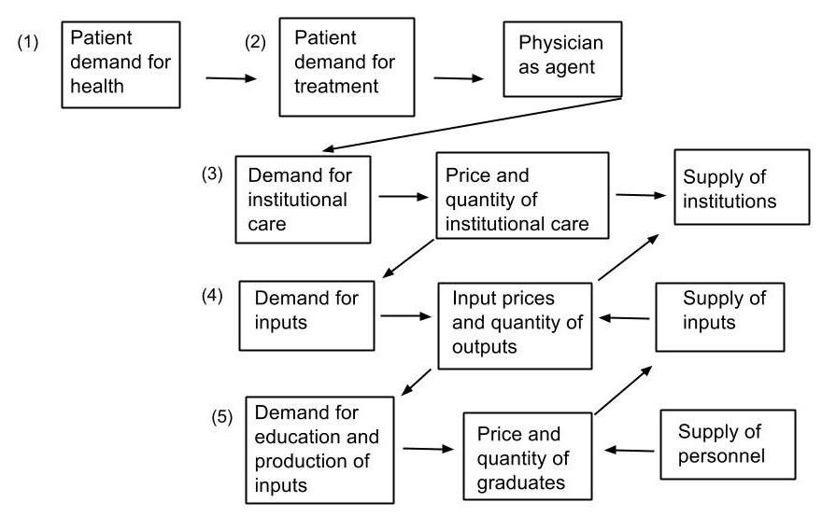
Look at the D & S framework another way:

Slide 41
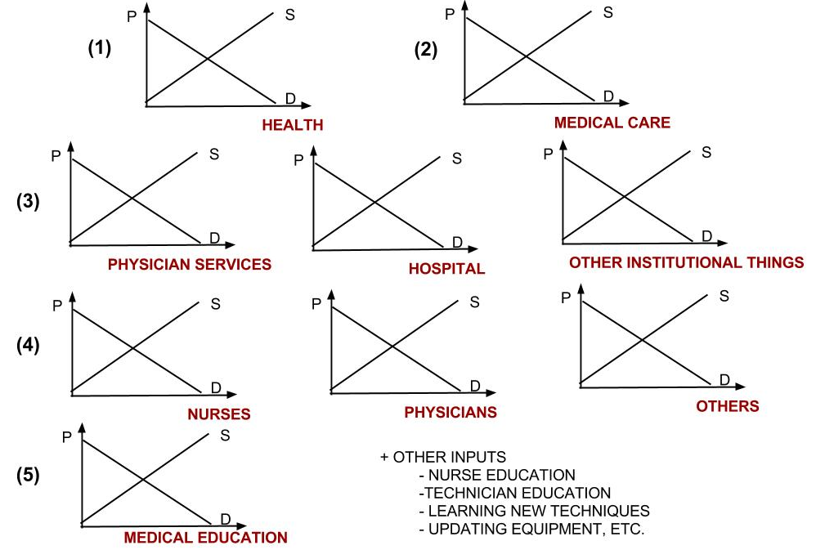
Or another way:

Slide 42
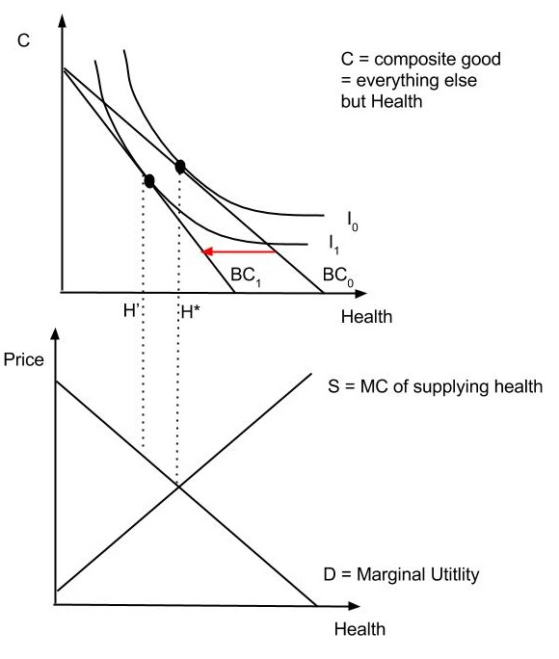
How does the transmittal between markets occur?
Assume we have a health production function:
H = f(M.C., + other inputs)
→ It defines the costs of producing health (specifically M.C.)
→ Demand for health is derived from utility analysis (see graph on left)
The interaction of D and S set the P and Q of Health.

Slide 43
But what is the D for medical care derived from?
From the demand for health → consumers willing to buy more M.C. to be healthier
Likewise the D for institutional services is derived from increases in need for M.C., and so on down the structure.

Slide 44
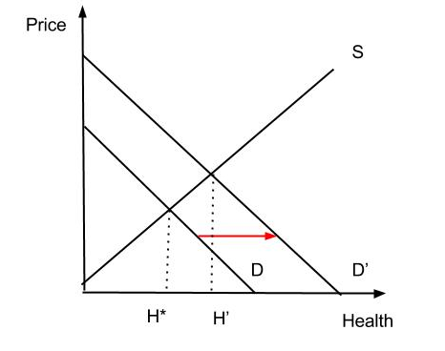
Example: Suppose an increase in the D for health
→ H* increases
Just as demand for health increases → So does demand for medical care
That is, to get an increase in health must increase inputs – including M.C. and other inputs

Slide 45
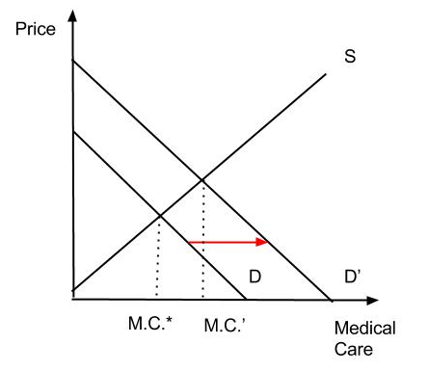
→ The increase in D for M.C. is derived from graph above, but M.C. = f (MDs, RNs, TECHs, HOSP, etc):
Use more of these inputs throughout the market
An increase in D for health ripples though all of the other markets as well → It is continues through all of the other markets.

Slide 46
Thus, increased D for Health increases D for MC, increasing P and Q of MC.
But increased D for MC increases D for institutional Care (e.g., hospital services and physician services), increasing P and Q of Institutional Services.
But increased D for Institutional Services increases D for labor inputs to produce those services (e.g., Physicians and Nurses), increasing wages (price) and Q of labor.
But increased D for Labor increases D for the education of that labor, increasing P and Q of education of labor.

Slide 47
At each level, how much D & S exists for the particular good or input (health, M.C., institutional inputs, manpower, education, etc.)?
It depends upon several factors:
Prices of other inputs
Legal restrictions on the use of the inputs
Whether the inputs are substitutes or complements
Price of the input
etc…

Slide 48
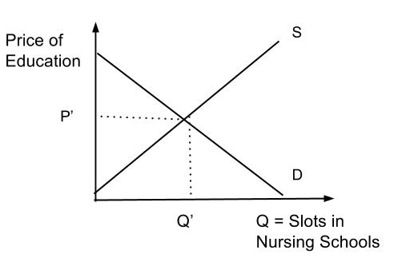
Second Example: Suppose the educational market for nurses is subsidized by the government?
Before subsidy exists →
How does this market operate if the subsidy exists?
Who demands nurse education? → potential nurses
Who supplies nurse education? → nursing schools

Slide 49
What do potential nurses look at?
Usage in the market for nurses
Price of nursing education
Usage in their next best alternative
Price of their next best alternative
→ Decide based on the expected return
= Present Value of Income Stream - Price
So more potential nurses will become nurse if
Usage for nurses increase → D for nurses increase
P of nurse education decreases → Quantity of nurses increase
Usage for alternative increase → D for nurses decrease
P of alternative decrease → Quantity of nurses decease
→ and vice versa

Slide 50
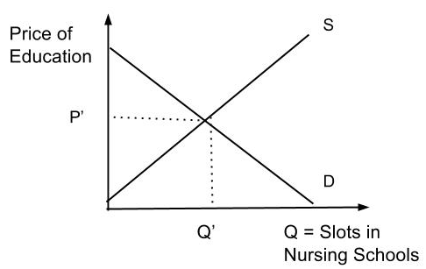
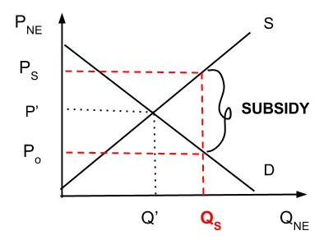
What impact the subsidy have on nurse D, S, and the other markets?
Before subsidy → P_{D} = P_{S} After subsidy → P_{D} = P_{S} – S,
where S = $ amount of subsidy

Slide 51
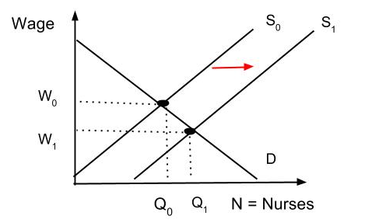
The subsidy impacts D & S of nurses ( although with some lag)
→ The subsidy in turn forces down the wage of nurses

Slide 52
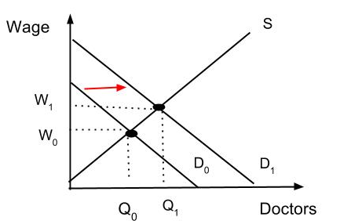
What happens to physician market?
It depends upon whether they are complements or substitutes - Legally, doctors and nurses are complements and for the most part they are
- Although there is likely to be very small change →
Doctors D increases → Wage increases

Slide 53
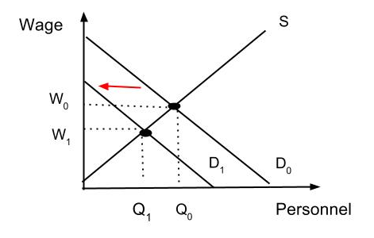
What happens to the manpower market?
Other healthcare personnel are likely to substitutes
So there is likely to be very small change →
Personnel's D decreases → Wage decreases

Slide 54
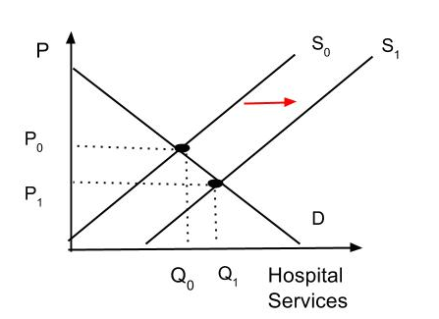
The net effect is to decrease cost of inputs for institutional service, especially the kind that is nurse intensive already → increase S of institutional services, as shown below, decreasing P and increasing Q.

Slide 55
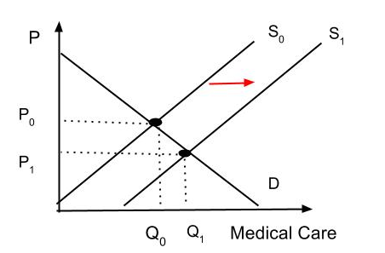
The same might happen in other markets → price of inputs into producing medial care will decrease, increasing S, and decreasing P and increasing Q of MC.

Slide 56
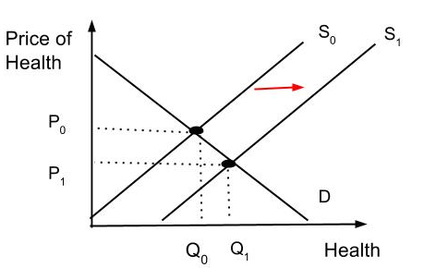
Therefore, the supply of health will increase because it is less costly to supply health now
So the nation becomes healthier!

Slide 57
Important: The size of the impact depends upon several factors →
The size of the subsidy
The elasticities in each market:
Supply elasticities
Demand elasticities
Cross elasticities

Slide 58
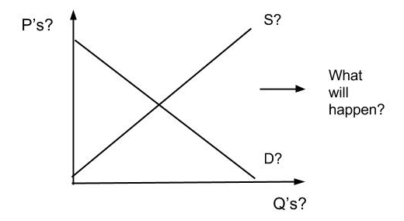
Now try to do the same thing with a D policy where we will have →
Increase in health insurance
Changes in tastes & preferences

