Slide 1
EARTHQUAKES AND EARTH’S INTERIOR

Slide 2
EARTHQUAKES
Definition, causes, and morphology of earthquakes
  Definition
    vibration of Earth’s surface usually caused by energy released from rocks rupturing under stress or by friction between moving rock materials at or below the Earth’s surface
    Seismology is the study of Earthquakes

Slide 3
EARTHQUAKES
  Causes of earthquakes
    rockslides, slumping or “caving in” of Earth’s surface or landslides(on land and in oceans) and nuclear explosions
    friction (grinding, bumping) between moving rock materials associated with volcanism
    fracturing and rock movement along faults or plate boundaries caused by Elastic Rebound=main destruction

Slide 4
EARTHQUAKES
  Morphology of earthquake and related terms
    Focus or hypocenter
      exact place of origin of earthquake disturbance and with few exceptions is located below surface of the Earth
    epicenter
      is the position on the surface of the Earth directly above the focus

Slide 5
Earthquake Focus and Epicenter

Slide 6
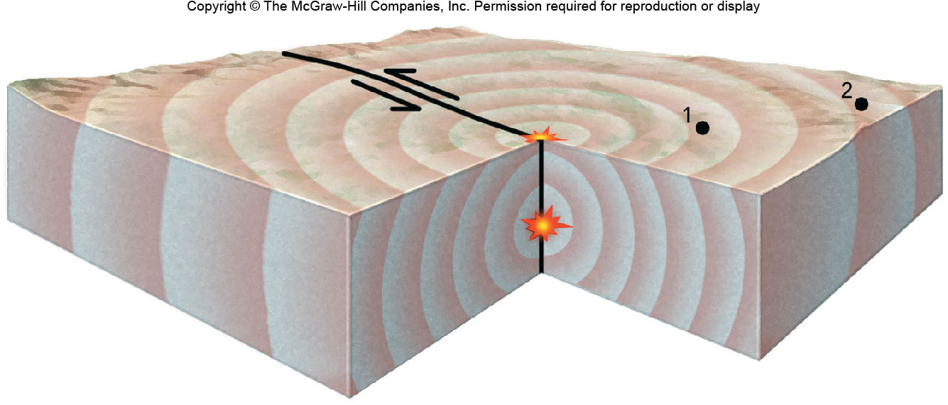
EARTHQUAKES
epicenter
Hypocenter or focus

Slide 7
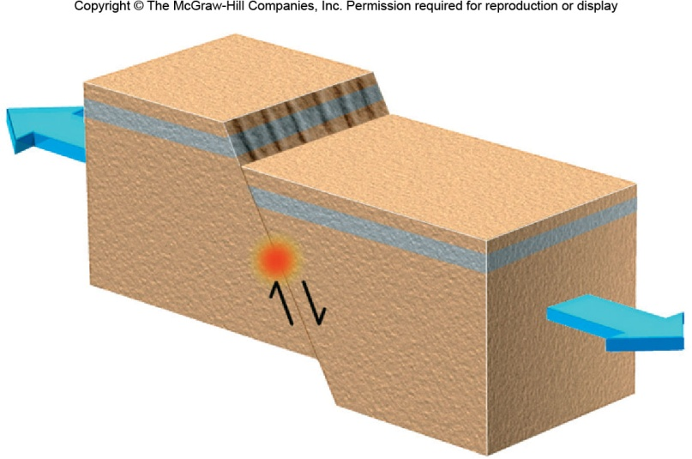
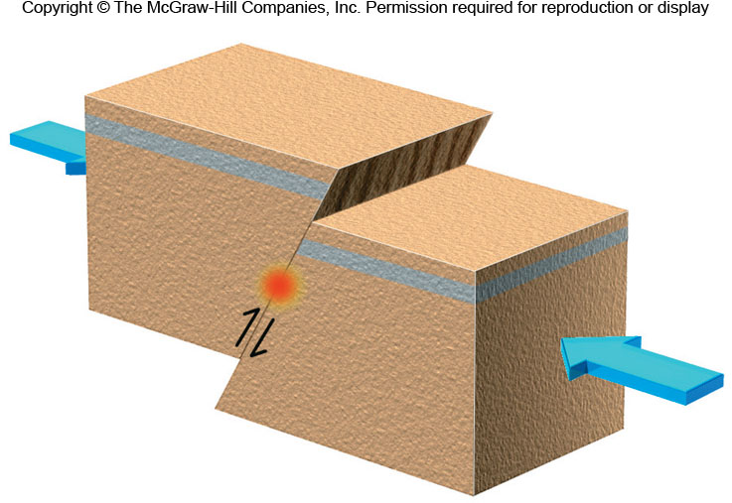
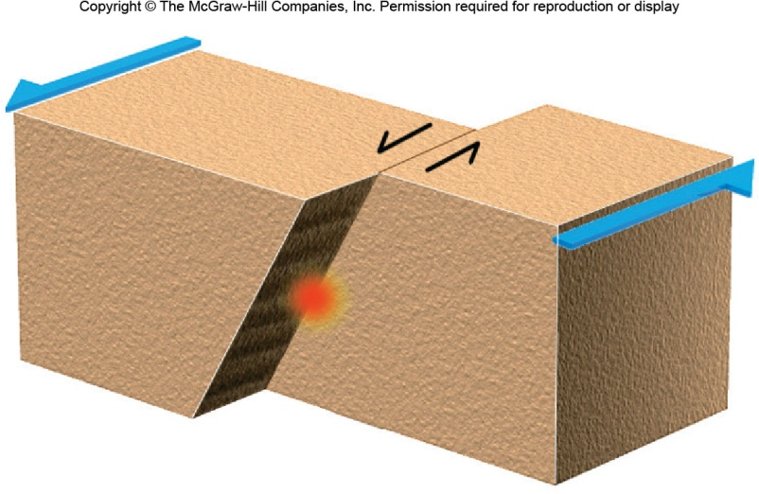
EARTHQUAKES
Elastic Rebound Associated with Faults and Plate Boundaries
Hypocenter or focus

Slide 8
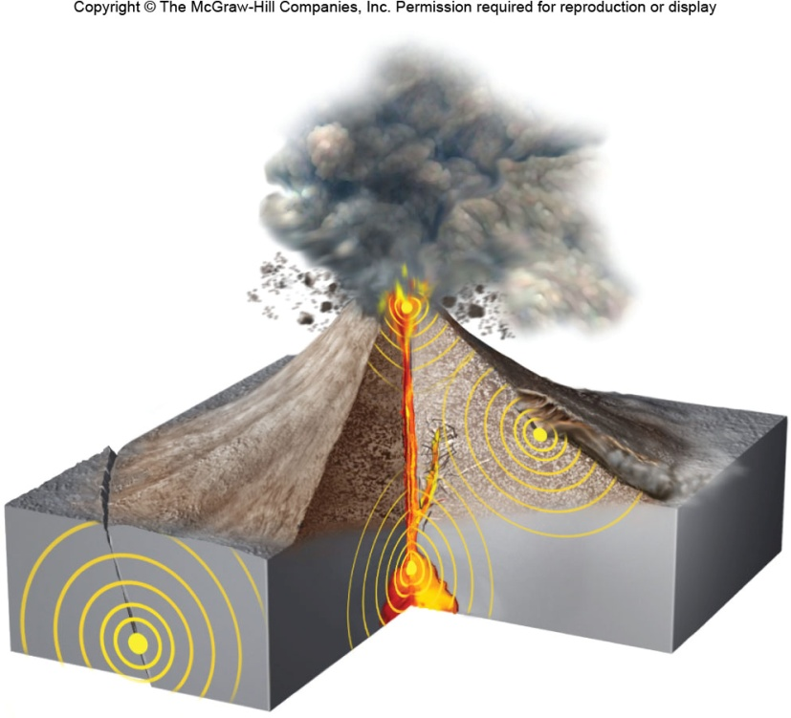
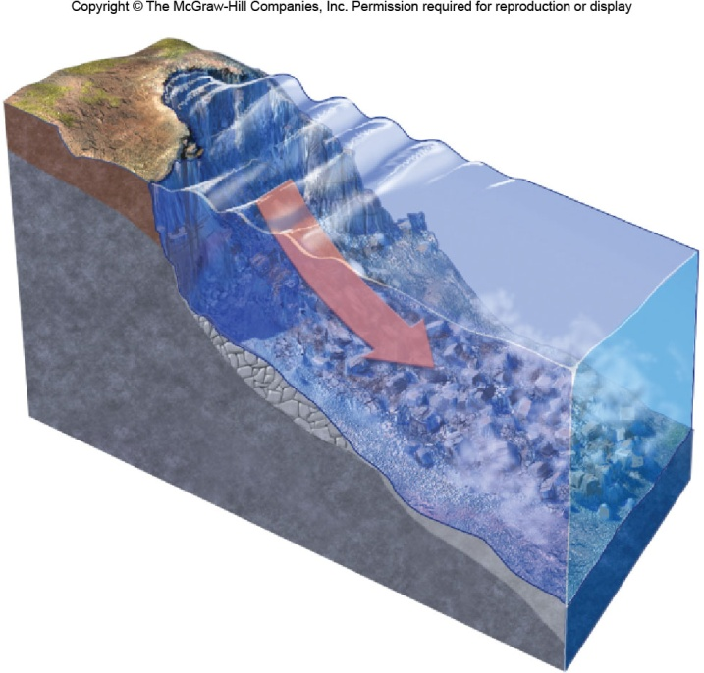
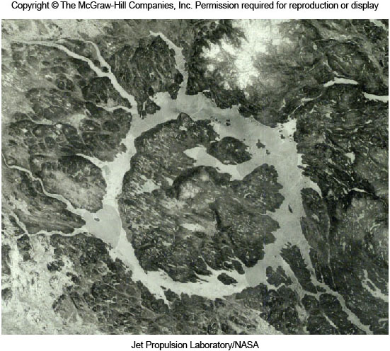
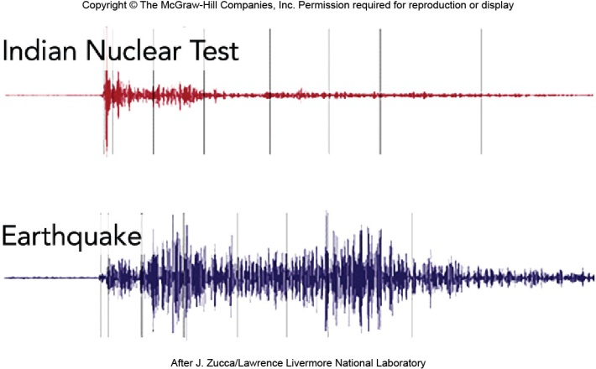
EARTHQUAKES
Other Causes
Volcanic Activity
Land—Ocean Slides
Mine and nuclear explosions
Meteor Impacts

Slide 9
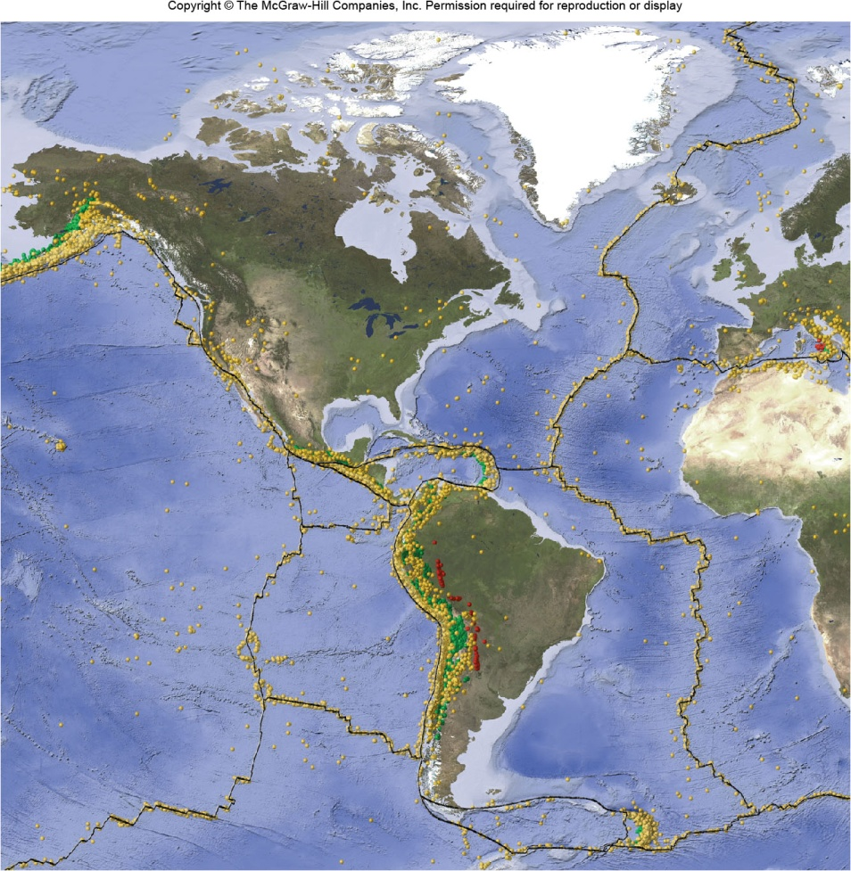
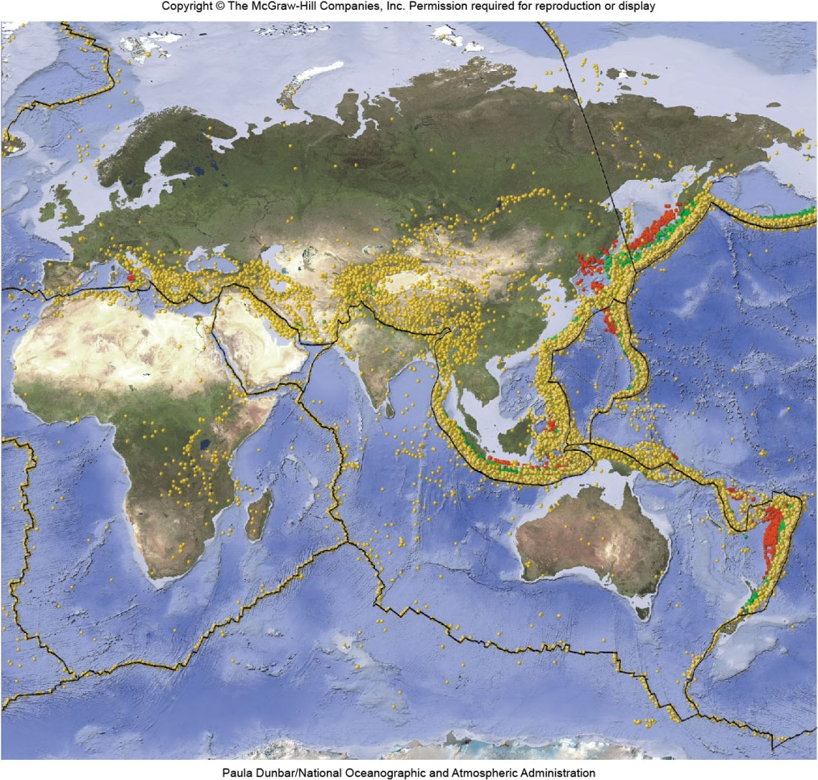
EARTHQUAKES
Caused by Global Plate Boundary Activities

Slide 10
EARTHQUAKES
    foreshock
      an earthquake generated at or very near the focus of the main earthquake disturbance (main shock) and prior to main shock
      foreshock(s) is (are) smaller in magnitude than main shock, may be of substantial magnitude and can preceed main shock by a short or substantial time interval

Slide 11
EARTHQUAKES
Earthquake waves
  types of waves
    body waves--travel below Earth’s surface
      P (primary) wave--compresses and expands rocks as it moves essentially in a straight line
      S (secondary) wave--vibrate rocks and moves in a looping motion along it’s path of movement

Slide 12
P and S Wave Paths in the Rocks

Slide 13
EARTHQUAKES
    surface (L, Love, Long) waves--move along surface of Earth
  Arrival of earthquake waves at seimic stations
    seismograph
      instrument which detects and records earthquake waves
    seismogram
      the paper on the seismograph with earthquake wave recordings

Slide 14
A Simple Seismometer--Seismograph

Slide 15
Seismogram

Slide 16
EARTHQUAKES
Locating the epicenter
  travel time (travel distance) graph
    a graph which plots distance from epicenter to seimic station
    distance of an earthquake epicenter can then be determined using lag time between arrival times of P and S waves

Slide 17
Travel Time Graph Plot

Slide 18
EARTHQUAKES
  three point or three arc method
    a plot showing the distance of the epicenter from three seismic stations by intersecting arcs can determine the earthquake epicenter accurately
    the closer the three seismic stations to the epicenter, the more accurate the location

Slide 19
Location of Earthquake Epicenter

Slide 20
EARTHQUAKES
Seismic intensity and magnitude
  Definitions
    earthquake intensity is a measure of the effects or physical destruction caused by an earthquake disturbance at a particular surface location
    earthquake magnitude is a measure of the strength of or energy released by an earthquake disturbance

Slide 21
EARTHQUAKES
  Factors influencing the intensity of an earthquake at a surface location
    total energy released at focus
    distance of focus
    type of rock support in an area
      solid bedrock will inhibit large damage
      thick soils will settle and damage results will be greater-liquefaction
    building construction and popul. density

Slide 22
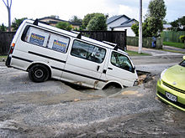
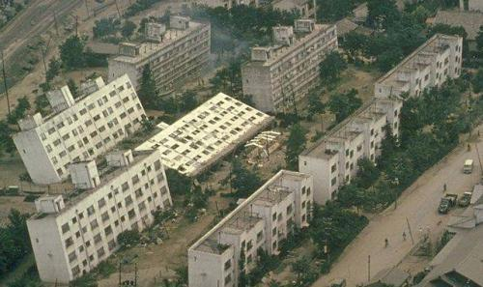
EARTHQUAKES
2 Examples of the Results of Liquefaction of Soil or Weakly Lithified Rocks by Surface Seismic Waves

Slide 23
EARTHQUAKES
  Mercalli intensity scale
    is a listing of earthquake intensities sucessively numbered from I to XII

Slide 24
Mercalli
Scale

Slide 25
EARTHQUAKES
  Earthquake magnitude
    Richter Number or “Local” Magnitude (MI)
      obtained by plotting lag time of P and S waves and wave height or amplitude of wave at a seismic station
      because amplitude is a function of distance the same Richter number will be obtained at any seismic station on Earth for an earthquake

Slide 26
Richter Number Chart

Slide 27
EARTHQUAKES
    magnitudes of energy
      each increase (or decrease) in Richter number by one equates to a multiple of 32 times more (or less) energy released
      a magnitude of 8 is 32X32X32 (32,700) times the energy released by an earthquake with a 5 magnitude
      the energy released by the first atomic bombs were equivalent to a 5 Richter number

Slide 28
EARTHQUAKES
Earthquake categories
  based on depth of focus
  shallow type
    focus is 0-42 miles deep--comprises about 85% of total global energy released by earthquakes
  intermediate type
    focus is 42-210 miles deep--comprises about 12% of total global energy released by earthquakes

Slide 29
EARTHQUAKES
  Deep type
    focus is greater than 210 miles--comprises about 3% of total global energy released by earthquakes--deepest recorded earthquake focus is 420 miles
    Geographic distribution of earthquake epicenters
  there are nearly 1 million earthquakes per year with those of major magnitude less frequent

Slide 30
Average Yearly Abundance
of Earthquake Magnitudes

Slide 32
EARTHQUAKES
  Circum-Pacific region
    is a region with many plate boundaries especially convergent types
    about 80% of global earthquake energy is generated each year
    California-Nevada area averages about 5000 earthquakes per year which equals 90% of total earthquake energy of US per year

Slide 33
EARTHQUAKES
  Mediterranean region
    large concentrated area of plates and about 15% of global seimic energy is generated each year
  Ocean ridge areas and intracontinental areas
    most famous intracontinental earthquake is the New Madrid Missouri events of 1811-1812--prediction of a “big one”--60% within 15 years or 95% chance within next 50 years

Slide 34
Global Earthquake Distribution

Slide 35
Earthquake Risk Map of USA

Slide 36
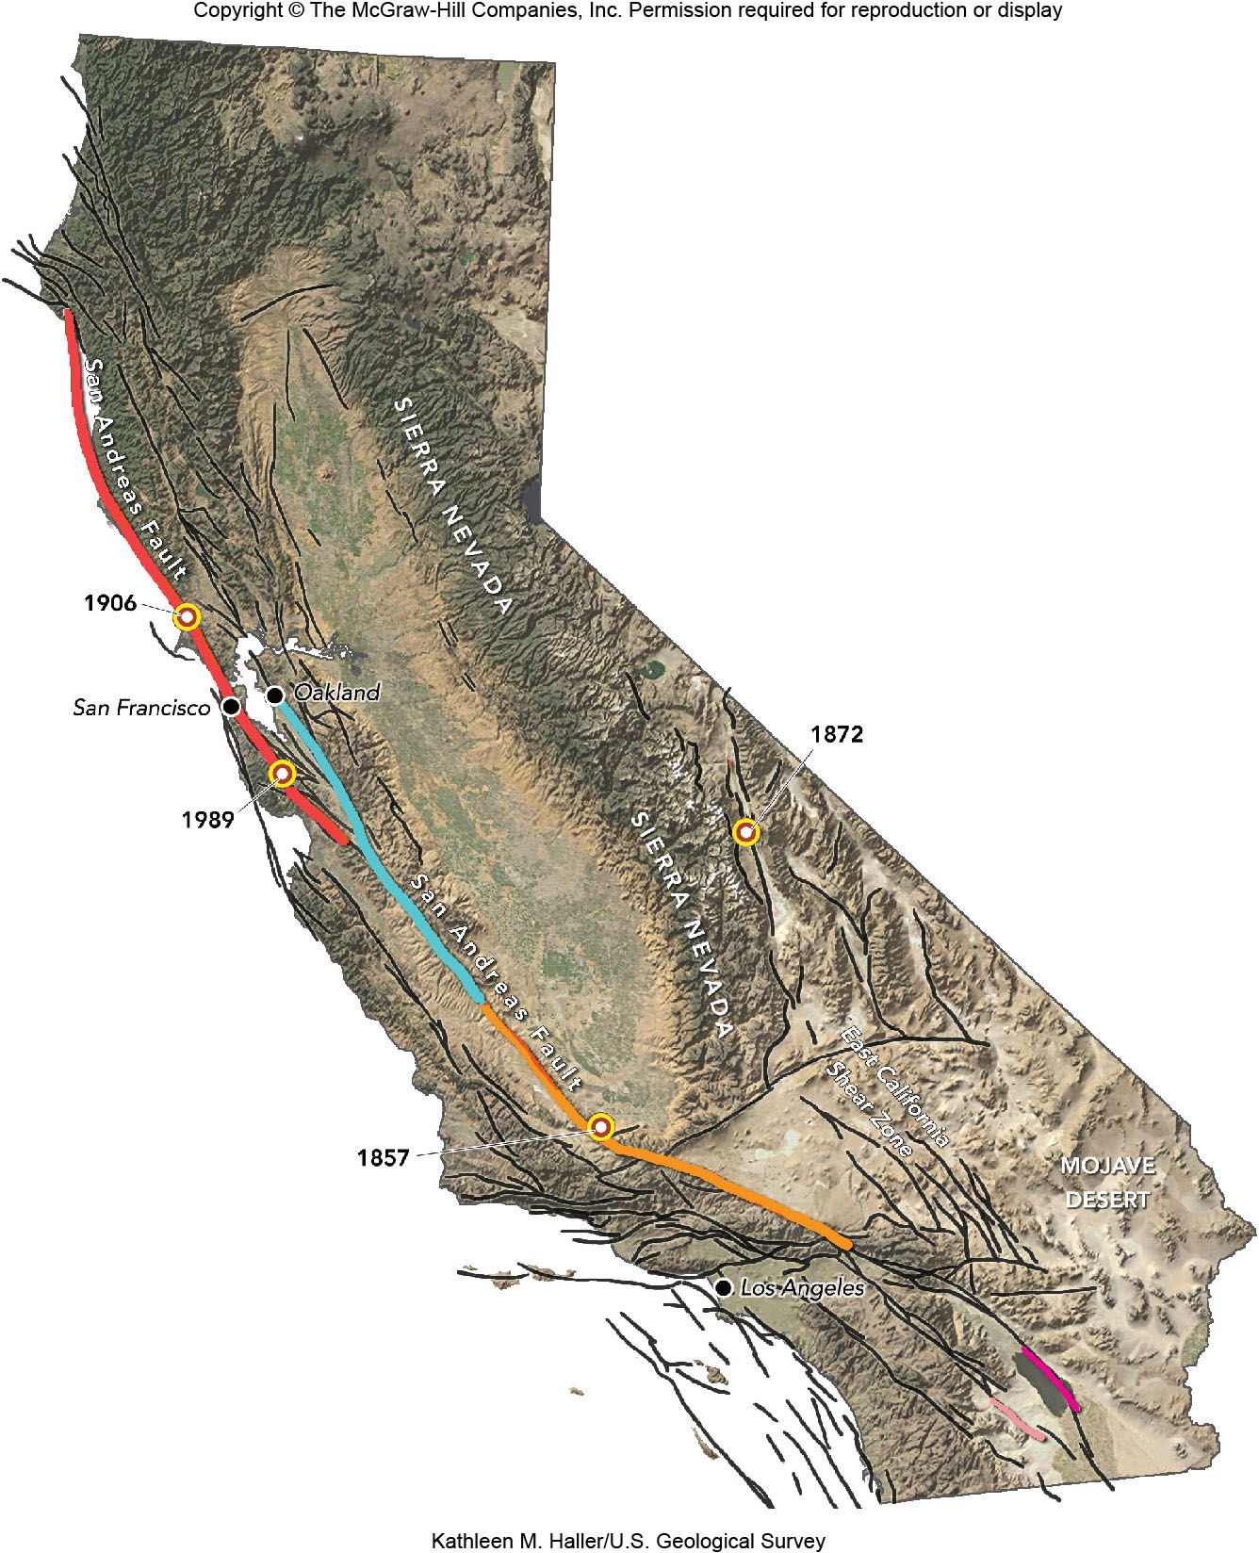
San Andreas Fault
Close to and part of plate boundary

Slide 37
EARTHQUAKES
Earthquake prediction,control and safety
  Earthquake precursors
    omens which may be observed prior to an earthquake and can aid in predicting the event
      dilatancy--swelling or buldging of surface rocks above an area with stress buildup--best example is Palmdale California and earthquake in the 1970’s--laser mirrors can measure magnitude of buldge

Slide 38
EARTHQUAKES
      changing habits of insects or animals prior to an earthquake--for some reason some creatures have an innate intuition about an earthquake to come--snakes awakened from hybernation prior to large earthquake in China

Slide 40
EARTHQUAKES
      strange glow emitted from rocks prior to an earthquake--stresses in rocks may cause a flow of electrons in quartz--this results in piezoelectricity which some believe can ionize gases causing a surface glowing
      increase of radon gas concentrations in environment-prior to some earthquakes higher concentrations of radon noticed in streams

Slide 41
EARTHQUAKES
  Earthquake control
    some speculate that lubricating rocks under stress with fluids (water) would result in the release of smaller bundles of energy and less energetic earthquakes thereby avoiding the “BIG ONE”
    Earthquake safety rules

Slide 43
EARTHQUAKES
  tsunami
    a series of seismic sea waves generated by an earthquake with an epicenter above the ocean crust or near the ocean
    seismic sea waves can be disastrous to property and life near ocean areas
    the Good Friday Earthquake of 1964 in Alaska generated a tsunami which devastated the west coast of North America

Slide 44
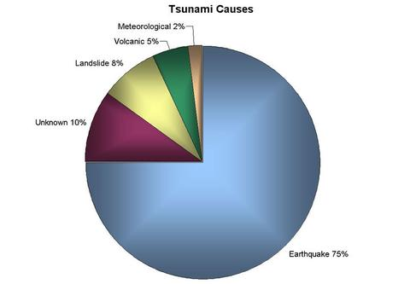
EARTHQUAKES
Main Causes of Tsunami Formation
Meteor Impact 2%
Caused By Convergent Plates
http://www.youtube.com/watch?v=RtsfhnmIVus

Slide 45
EARTHQUAKES
Tsunami---Water Ripple Effect

Slide 46
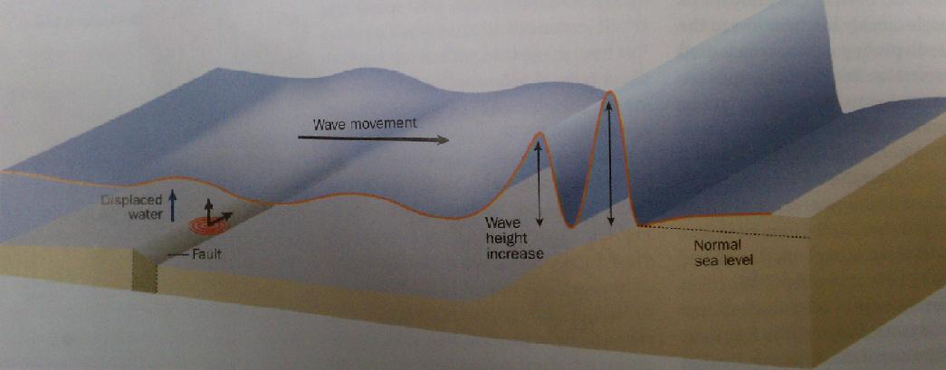
EARTHQUAKES
Tsunami Waves Breaking

Slide 47
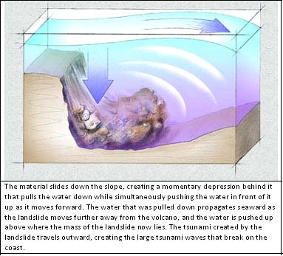
EARTHQUAKES
Tsunamis From Ocean Slumping

Slide 48
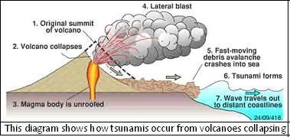
EARTHQUAKES
Tsunamis From Volcanic Slumping

Slide 49
EARTHQUAKES
Earth’s interior deduced from seismic waves
    structure and composition of interior of Earth has been determined with the aid of body waves and meteorite composition
  body wave paths and velocities in Earth’s interior
    homogeneous and inhomogeneous interior Earth concepts--paths of body waves are straight if Earth is homogene-ous or curved if inhomogeneous

Slide 50
Paths of Body Waves in Homogeneous
vs Inhomogeneous Earth Models

Slide 51
EARTHQUAKES
    actual velocities and paths of body waves within the Earth
      velocities of P and S waves increase with depth changing velocities at each minor and major interior Earth boundary
      at the boundary of lower mantle and outer core , the velocity of the P wave decreases and S wave ceases to exist

Slide 52
EARTHQUAKES
  Shadow zones of P and S waves
    are areas on Earth’s surface which do not receive P and/or S waves and can be explained by Earth’s interior structure--note P and S waves on figure

Slide 53
Body Wave Shadow Zones

Slide 54
EARTHQUAKES
    from results on velocities, paths, and shadow zones of body waves, important information of Earth’s interior can be revealed

