Slide 1
INTRODUCTION
Purpose of Intro is to show topics in course, relevance of the material, stimulate one’s curiosity, and treat concepts occurring in course.
Definition--Nature of Geology
  science that examines the Earth, its form, composition and changes that it has undergone is undergoing and will undergo.
The Scientific Method---An initial idea (hypothesis--theory) needs to have adequate supportive material (data) in order to be an accepted fact

Slide 2
INTRODUCTION
How Does a Hypothesis (Theory) Become an Established Fact?
Ans: after extensive scientific scrutiny; the hypothesis, through supportive data has to survive intense investigation, experimentation and testing

Slide 3
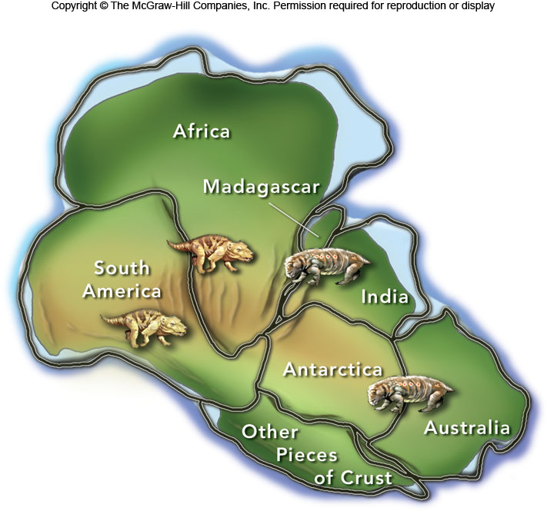
Continental Drift Example-Were the continents once joined together?-----hypothesis
Same fossils and rocks found on pre-joined portions of land---data

Slide 4
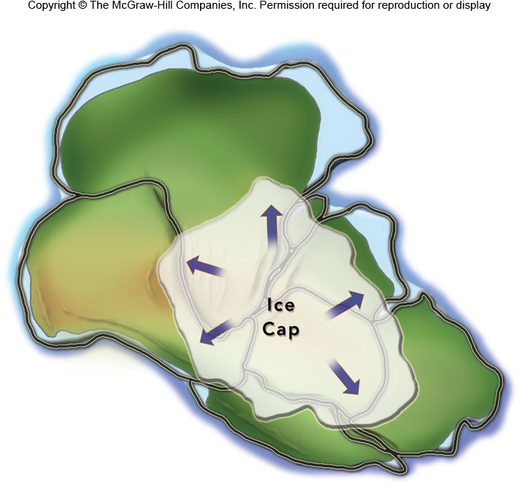
INTRODUCTION
Glacial activity on pre-joined land portions---data

Slide 5
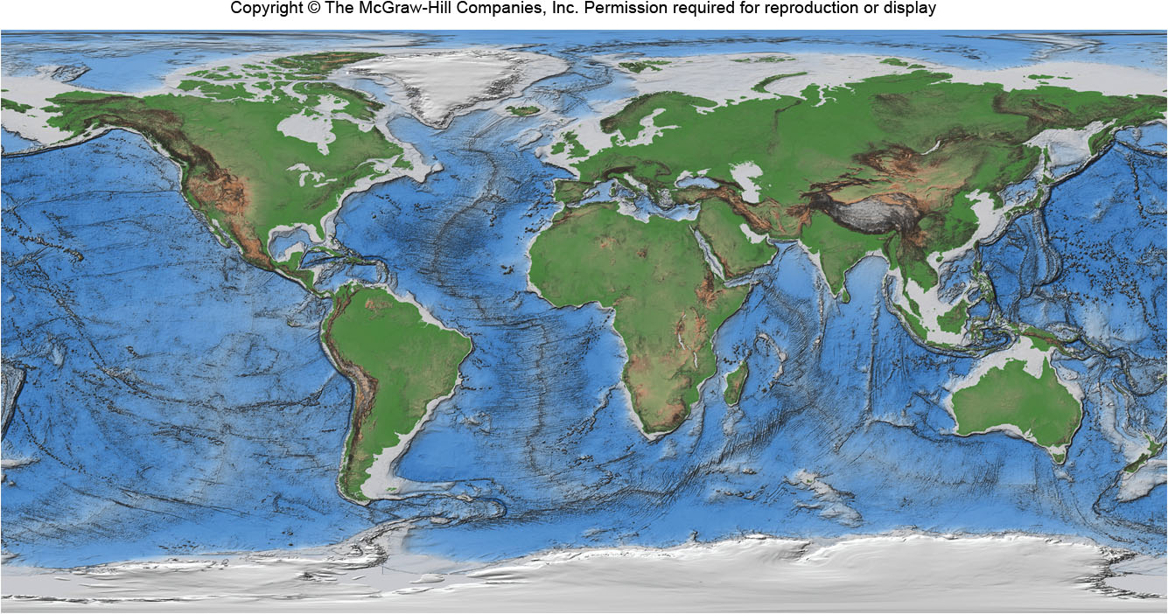
INTRODUCTION
Present Location of the Continents—map fit--data

Slide 6
INTRODUCTION
Time and Geology
  Relative Time
  Absolute Time
  Geologic Time Scale and Time Divisions
    eons, eras, periods, epochs-show the history of geologic events
    specific life changes found in rocks (fossils) separate one division from another

Slide 7
Upper Geologic Time Scale
    Meteor impact on Earth may have helped caused massive extinction of many life forms such as dinosaurs

Slide 8
What would a concerned dinosaur think of the up-coming danger????

Slide 9
Meteor impacts in Missouri and adjacent States ???

Slide 10
Lower Geologic Time Scale

Slide 11
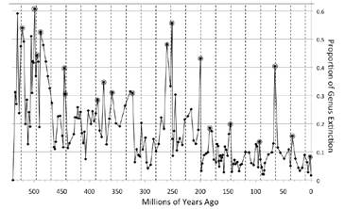
INTRODUCTION
--From fossil history in rocks, there appears to be a 27 million year life extinction pattern on Earth----What Causes This to happen??
--Possibly another star (Nemesis) disrupts the meteor Ort Cloud at the outer boundary of our Solar System
Mesozoic-Cenozoic-Era Boundary
Silurian- Ordovician Period Boundary
Paleozoic- Mesozoic Era Boundary
Jurassic—Triassic Period Boundary
Eocene-Oligiocene-Epoch Boundary
Cambrian—Ordovician Period Boundary

Slide 12
INTRODUCTION
Uniformitarianism
  the laws of nature have not changed and will be the same in the future
  the present is a key to the past (and future)

Slide 13
INTRODUCTION
Earth Materials (minerals and rocks)
  Minerals
    are individual chemical substances with important uses
      gemstones
      source of chemical elements
      precious metals
    comprise composition of rock families

Slide 14
INTRODUCTION
  Rock Families
    igneous rocks
      formed from cooling of molten rock material (magma) at surface (extrusive) or below surface (intrusive)
      geothermal energy is the result of igneous rock activity

Slide 16
Hot Springs

Slide 17
INTRODUCTION
    sedimentary rocks
      formed mostly in large bodies of water by physical, biological, or chemical processes at low temperatures
      formed in layers and contain important information on the history of life forms on Earth throughout geologic time

Slide 18
Layering of Sedimentary Rocks

Slide 19
INTRODUCTION
    metamorphic rocks
      formed from any preexisting rock subjected to high temperature and/or pressure conditions for long periods of time
  all three families of rocks have important uses in the building industries

Slide 20
INTRODUCTION
  Rock cycle
    the inter-relationship between the 3 rock families

Slide 22
INTRODUCTION
Volcanic activity
  any gas(es) and/or molten rock material emitted at the Earth’s surface
  mode of eruption may be passive (gentle) or explosive (violent) based on magma viscosity
  “Ring of fire” is largest concentration of volcanic activity

Slide 23
INTRODUCTION
Ring of Fire

Slide 24
INTRODUCTION
  benefits from volcanic activity and igneous activity are:
    fertile soils
    geothermal energy
Earth’s interior,continental drift, and rock plates
  Internal structure of Earth
    crust--comprised of continental and ocean basin crust

Slide 25
INTRODUCTION
    mantle--comprised of a solid top and bottom layer with a center section called the asthenosphere which consists of a more hot viscous-like material
    core--comprised of a liquid outer or upper portion and a solid lower or inner section---both sections comprised of mainly iron and nickel

Slide 26
INTRODUCTION
Internal Structure of Earth

Slide 27
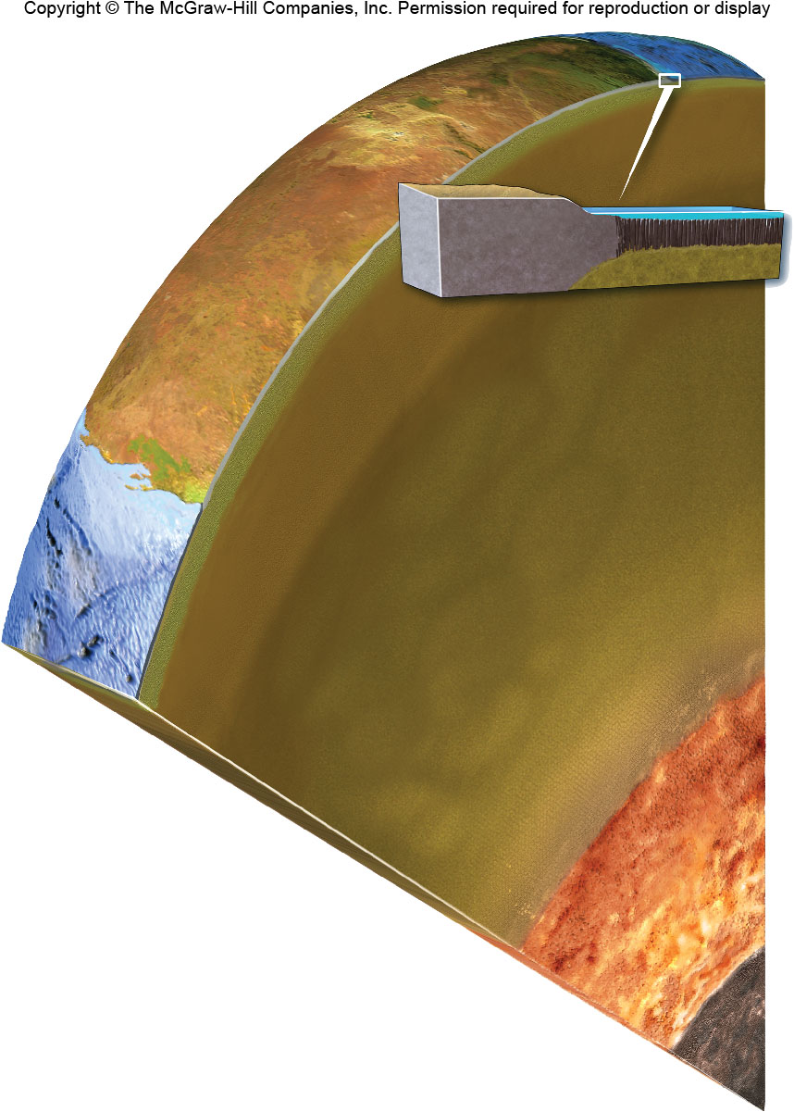
INTRODUCTION
Another example of Interior Structure of Earth
Continental Crust
Oceanic Crust
Upper Mantle
(solid upper and viscous lower called Asthenosphere)
Mantle
Lower Mantle
Inner Core--solid
Outer Core-liquid

Slide 28
INTRODUCTION
    lithosphere--entire solid outer portion of Earth resting on top of asthenosphere and includes the upper solid mantle, crust and any rock family formed subsequent to granite crust

Slide 29
INTRODUCTION
Upper Structure of Earth

Slide 30
INTRODUCTION
      isostacy--is the floating balance between the lithosphere and asthenosphere—regional elevations adjust to types and thicknesses of rocks

Slide 31
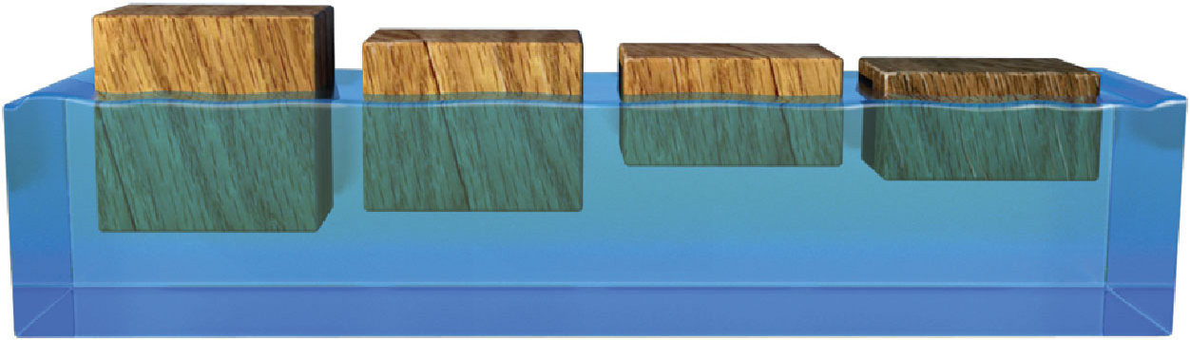
INTRODUCTION
Lithosphere floats on asthenosphere like balsa wood on water—denser materials sink and less dense, float----
--thicker but same density materials float higher—mountain belts have thick roots--

Slide 32
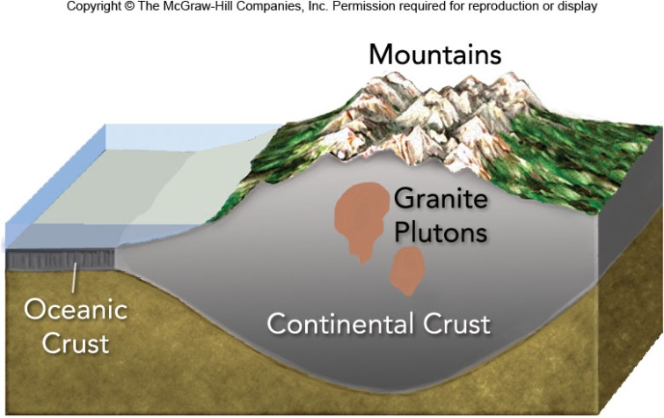
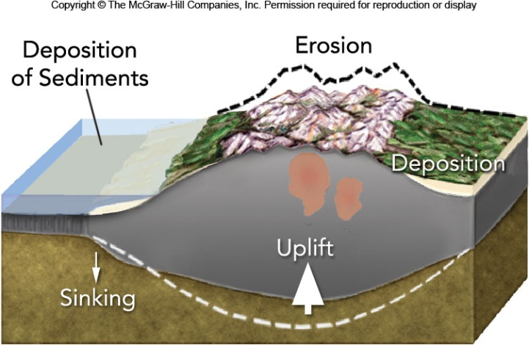
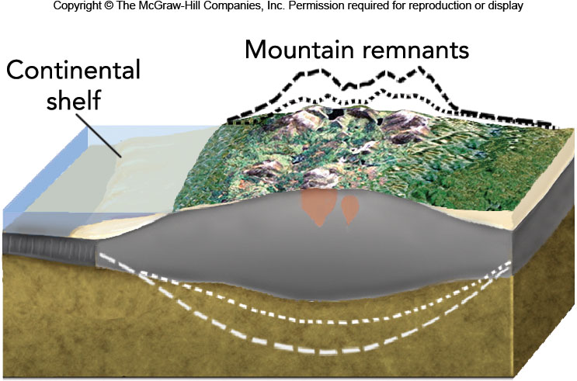
INTRODUCTION
Erosion of rock material or melting of ice causes adjustment by rebounding of rock below---like rebound of filled balloon after hand pressure is released

Slide 33
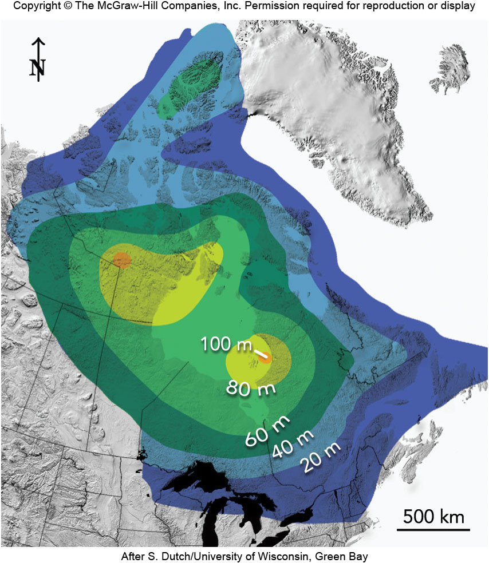
INTRODUCTION
Melting of Glacial Ice Causing Isostacy

Slide 34
INTRODUCTION
  Continental drift
    a single super “protocontinent” (Pangaea) split into sections and drifted apart beginning about 150-200 million years ago
    a lot of data supports this idea including a map fit or jig saw puzzle effect of the present continents

Slide 35
INTRODUCTION
Protocontinent, Pangaea

Slide 36
INTRODUCTION
  Rock plate concept (plate tectonics)
    born from continental drift idea and explains many solid plates bounded together
    plates can move towards boundaries (convergent), away from boundaries (divergent), or along boundaries (transformed)
    convergent boundaries form trenches--divergent ,ridges or rifts

Slide 37
INTRODUCTION
    driving force for plate movement is primarily convection cells
    plate boundaries are related to important geologic phenomena as volcanoes and earthquakes

Slide 38
Convection Cells

Slide 39
Plate Boundaries

Slide 40
INTRODUCTION
Geologic structures
  deep seated folded rocks on a large scale can harbour large deposits of oil, gas and faulted rocks can contain precious metals as gold and silver
  major erosional structures as unconformities aid in dividing geologic time

Slide 41
Unconformity and erosion surface

Slide 42
Folded rock layer

Slide 43
INTRODUCTION
Weathering and erosion
  weathering is the breaking down of a rock or mineral and erosion is the removal or transportation of rock and/or mineral material
  weathering can be chemical or physical by nature
  stream waters, glacial ice or wind can act as erosion agents
  soil is a byproduct of these two

Slide 44
INTRODUCTION
Surface streams and groundwater
  these two are very important sources of municipal water
  there are pollution problems associated with these which we will treat later ( pollution from landfills and industry)
  associated features are sinkholes, caves, and speleothem

Slide 45
Sinkhole

Slide 46
Speleothems

Slide 47
INTRODUCTION
Glaciers
  during the “Great Ice Age” of North America glaciers formed the Great Lakes
  some glacial deposits are important to the concrete and cement industry

Slide 48
INTRODUCTION
  the glacial ice present on Greenland and Antartic comprise about 96% of all global ice---if all melted sea level would rise about 215 feet

Slide 49
Glacial Ice During North American Ice Age

Slide 50
Effects of Coastlines by
Glacial Activity

Slide 51
INTRODUCTION
Earthquakes
  seismology is the study of earthquakes
  a large earthquake is predicted in southeastern Missouri within the next 50 years
  in 1811 and 1812, three large earthquakes along the New Madrid Fault in SE Missouri took place
  tsunami is a seismic sea wave

Slide 52
INTRODUCTION
Tsunami

Slide 53
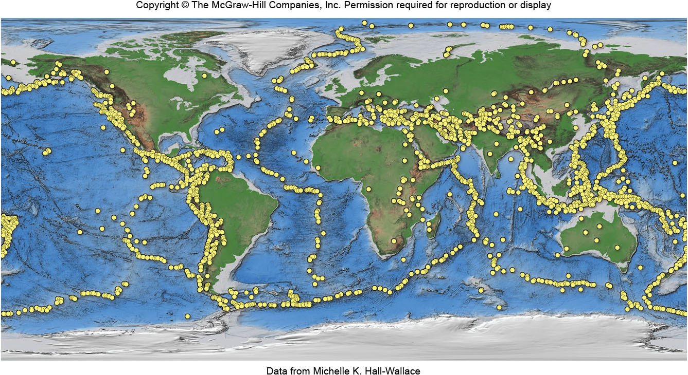
Introduction
Global earthquake distribution

