Slide 1
The Gilgamesh Epic
LLT 180
Spring MMXVIII

Slide 2
Land Between The Rivers

Slide 3
The MESOPOTAMIANS!!!
4000 BC: Sumerians build ziggurats, cities along the rivers
3300 BC: Invention of wheel, writing, prostitution
2400 BC: Switch to cuneiform – Gilgamesh rules in Uruk
2330 BC: Akkadians take over from Sumerians
1900 BC: Assyrians take over from Akkadians
1792 BC: Hammurabi of Babylon takes over
1250 BC: Assyrians make a comeback now featuring IRON
600 BC: Nebuchadnezzar and New Babylonians come back

Slide 4
Weltanschauung
German word meaning “world outlook”
Society’s place in the world, and expectations for life
Every society has a general Weltanschauung
Groups of people have a general Weltanschauung
Individuals have an individual Weltanschauung
Determined by one’s physical location
Determined by one’s prevailing culture
Determined by one’s generation
Important factor underlying CULTURAL COMPETENCE

Slide 5
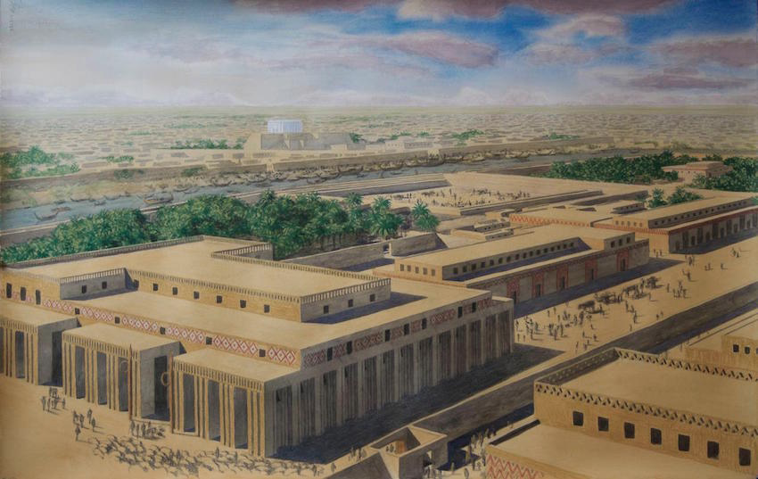
Uruk, ca. 3000 BC

Slide 6
50,000-80,000 Inhabitants

Slide 7
Mesopotamian Deities
An (Anu): god of the heavens
Aruru (Ninsun): mother of Gilgamesh
Enki (Ea): god of fresh waters; tricksy sort of guy
Enlil (Ellil): Lord Wind, wind/storm god
Huwawa (Humbaba): guardian of the Cedar Forest
Inanna (Ishtar): goddess of passion, war, lots of other things
Lugulbanda: father of Gilgamesh, deified hero or demigod
Shamash (Utu): friendly neighborhood sun god
Siduri: barmaid who runs the tavern on the way to Dilmun
Urshanabi: ferryman on the Dilmun route
Utnapishtim: originally human, survived Flood, became a god

Slide 8
Ancient deities
Deity = preferable term for “god” or “goddess”
Animistic vs. anthropomorphic vs. theriomorphic
Anu of the firmament: animistic: basically just there
Anthropomorphic = human appearance and personality
Ishtar is a good example: strong personality
Can be human-like to a fault
Behavior of anthropomorphic deities = good cultural indicator
Different cultures’ deities behave very differently

Slide 9
Meet our protagonist
I will proclaim to the world the deeds of Gilgamesh. This was the man to whom all things were known; this was the king who knew the countries of the world. He was wise, he saw mysteries and knew secret things, he brought us a tale of the days before the flood. He went on a long journey, was weary, worn out with labor, returning he rested, he engraved on a stone the whole story.
When the gods created Gilgamesh they gave him a perfect body. Shamash the glorious sun endowed him with beauty, Adad the god of the storm endowed him with courage, the great gods made his beauty perfect, surpassing all others, terrifying like a great wild bull. Two thirds they made him god and one third man.
In Uruk he built walls, a great rampart, and the temple of blessed Eanna for the god of the firmament Anu, and for Ishtar the goddess of love.

Slide 10
Gilgamesh’s Poll Results
Gilgamesh went abroad in the world, but he met with none who could withstand his arms till be came to Uruk. But the men of Uruk muttered in their houses, ‘Gilgamesh sounds the tocsin for his amusement, his arrogance has no bounds by day or night. No son is left with his father, for Gilgamesh takes them all, even the children; yet the king should be a shepherd to his people. His lust leaves no virgin to her lover, neither the warrior's daughter nor the wife of the noble; yet this is the shepherd of the city, wise, comely, and resolute.'

Slide 11
Passion for Public Affairs
Gilgamesh sounds the tocsin (alarm drum) for his amusement
His arrogance knows no bounds by day or night
His lust leaves no virgin to her lover (ius primae noctis)
Yet this is the shepherd of the city, wise, comely, and resolute
Obvious expectations of ETHICAL LEADERSHIP
On the other hand a king is given to the people by the gods
The people complain to the gods about Gilgamesh’s unique approach to COMMUNITY ENGAGEMENT
Anu actually listens to the people of Uruk’s complaints
For once, the gods practice ETHICAL LEADERSHIP!
The goddess Aruru is tasked with finding a solution
Hey! You mean that goddesses get to do stuff too?

Slide 12
Alter Ego = Second Self
When Anu had heard their lamentation the gods cried to Aruru, the goddess of creation, ‘You made him, O Aruru; now create his equal; let it be as like him as his own reflection, his second self; stormy heart for stormy heart. Let them contend together and leave Uruk in quiet.
Alter ego = Latin for “another I” = important theme
Can mirror a character in a work, or also the author
Gilgamesh and Enkidu first example in Western literature
Similarities are important but so are the differences
Some people call me Maurrrrrice…

Slide 13
Enkidu?

Slide 14
Nature versus culture
Nature vs. culture = antithesis (comparison of opposites)
Utopia (perfect state) vs. dystopia (worst state) another
Enkidu = nature; Shamhat (the “harlot”) = culture
Reminiscent of Adam and Eve in the Garden of Eden
Shamhat civilizes Enkidu by having sex with him
Ultimately he starts wearing clothes; the animals ignore him
Enkidu starts living with the shepherds
Gilgamesh has two dreams about one whom he will love
He is bored, really, and in need of a new adventure
He is not interested in learning ETHICAL LEADERSHIP

Slide 15
The trapper is horrified
On three days he met him face to face, and the trapper was frozen with fear, and he was dumb, benumbed with terror. His face was altered like that of one who has made a long journey. With awe in his heart he spoke to his father: ‘Father, there is a man, unlike any other, who comes down from the hills. He is the strongest in the world, he is like an immortal from heaven. He ranges over the hills with wild beasts and eats grass; the ranges through your land and comes down to the wells. I am afraid and dare not go near him. He fills in the pits which I dig and tears up-my traps set for the game; he helps the beasts to escape and now they slip through my fingers.'

Slide 16
The trapper gets some advice
Go to Uruk, find Gilgamesh, extol the strength of this wild man. Ask him to give you a harlot, a wanton from the temple of love; return with her, and let her woman's power overpower this man. When next he comes down to drink at the wells she will be there, stripped naked; and when he sees her beckoning he will embrace her, and then the wild beasts will reject him.' So the trapper set out on his journey to Uruk and addressed himself to Gilgamesh saying, ‘A man unlike any other is roaming now in the pastures; he is as strong as a star from heaven and I am afraid to approach him. Gilgamesh said, ‘Trapper, go back, take with you a harlot, a child of pleasure. At the drinking hole she will strip, and when, he sees her beckoning he will embrace her and the game of the wilderness will surely reject him.'

Slide 17
Seduction, Sumerian Style
She was not ashamed to take him, she made herself naked and welcomed his eagerness; as he lay on her murmuring love she taught him the woman's art. For six days and seven nights they lay together, for Enkidu had forgotten his home in the hills; but when he was satisfied he went back to the wild beasts. Then, when the gazelle saw him, they bolted away; when the wild creatures saw him they fled. So he returned and sat down at the woman's feet, and listened intently to what she said. ‘You are wise, Enkidu, and now you have become like a god. Why do you want to run wild with the beasts in the hills? Come with me. I will take you to strong-walled Uruk, to the blessed temple of Ishtar and of Anu, of love and of heaven there Gilgamesh lives, who is very strong, and like a wild bull he lords it over men.'

Slide 18
Gilgamesh’s Second Dream
Gilgamesh said, ‘Mother, I dreamed a second dream. In the streets of strong-walled Uruk there lay an axe; the shape of it was strange and the people thronged round. I saw it and was glad. I bent down, deeply drawn towards it; I loved it like a woman and wore it at my side.' Ninsun answered, ‘That axe, which you saw, which drew you so powerfully like love of a woman, that is the comrade whom I give you, and he will come in his strength like one of the host of heaven. He is the brave companion who rescues his friend in necessity.' Gilgamesh said to his mother, 'A friend, a counsellor has come to me from Enlil, and now I shall befriend and counsel him.' So Gilgamesh told his dreams; and the harlot retold them to Enkidu.

Slide 19
Holding each other like bvlls

Slide 20
A New Bromance
Mighty Gilgamesh came on and Enkidu met him at the gate. He put out his foot and prevented Gilgamesh from entering the house, so they grappled, holding each other like bulls. They broke the doorposts and the walls shook, they snorted like bulls locked together. They shattered the doorposts and the walls shook. Gilgamesh bent his knee with his foot planted on the ground and with a turn Enkidu was thrown. Then immediately his fury died. When Enkidu was thrown he said to Gilgamesh, ‘There is not another like you in the world. Ninsun, who is as strong as a wild ox in the byre, she was the mother who bore you, and now you are raised above all men, and Enlil has given you the kingship, for your strength surpasses the strength of men.’ So Enkidu and Gilgamesh embraced and their friendship was sealed.

Slide 21
Gilgamesh seeks kleos (1)
''Where is the man who can clamber to heaven? Only the gods live forever with glorious Shamash, but as for us men, our days are numbered, our occupations are a breath of wind. How is this, already you are afraid! I will go first although I am your lord, and you may safely call out, "Forward, there is nothing to fear!" Then if I fall I leave behind me a name that endures; men - will say of me, "Gilgamesh has fallen in fight with ferocious Humbaba." Long after the child has been born in my house, they will say it, and remember.' Enkidu spoke again to Gilgamesh, 'O my lord, if you will enter that country, go first to the hero Shamash, tell the Sun God, for the land is his. The country where the cedar is cut belongs to Shamash.'

Slide 22
Gilgamesh seeks kleos (II)
'O Shamash, hear me, hear me, Shamash, let my voice be heard. Here in the city man dies oppressed at heart, man perishes with despair in his heart. I have looked over the wall and I see the bodies floating on the river, and that will be my lot also. Indeed I know it is so, for whoever is tallest among men cannot reach the heavens, and the greatest cannot encompass the earth. Therefore I would enter that country: because I have not established my name stamped on brick as my destiny decreed, I will go to the country where the cedar is cut. I will set up my name where the names of famous men are written; and where no man's name is written I will raise a monument to the gods.'

Slide 23
Land of the Living – Why?
Actual reason – get much needed cedar wood from Lebanon
But Gil’s name is not yet “stamped on brick”
Gil wants to compensate for mortality by great deeds
Humbaba is appointed by Enlil as guardian of the forest
Enkidu will provide “nature boy” skillz
Ninsun asks Shamash (a superior god) to help her boyz
Councillors advise Gilgamesh on how to proceed
Gilgamesh and Enkidu walk 50 leagues for 3 days = 50 miles
They walk through a thick forest, superhero style
Gilgamesh has dreams which Enkidu interprets
They get afraid and call out to Shamash for help

Slide 24
Acquiring Weapons
'I will give orders to the armourers; they shall cast us our weapons while we watch them.' So they gave orders to the armourers and the craftsmen sat down in conference. They went into the groves of the plain and cut willow and box-wood; they cast for them axes of nine score pounds, and great swords they cast with blades of six score pounds each one, with pommels and hilts of thirty pounds. They cast for Gilgamesh the axe ‘Might of Heroes' and the bow of Anshan; and Gilgamesh was armed and Enkidu; and the weight of the arms they carried was thirty score pounds.

Slide 25
The Axe “Might of Heroes”

Slide 26
Ninsun’s Lament
Ninsun went into her room, she put on a dress becoming to her body, she put on jewels to make her breast beautiful, she placed a tiara on her head and her skirts swept the ground. Then she went up to the altar of the Sun, standing upon the roof of the palace; she burnt incense and lifted her arms to Shamash as the smoke ascended: ‘O Shamash, why did you give this restless heart to Gilgamesh, my son; why did you give it? You have moved him and now he sets out on a long journey to the Land of Humbaba, to travel an unknown road and fight a strange battle.

Slide 27
The Counselors of Uruk
We, the counsellors of Uruk entrust our king to you, O Enkidu; bring him back safely to us.' Again to Gilgamesh, they said, ‘May Shamash give you your heart's desire, may he let you see with your eyes the thing accomplished which your lips have spoken; may he open a path for you where it is blocked, and a road for your feet to tread. May he open the mountains for your crossing, and may the nighttime bring you the blessings of night, and Lugulbanda, your guardian god, stand beside you for victory. May you have victory in the battle as though you fought with a child. Wash your feet in the river of Humbaba to which you are journeying; in the evening dig a well, and let there always be pure water in your water-skin. Offer cold water to Shamash and do not forget Lugulbanda.'

Slide 28
A Liminal Experience
They crossed seven mountains before they came to the gate of the forest. Then Enkidu called out to Gilgamesh, ‘Do not go down into the forest; when I opened the gate my hand lost its strength.' Gilgamesh answered him, ‘Dear friend, do not speak like a coward. Have we got the better of so many dangers and travelled so far, to turn back at last? You, who are tried in wars and battles, hold close to me now and you will feel no fear of death; keep beside me and your weakness will pass, the trembling will leave your hand. Would my friend rather stay behind? No, we will, go down together into the heart of the forest. Let your courage be roused by the battle to come; forget death and follow me, a man resolute in action, but one who is not foolhardy. When two go together each will protect himself and shield his companion, and if they fall they leave an enduring name.'

Slide 29
TOPOLOGY of the Katabasis
Long, tiresome, dangerous journey
Sometimes accompanied by a buddy or a guide
Darkness and difficult terrain
Occasionally there be monsters on the way
LIMINAL EXPERIENCE = point of no return
Sometimes a river or pool of skanky water
Demons and other scary monsters
Souls of the dead, sometimes being punished
Wisdom figures to be consulted
An object to be retrieved
Long, tiresome, dangerous journey

Slide 30
Gilgamesh’s First Dream
Gilgamesh dreamed, and at midnight sleep left him, and he told his dream to his friend. ‘Enkidu, what was it that woke me if you did not? My friend, I have dreamed a dream. Get up, look at the mountain precipice. The sleep that the gods sent me is broken. Ah, my friend, what a dream I have had! Terror and confusion; I seized hold of a wild bull in the wilderness. It bellowed and beat up the dust till the whole sky was dark, my arm was seized and my tongue bitten. I fell back on' my knee; then someone refreshed me with water from his water-skin.'

Slide 31
Enkidu becomes afraid
Then Enkidu, the faithful companion, pleaded, answering him, ‘O my lord, you do not know this monster and that is the reason you are not afraid. I who know him, I am terrified. His teeth are dragon's fangs, his countenance is like a lion, his charge is the rushing of the flood, with his look he crushes alike the trees of the forest and reeds in the swamp. O my Lord, you may go on if you choose into this land, but I will go back to the city. I will tell the lady your mother all your glorious deeds till she shouts for joy: and then I will tell the death that followed till she weeps for bitterness.'

Slide 32
Gilgamesh and Enkidu

Slide 33
Let the fray begin
Humbaba came from his strong house of cedar. He nodded his head and shook it, menacing Gilgamesh; and on him he fastened his eye, the eye of death. Then Gilgamesh called to Shamash and his tears were flowing, ‘O glorious Shamash, I have followed the road you commanded but now if you send no succour how shall I escape? Glorious Shamash heard his prayer and he summoned the great wind, the north wind, the whirlwind, the storm and the icy wind, the tempest and the scorching wind; they came like dragons, like a scorching fire, like a serpent that freezes the heart, a destroying flood and the lightning's fork. The eight winds rose up against Humbaba, they beat against his eyes; he was gripped, unable to go forward or back.

Slide 34
The Death of Humbaba
For as far as two leagues the cedars shivered when Enkidu felled the watcher of the forest, he at whose voice Hermon and Lebanon used to tremble. Now the mountains were moved and all the hills, for the guardian of the forest was killed. They attacked the cedars, the seven splendours of Humbaba were extinguished. So they pressed on into the forest bearing the sword of eight talents. They uncovered the sacred dwellings of the Anunnaki and while Gilgamesh felled the first of the trees of the forest Enkidu cleared their roots as far as the banks of Euphrates. They set Humbaba before the gods, before Enlil; they kissed the ground and dropped the shroud and set the head before him. When he saw the head of Humbaba, Enlil raged at them. ‘Why did you do this thing? From henceforth may the fire be on your faces, may it eat the bread that you eat, may it drink where you drink.

Slide 35
HUMBABA

Slide 36
Katabasis #1
Gate = liminal experience = point of no return
Gil and Enkidu take turns getting afraid
Shamash sends various winds, a flood, and thunderbolts.
Humbaba fights back with his seven splendors but loses
Humbaba pleads for his life, saying he works for Enlil
Enkidu counsels Gilgamesh to kill Humbaba
The two then chop down the cedars of the forest
They display Humbaba’s head to Enlil, causing Enlil to get very angry with them.
Enlil reassigns Humbaba’s seven splendors

Slide 37
Results of Katabasis #1
Quest for wood in the “Land of the Living”
Super-heroic touches = long journeys, sword of eight talents
Plenty of doubts and fears
Guide = Shamash
Liminal experience at Humbaba’s gate on the mountain
Combat with ferocious monster - almost an afterthought
Humbaba pleads for his life – Enkidu advises DEATH
The wood is cut down and sent to Uruk
They expose Humbaba’s head to Enlil (hubris)
They return to Uruk (not much of an an anabasis here)
What CULTURAL COMPETENCE have they gained?

Slide 38
Ishtar/Inanna

Slide 39
Ishtar comes on to Gilgamesh
Gilgamesh washed out his long locks and cleaned his weapons; he flung back his hair from his shoulders; he threw off his stained clothes and changed them for new. He put on his royal robes and made them fast. When Gilgamesh had put on the crown, glorious Ishtar lifted her eyes, seeing the beauty of Gilgamesh. She said, ‘Come to me Gilgamesh, and be my bridegroom; grant me seed of your body, let me be your bride and you shall be my husband. I will harness for you a chariot of lapis lazuli and of gold, with wheels of gold and horns of copper; and you shall have mighty demons of the storm for draft mules.

Slide 40
Gilgamesh Disses Ishtar
Ishtar's the hearth gone cold, a broken door, without the gold; a fort that shuts its soldiers out, a water well that's filled with doubt; tar that can't be washed away, a broken cup, stained and gray; rock that shatters to dust and sand, a useless weapon in the hand; and worse than that or even this, a god's own sandal filled with piss. You've had your share of boys, that's true, but which of them came twice for you?

Slide 41
Ishtar complains to Daddy
Ishtar opened her mouth and said again, ‘My father, give me the Bull of Heaven to destroy Gilgamesh. Fill Gilgamesh, I say, with arrogance to his destruction; but if you refuse to give me the Bull of Heaven I will break in the doors of hell and smash the bolts; there will be confusion of people, those above with those from the lower depths. I shall bring up the dead to eat food like the living; and the hosts of dead will outnumber the living.' Anu said to great Ishtar, ‘If I do what you desire there will be seven years of drought throughout Uruk when corn will be seedless husks. Have you saved grain enough for the people and grass for the cattle? Ishtar replied. ‘I have saved grain for the people, grass for the cattle; for seven years of seedless husks, there is grain and there is grass enough.’

Slide 42
Enkidu’s Very Bad Career Move
But Ishtar rose tip and mounted the great wall of Uruk; she sprang on to the tower and uttered a curse: ‘Woe to Gilgamesh, for he has scorned me in killing the Bull of Heaven.' When Enkidu heard these words he tore out the Bull's right thigh and tossed it in her face saying, ‘If I could lay my hands on you, it is this I should do to you, and lash the entrails to your side.' Then Ishtar called together her people, the dancing and singing girls, the prostitutes of the temple, the courtesans. Over the thigh of the Bull of Heaven she set up lamentation.

Slide 43
Inanna and the Bvll of Heaven
Inanna = goddess of war, love, fertility
Of course she has a lot of partners – it’s her job
Comes on to Gilgamesh, very rudely turned down
Still deficient in CULTURAL COMPETENCE
Anu sends in Bvll of Heaven (aka Gugulanna)
Probably metaphoric representation of earthquake
Gilgamesh and Enkidu kill the Bvll (hubris)
Enkidu throws the right haunch at Inanna (bad career move)
Feasting and celebrations in Gilgamesh’s palace: “Who is the most glorious of heroes, who is eminent among men?”
But in the palace that night, Enkidu has a very bad dream.

Slide 44
A Very Bad Dream
When the daylight came Enkidu got up and cried to Gilgamesh, ‘O my brother, such a dream I had last night. Anu, Enlil, Ea and heavenly Shamash took counsel together, and Anu said to Enlil, "Because they have killed the Bull of Heaven, and because they have killed Humbaba who guarded the Cedar Mountain one of the two must die." Then glorious Shamash answered the hero Enlil, "It was by your command they killed the Bull of Heaven, and killed Humbaba, and must Enkidu die although innocent?" Enlil flung round in rage at glorious Shamash, "You dare to say this, you who went about with them every day like one of themselves!”’

Slide 45
Katabasis #2
Gilgamesh acquired no CULTURAL COMPETENCE from his first katabasis to the Land of the Living.
Enkidu’s death drives him mad with fear of his own mortality
Gilgamesh tries to deny Enkidu’s death, dresses as a wild man
Decides to visit Utnapishtim, the “Sumerian Noah”
Epic journey to Dilmun, at the far edge of the known world
He will meet Siduri the barmaid/psychologist
Utnapishtim tells him the Flood story
Gilgamesh attempts to earn immortality, then youth = FAIL
Gilgamesh weeps and then returns sadly home
Tells his story = CULTURAL COMPETENCE
Shares his story = COMMUNITY ENGAGEMENT

Slide 46
Looking for Answers
Enkidu curses the forest, the trapper, and Shamhat
Shamash makes him retract his curses = culture is GOOD
Gilgamesh is crushed by the loss of his alter ego
Denies Enkidu’s death, makes beautiful statue, worm
Gilgamesh worries about his own mortality (naturally)
What my brother is now, that I shall be when I am dead
Lets hair grow, wanders wild in lion skin = culture is BAD
Decides to go interview Utnapishtim and ask for the secret
Scorpion-Man (Mt. Mashu) warns him it’s pointless
Siduri (barmaid at World’s End) warns him it’s pointless

Slide 47
Enkidu Curses Shamhat
When he had cursed the Trapper to his heart's content he turned on the harlot. He was roused to curse her also. ‘As for you, woman, with a great curse I curse you! I will promise you a destiny to all eternity. My curse shall come on you soon and sudden. You shall be without a roof for your commerce, for you shall not keep house with other girls in the tavern, but do your business in places fouled by the vomit of the drunkard. Your hire will be potter's earth, your thievings will be flung into the hovel, you will sit at the cross-roads in the dust of the potter's quarter, you will make your bed on the dunghill at night, and by day take your stand in the wall's shadow. Let you be stripped of your purple dyes, for I too once in the wilderness with my wife had all the treasure I wished.'

Slide 48
Shamash corrects Enkidu
When Shamash heard the words of Enkidu he called to him from heaven: ‘Enkidu, why are you cursing the woman, the mistress who taught you to eat bread fit for gods and drink wine of kings? She who put upon you a ‘magnificent garment, did she not give you glorious Gilgamesh for your companion, and has not Gilgamesh, your own brother, made you rest on a 'royal bed and recline on a couch at his left hand? He has made the princes of the earth kiss your feet, and now all the people of Uruk lament and wail over you. When you are dead he will let his hair grow long for your sake, he will wear a lion's pelt and wander through the desert.'

Slide 49
Another Very Bad Dream
…stood I before an awful being, the sombre-faced man-bird; he had directed on me his purpose. his was a vampire face, his foot was a lion's foot, his hand was an eagle's talon. He fell on me and his claws were in My hair, he held me fast and I smothered; then he transformed me so that my arms became wings covered with feathers…
There is the house whose people sit In darkness; dust is their food and clay their meat. They are clothed like birds with wings for covering, they see no light, they sit in darkness. I entered the house of dust and I saw the kings of the earth, their crowns put away for ever; rulers and princes, all those who once wore kingly crowns and ruled the world in the days of old. They who had stood in the place of the gods like Anu and Enlil stood now like servants to fetch baked meats in the house of dust, to carry cooked meat and cold water from the water-skin.

Slide 50
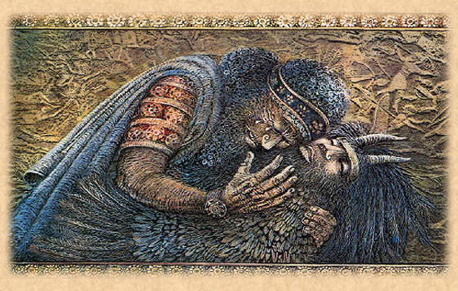
The Death of Enkidu

Slide 51
The Death of Enkidu
This day on which Enkidu dreamed came to an end and he lay stricken with sickness. One whole day he lay on his bed and his suffering increased. He said to Gilgamesh, the friend for whom he had left the wilderness, 'Once I ran for you, for the water of life, and I now have nothing:' A second day he lay on his bed and Gilgamesh watched over him but the sickness increased. Ten days he lay and his suffering increased, eleven and twelve days he lay on his bed of pain. Then he called to Gilgamesh, 'My friend, the great goddess cursed me and I must die in shame. I shall not die like a man fallen in battle; I feared to fall, but happy is the man who falls in the battle, for I must die in shame.' And Gilgamesh wept over Enkidu.

Slide 52
Elisabeth Kübler-Ross’s stages of grief
Denial: Gilgamesh refuses to accept Enkidu’s death until “the worm fastened upon him”
Anger: Gilgamesh began to “rage like a lion, like a lioness deprived of her whelps”
Bargaining: Gilgamesh goes on a katabasis to seek the secret of eternal life
Depression: Gilgamesh weeps at the end for his aging and his mortality
Acceptance: Gilgamesh returns home, and shares his story of personal growth through CULTURAL COMPETENCE.

Slide 53
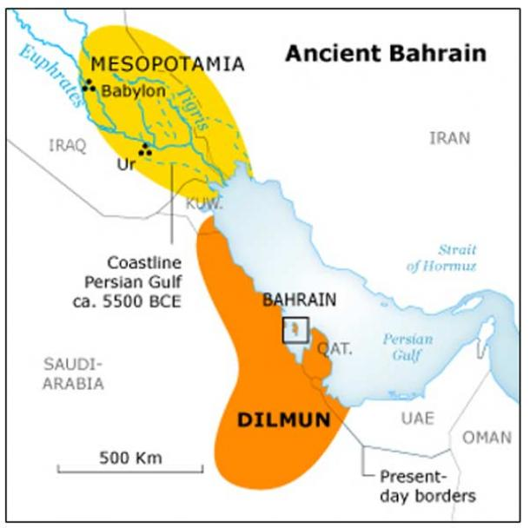
Dilmun

Slide 54
TOPOLOGY of the Katabasis
You can’t just catch a plane or take a bus to the underworld
Liminal experience required (Mt. Mashu, etc.)
Long, weary, boring trip required
Monsters, storms, demons etc: MAN-SCORPION
Bodies of water (rivers or seas) also necessary
Often poisonous and/or stinky
Surly boatman who is NOT a wisdom figure
Utnapishtim is the first, Charon the most famous
Gilgamesh has broken “the tackle” of Urshanabi’s boat
Has to cut 120 60-cubit (90’) logs to pole the boat

Slide 55
The Man-Scorpion at Mt. Mashu
‘Why have you come so great a journey; for what have you travelled so far, crossing the dangerous waters; tell me the reason for your coming?' Gilgamesh answered, ‘For Enkidu; I loved him dearly, together we endured all kinds of hardships; on his account I have come, for the common lot of man has taken him. I have wept for him day and night, I would not give up his body for burial, I thought my friend would come back because of my weeping. Since he went, my life is nothing; that is why I have travelled here in search of Utnapishtim my father; for men say he has entered the assembly of the gods, and has found everlasting life: I have a desire to question him, concerning the living and the dead.'

Slide 56
Siduri

Slide 57
Siduri Meets Gilgamesh
Beside the sea she lives, the woman of the vine, the maker, of wine; Siduri sits in the garden at the edge of the sea, with the golden bowl and the golden vats that the gods gave her. She is covered with a veil; and where she sits she sees Gilgamesh coming towards her, wearing skins, the flesh of the gods in his body, but despair in his heart, and his face like the face of one who has made a long journey. She looked, and as she scanned the distance she said, ‘Surely this is some felon; where is he going now? And she barred her gate against him with the cross-bar. But Gilgamesh, hearing the sound of the bolt, lodged his foot in the gate; he called to her, ‘Young woman, maker of wine, why do you bolt your door? I will break in your door and burst in your gate, for I am Gilgamesh who seized and killed the Bull of Heaven, I killed the watchman of the cedar forest, I overthrew Humbaba who lived in the forest, and I killed the lions in the passes of the mountain.'

Slide 58
Gilgamesh to Siduri
‘Why should not my cheeks be starved and my face drawn? Despair is in my heart and my face is the face of one who has made a long journey. It was burned with heat and with cold. Why should I not wander over the pastures? My friend, my younger brother who seized and killed the Bvll of Heaven and overthrew Humbaba in the cedar forest, my friend who was very dear to me and endured dangers beside me, Enkidu, my brother whom I loved, the end of mortality has overtaken him. I wept for him seven days and nights till the worm fastened on him. Because of my brother I am afraid of death; because of my brother I stray through the wilderness. His fate lies heavy upon me. How can I be silent, how can I rest? He is dust and I shall die also and be laid in the earth for ever.

Slide 59
Carpe Diem
(Siduri) answered, ‘Gilgamesh, where are you hurrying to? You will never find that life for which you are looking. When the gods created man they allotted to him death, but life they retained in their own keeping. As for you, Gilgamesh, fill your belly with good things; day and night, night and day, dance and be merry, feast and rejoice. Let your clothes be fresh, bathe yourself in water, cherish the little child that holds your hand, and make your wife happy in your embrace; for this too is the lot of man.'

Slide 60
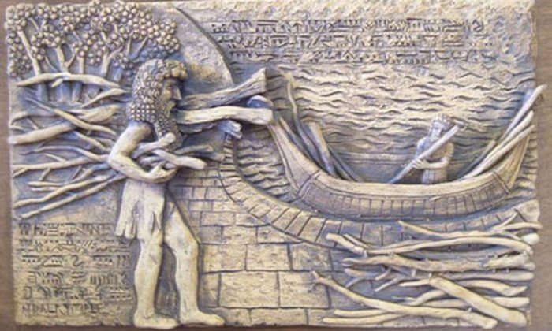
Utnapishtim and the Flood

Slide 61
Sumerian & Hebrew Floods
Humans destroyed because they are sinful in both
Noah and Utnapishtim told to build boats in both
Hebrew flood = 40 days; Sumerian = 6 days
Noah sends a raven and three doves to find land
Utnapishtim sends a raven, a swallow, and a dove
Noah and his family are saved because they are good
The Utnapishtims are saved because Ea likes them
The Sumerian gods are very angry after the flood

Slide 62
Utnapishtim’s Dream
In those days the world teemed, the people multiplied, the world bellowed like a wild bull, and the great god was aroused by the clamor. Enlil heard the clamour and he said to the gods in council, "The uproar of mankind is intolerable and sleep is no longer possible by reason of the babel." So the gods agreed to exterminate mankind. Enlil did this, but Ea because of his oath warned me in a dream. He whispered their words to my house of reeds, "Reed-house, reed-house! Wall, o wall, hearken reed-house, wall reflect; o man of Shurrupak, son of Ubara-Tutu; tear down your house and build a boat, abandon possessions and look for life, despise worldly goods and save your soul!

Slide 63
The Great Flood
One whole day the tempest raged, gathering fury as it went, it poured over the people like the tides of battle; a man could not see his brother nor the people be seen from heaven. Even the gods were terrified at the flood, they fled to the firmament of Anu; they crouched against the walls, cowering like curs. Then Ishtar the Queen of Heaven cried out like a woman in travail: "Alas the days of old are turned to dust because I commanded evil; why did I command thus evil in the council of all the gods? I commanded wars to destroy the people, but are they not my people, for I brought them forth? Now like the spawn of fish they float in the ocean." The great gods of heaven and of hell wept, they covered their mouths. For six days and six nights the winds blew, torrent and tempest and flood overwhelmed the world.

Slide 64
Utnapishtim explains
Utuapishtim said, ‘There is no permanence. Do we build a house to stand for ever, do we seal a contract to hold for all time? Do brothers divide an inheritance to keep for ever, does the flood-time of rivers endure? It is only the nymph of the dragon-fly who sheds her larva and sees the sun in his glory. From the days of old there is no permanence. The sleeping and the dead, how alike they are, they are like a painted death. What is there between the master and the servant when both have fulfilled their doom? When the Anunnaki, the judges, come together, and Mammetun the mother of destinies, together they decree the fates of men. Life and death they allot but the day of death they do not disclose.'

Slide 65
Enki (Ea) berates Enlil
‘When Enlil had come, when he saw the boat, he was wrath and swelled with anger at the gods, the host of heaven, "Has any of these mortals escaped? Not one was to have survived the destruction." Then the god of the wells and canals Ninurta opened his mouth and said to the warrior Enlil, "Who is there of the gods that can devise without Ea? It is Ea alone who knows all things." Then Ea opened his mouth and spoke to warrior Enlil, "Wisest of gods, hero Enlil, how could you so senselessly bring down the flood?

Slide 66
Mr. & Mrs. Utnapishtim
It was not I that revealed the secret of the gods; the wise man learned it in a dream. Now take your counsel what shall be done with him."
‘Then Enlil went up into the boat, he took me by the hand and my wife and made us enter the boat and kneel down on either side, he standing between us. He touched our foreheads to bless us saying, "In time past Utnapishtim was a mortal man; henceforth he and his wife shall live in the distance at the mouth of the rivers." Thus it was that the gods took me and placed me here to live in the distance, at the mouth of the rivers.'

Slide 67
Mr. and Mrs. Utnapishtim

Slide 68
Gilgamesh’s Epic Fail
But while Gilgamesh sat there resting on his haunches, a mist of sleep like soft wool teased from the fleece drifted over him, and Utnapishtim said to his wife, ‘Look at him now, the strong man who would have everlasting life, even now the mists of sleep are drifting over him.' His wife replied, ‘Touch the man to wake him, so that he may return to his own land in peace, going back through the gate by which he came.' Utnapishtim said to his wife, ‘All men are deceivers, even you he will attempt to deceive; therefore bake loaves of bread, each day one loaf, and put it beside his head; and make a mark on the wall to number the days he has slept.

Slide 69
The Old Men Are Young Again
Gilgamesh saw a well of cool water and he went down and bathed; but deep in the pool there was lying a serpent, and the serpent sensed the sweetness of the flower. It rose out of the water and snatched it away, and immediately it sloughed its skin and returned to the well. Then Gilgamesh sat down and wept, the tears ran down his face, and he took the hand of Urshanabi; ‘O Urshanabi, was it for this that I toiled with my hands, is it for this I have wrung out my heart's blood? For myself I have gained nothing; not I, but the beast of the earth has joy of it now. Already the stream has carried it twenty leagues back to the channels where I found it. I found a sign and now I have lost it. Let us leave the boat on the bank and go.'

Slide 70
Passion for Public Affairs
Gilgamesh has learned he is mortal, can not be young again
Sadly retraces his steps with Urshanabi back to Uruk
Our “Gilgamesh Epic” is the story he shares with his people
What he learns on his journeys is acquiring CULTURAL COMPETENCE and shows he has grown up
His growing up shows he will practice ETHICAL LEADERSHIP in the future as King of Uruk
His sharing the story is COMMUNITY ENGAGEMENT because he is helping his people to live better lives.
It’s also a seriously good story

Slide 71
TOPOLOGY of the Katabasis
Liminal Experience – gate, door, tunnel: point of no return
Long, dangerous journey – dark, lonely (if no guide)
May be a guide who shows the hero the way
Fetid, stinky waters, often patrolled by a surly boatman
Scary monsters who could hurt the hero
Dead people; can either have bodies or just be souls
Sometimes (but not always) punishment is handed out
Dead wisdom figures who can give the hero guidance
Hero reflects on life and public affairs
Hero makes the long trip back.
Hero passes through the Liminal Gate = rebirth?

Slide 72
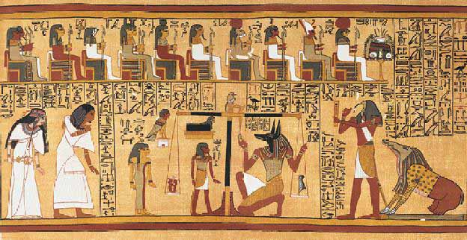
Egyptian Afterlife

Slide 73
Egyptian Afterlife
Egyptian culture flourished at the same time as the Sumerian
Egyptians had better climate, richer soil
Egyptians had a kinder, gentler Weltanschauung
Believed that life was to be enjoyed
Believed in deities that cared about humans
Believed that people had souls
Believed that people ought to behave morally
Believed in eternal punishment/reward
Heart is weighed against the feather of Ma’at (truth)
You win – you party with Ra forever
You lose – your soul and your body are devoured

Slide 74
Anubis P. Hughes

Slide 75
Humans and Deities
Weltanschauung – world view of a people or civilization
Varies by 1) time, 2) location, 3) status
Mythology greatly helps in determining Weltanschauung
Sumerians had a depressing one, Egyptians a happy one
What is the purpose of life?
Do the deities care about human beings?
Do the deities practice cultural competence?
Do the deities practice ethical leadership?
Do the deities practice community engagement?

