Slide 1
THE FROGS
A Public Affairs katabasis by
ARISTOPHANES

Slide 2
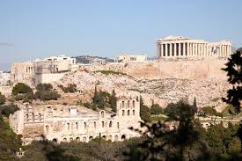
ATHENS

Slide 3
DEMOCRACY
Greece was usually ruled by kings or tyrants. Not all of them were totally bad, but still… Democracy (rule of the demos) gradually developed in Athens after 600 BC. Citizenship was determined not by family but by districts called “demes.” Military-trained adult males could vote. Far more opportunities for citizen participation than today. Anyone can propose a law, start a trial, attend assembly or not. Free Athenian males were not subjects of a king, but citizens of a truly democratic and extremely powerful city-state.

Slide 4
ATHENS VS. SPARTA
The Peloponnesian War between the empires of Athens and Sparta lasted from 431 to 404 BC. There were truces from time to time, but the suffering was terrible. The ambitious Athenian attack on Sicily of 415 BC was doomed by the defection of its commander, Alcibiades. The Athenian forces were destroyed within two years. The Spartans had the upper hand for the rest of the war, and eventually conquered Athens.

Slide 5
The Peloponnesian War

Slide 6
Three hermai

Slide 7
A TIGHT SPOT
The year is 405 BC. The ancient Greek city of Athens is in a tight spot. The Peloponnesian War is going very badly for Athens. The Spartans have just defeated them (406) in the naval battle of Arginusae. They have long since taken over all of Attica, forcing all the farmers to live within the city of Athens, and are now just about up to the gates of Athens. Food is short and disease is rampant. Within the next year Spartans will be roaming the streets of Athens, trying to turn it into a parking lot. It’s only a matter of time. The Athenians desperately need… a laugh.

Slide 8
ARISTOPHANES
Aristophanes (448 BC-388 BC) , the Greek comedic playwright, was the funniest human being who ever lived. But he did more than just make people laugh. He considered himself a teacher (didaskalos) of his Athenian audiences, commenting upon and forcing them to think seriously about – gulp! – public affairs issues.
In The Frogs, Aristophanes takes up two important points: 1) the importance of Arts and Humanities to public life, and 2) ethical leadership.

Slide 9
HVMANITIES
The humanities are disciplines which study the human condition – that is, those behaviors and traits which distinguish us from the animals. The Humanities seldom yield the intellectual certainty or the financial benefits which other majors across campus can promise. Still, we humans cannot become what we dream of becoming unless we already know who and what we already are, which is impossible without the knowledge of who and what we have already been.

Slide 10
ARTS
The humanities cannot be explored through scholarship alone. Sometimes the Humanities have to be sung, or danced, or painted or sculpted – or some combination of the above. We will see that Athens does not so much need a professor as it needs a tragic playwright who can give the Athenian people the spiritual strength they will need for the exceedingly difficult times in Athens’s immediate future. Even Aristophanes himself can’t find much to laugh about in that picture.

Slide 11
GREEK THEATER

Slide 12
ORIGINS OF DRAMA
The ancient Greeks hardly invented drama. But their version grew out of performing choral odes, or comedic improvisation at an Athenian spring festival called the Dionysia, held to honor Dionysus, the god of wine and festivity (and fertility).

Slide 13
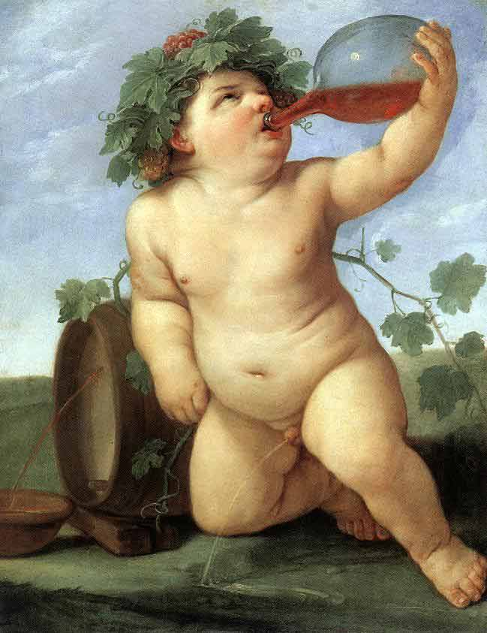
Baby Dionysus

Slide 14
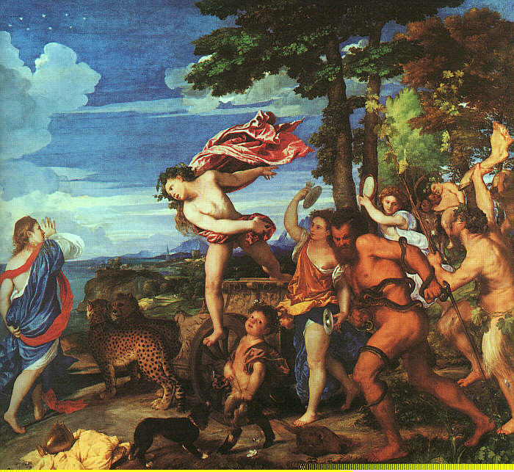
Adult Dionysus

Slide 15
Dionysus
Birth from Zeus’s thigh after Semele’s unfortunate death
Raised by magical goat named Amalthea
Parties with nymphs (nymphomania)
Parties with satyrs (satyriasis)
Drinking buddies: Pan, Silenus
Externalization of the power of wine
Fertility god with his own spring festival
Has his own mystery religion, in which he is a BAMF

Slide 16
His Royal Badness (1958-2016)

Slide 17
ORIGINS OF DRAMA
The Dionysian festival evolved over time.Gradually, the ‘hypocrites’ or actor took precedence over the singing and dancing and joking. The odes and freelance joking and exuberant dancing took second place to concerns such as plot, character, and didactic messages from the author. The serious branch became tragedy and the less serious branch became comedy.

Slide 18
GREEK THEATER

Slide 19
Poet as TEACHER
Comedic and tragic poets composed plays both to entertain and to inform their audiences. Sometimes the dramas spoke exclusively to issues of private life – such as Euripides’s Phaedra, which explores the theme of female sexual desire. Most often, though, the drama touches on one or another aspect of… wait for it… PUBLIC AFFAIRS.

Slide 20
Teacher as POET

Slide 21
COMEDY
Rightly judged the lesser of the two dramatic arts. It’s so easy to laugh, it’s so easy to hate. It takes guts to be gentle and kind. Laughter is in itself an invaluable defense mechanism: Zeus only knows that the Athenians needed a few laughs in 405 BC. But one can not construct an actual value system on jokes and general buffoonery – no matter how dearly the Deluxe Yours Truly adores jokes and general buffoonery. By demanding a tragic poet, Aristophanes implicitly acknowledges his limitations as a teacher of the Athenian people.

Slide 22
TRAGEDY
Tragedy is drama about human beings being forced to make life changing decisions based on incomplete information which they are bound to misinterpret anyway, seeing that they are only human beings equipped with human brains. The ancient Greeks did not invent situations like this. They just developed a dramatic form which handled these situations so well that everything that came afterward was more or less a refinement.

Slide 23
ARISTOTLE
Poetry now diverged in two directions, according to the individual character of the writers. The graver spirits imitated noble actions, and the actions of good men. The more trivial sort imitated the actions of meaner persons, at first composing satires, as the former did hymns to the gods and the praises of famous men. A poem of the satirical kind cannot indeed be put down to any author earlier than Homer; though many such writers probably there were. But from Homer onward, instances can be cited—his own Margites, for example, and other similar compositions. The appropriate meter was also here introduced; hence the measure is still called the iambic or lampooning measure, being that in which people lampooned one another. Thus the older poets were distinguished as writers of heroic or of lampooning verse.

Slide 24
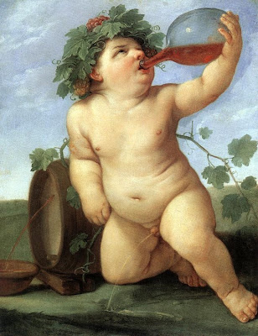
DIONYSUS

Slide 25
DIONYSUS
Dionysus is an unlikely Greek god; both son and daughter of Zeus and just about always drunk. He is also somewhat of what we would today call a “gender-bender.” But he is also connected with his own mystery religion, as well as with Athens’s dramatic festivals. More than any other Greek god, he can be a figure of ridicule, as he is in the Frogs. But as Euripides shows in the Bacchae, he is also a powerful deity who is very jealous of his personal honor.

Slide 26
HERACLES

Slide 27
HERACLES

Slide 28
HERACLES
Heracles (or Hercules) is the Greco-Roman world’s equivalent of the great Chuck Norris. He is such a BAMF that it is, literally, funny. His own katabasis involved him going down to Hades and stealing the three headed dog Cerberus. His other adventures there are pretty much Aristophanes’s inventions. But at the same time, they are quite believable. He is pretty much a dramatic foil for his delicate half brother.

Slide 29
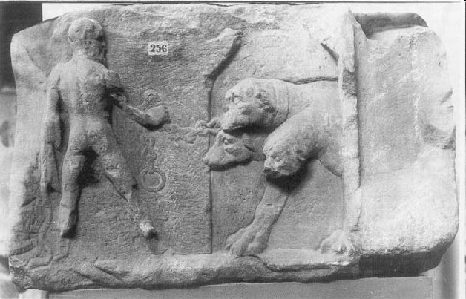
Heracles and Cerberus

Slide 30
KATABASIS
Gilgamesh (2500 BC)
Odyssey (800 BC)
Hymn to Persephone (800 BC)
Frogs (405 BC)
Republic (400 BC)
Aeneid (25 BC)
Golden Ass (125 AD)
Inferno (1300 AD)

Slide 31
KATABASIS
This play is very much a katabasis story. Dionysus must descend, have a liminal experience, work with a guide, experience what happens in the afterlife, and acquire wisdom. Like Gilgamesh, Dionysus becomes a culture hero and acquires the coveted Community Engagement badge by sharing with the people what he has learned. In this case, it is by first selecting and then bringing back to Athens the tragedic poet it needs in this tragic time – Aeschylus.

Slide 32
AESCHYLVS

Slide 33
AESCHYLVS
Old-school tragedian who believed that Zeus really was the sole source of justice on earth. Loved big long words and characters who just stood around and talked. Humans are always far, far inferior to the gods and should always know their place. Women and barbarians should know their places too. Very skeptical of anything new or innovative and very resistant to change.

Slide 34
AESCHYLVS

Slide 35
AESCHYLVS
How the Achaeans’ twin-throned power, youth of Greece
Tophlatto-thratto-phlilatto-thrat
sent by the Sphinx, presiding she dog of unlucky days
Tophlatto-thratto-phlilatto-thrat
swooping bird with spear and with avenging hand
Tophlatto-thratto-phlilatto-thrat
granting eager sky-diving dogs to light upon
Tophlatto-thratto-phlilatto-thrat—
the allied force assembled to assault great Ajax
Tophlatto-thratto-phlilatto-thrat.

Slide 36
EURIPIDES

Slide 37
EURIPIDES
New-wave, trendy, hipster tragedic poet. Interested in new ideas like philosophy and rhetoric. Wants to portray people and even gods and even women as they really are, and is always willing to take chances. He portrays the gods as powerful but ultimately flawed human beings who cause more hurt because of their divinity. Very scornful of old codgers like Aeschylus and their old school approach to modern problems.

Slide 38
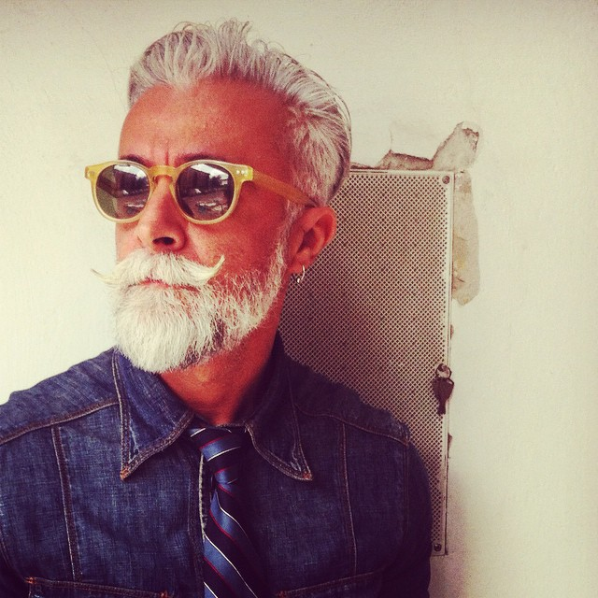
EURIPIDES

Slide 39
EURIPIDES
You chattering kingfishers in the sea in the ever-flowing waves who wet wing-tops with water drops like so much dripping dew, and spiders underneath the roof, your fingers wi-i-i-i-i-i-i-i-inding threads for stretching on the loom, work of tuneful weaving rods, where dolphins, those flute-loving fish, leap at the blue-peaked prows, at oracles and stadiums.
I joy in early budding vines,
the spiral cluster, killing pain.
Oh my child, hurl your arms about me . . .
You see this foot?

Slide 40
Trailer for THE FROGS
Democratic nature of attending the plays
Made fun of the gods
Greek beliefs more ritual than what we consider religion
Not particularly spiritual
Gradual turn to mystery religions (like Dionysus)
https://www.youtube.com/watch?v=vLZnlC0iSq8

Slide 41
TOPOLOGY
Difficult journey down
Annoying sidekick Xanthias
Liminal experience
Body of putrid water
No sacrificed man
Surly boatman Charon
Wisdom figures
Cerberus the doggy, Aeacus the judge
Other monsters like Empusa
Happy and unhappy campers

Slide 42
The usual stuff
XANTHIAS: Look, master, an audience! Shouldn’t I say something?
Tell them one of those jokes they always fall for?
DIONYSUS: Oh, all right—say what you like. Only no jokes
about how you’re dying to piss. I can’t stand those—
they’re all so stale.
XANTHIAS: What about my other jokes?
DIONYSUS: Go ahead—just nothing about your bladder,
about how it’s going to burst.
XANTHIAS: What? You mean I can’t tell
that really funny one . . .
DIONYSUS: I suppose so—
but don’t say anything about the bit.
XANTHIAS: What bit?
DIONYSUS: The bit about how you need to shift your load
to take a piss.
XANTHIAS: Not even this one—
"Here I am transporting such a load
if I get no relief I may explode."
DIONYSUS: Please, please, don't say that one—
not unless I’m sick and need to throw up.

Slide 43
Desperately Seeking Euripides
HERCULES: Tell me, my little brother, what’s it like?
DIONYSUS I can’t explain. [60] But I’ll try to show you by analogy. Have you ever had a craving for some stew?
HERCULES: For stew? In my life maybe ten thousand times.
DIONYSUS: Is that explanation clear enough to you? Or shall I try some other way?
HERCULES: Not about stew! That I understand completely.
DIONYSUS: Well then, 80 that’s how much I’m eaten up with my desire for Euripides.
HERCULES: Even when he’s dead?
DIONYSUS: So no one’s going to talk me out of it— I have to find him.
HERCULES: Right down in Hell?
DIONYSUS: Or even lower, by god, if there’s such a place. [70]
HERCULES: What’s the point of that?
DIONYSUS: I need a clever poet. There’s none around. The ones we’ve got are all so lousy.

Slide 44
Highway to Hell
DIONYSUS: That’s the reason I’ve come here and dressed like you—so you can fill me in, in case I need to know, about this place— who welcomed you down here, who'd you meet 130 [110] that time you went down after Cerberus. Tell me about the harbours, resting places, bakeries and brothels, water fountains, the cities, highways, all the detours, the local customs and the fine hotels, the ones with fewest bugs.
XANTHIAS: Still no word of me.
HERCULES: Oh you valiant heart! Are you man enough to venture down below?
DIONYSUS: Forget my courage. Show me the highway, the shortest one there is, that takes me directly down to Hades. 140 Don’t prattle on about the temperature— and say it's way too hot or cold for me.
HERCULES: Let’s see . . . what should I mention first of all? Which one? Hmmm. You could try a stool and rope— you could just hang yourself.

Slide 45
The Initiates
HERCULES: Next the breath of flutes will sound around you. 180 You’ll see the finest light, just like in Athens, and myrtle groves, with happy men and women gathered there to celebrate and clap their hands.
DIONYSUS: So who are they?
HERCULES: Those are the initiates, the ones who celebrate the mysteries.
XANTHIAS: Then, by god, in these mysteries I play the ass. I’ll not stand for this a moment longer. [160]
[Xanthias dismounts and starts to unload the baggage he has been carrying]
HERCULES: Those ones will tell you all you need to know. These initiates live closest to the road which takes you to the doors of Pluto’s place. 190 And so, my brother, I bid you fond farewell.
DIONYSUS: Good bye—god keep you healthy, too.

Slide 46
Charon

Slide 47
Charon
CHARON: Ahoy there! Coming alongside. [180]
XANTHIAS: What’s this?
DIONYSUS: This? 210 By god, it’s the lake Hercules talked about. And I see the boat . . .
XANTHIAS: You’re right. Thanks to Poseidon. This must be Charon.
DIONYSUS: Ahoy there, Charon . . . Greetings, Charon . . . Charon, halloooo!
CHARON: Who’s seeks a rest from work and trouble? Who’s heading for Fields of Forgetfulness, Never-never land, the Cerberians, the Ravens, and Tartarus.
DIONYSUS: That’s me.
CHARON: Then jump aboard.
DIONYSUS: Where do you put in? The Ravens? Is that a stop?
CHARON: Yes, by god— 220 a special stop just for you. Get in.
DIONYSUS: [to Xanthias] All right, my lad, hop in.
CHARON: I won’t take the slave— [190] not unless he fought at sea to save his skin.

Slide 48
Empusa

Slide 49
Empusa
XANTHIAS: Of course you are. What’s that? I hear a noise.
DIONYSUS: What? Where is it?
XANTHIAS: Behind us.
DIONYSUS: [pushing Xanthias] Get behind me.
XANTHIAS: No, it’s up ahead.
DIONYSUS: [pushing Xanthias again] You get in front.
XANTHIAS: My god! Now I see it. Ooooh, a monstrous beast!
DIONYSUS: [cowering behind Xanthias] What’s it like?
XANTHIAS: It's weird—all sorts of shapes. Now it’s an ox—no, no, a jackass— now it’s a woman—what a gorgeous babe! [290]
DIONYSUS: Where is she? I’ll go say hello.
XANTHIAS: Hold on a minute! 330 She’s not a woman any more. Now she’s a bitch!
DIONYSUS: [terrified] It’s Empusa!!*
XANTHIAS: Her whole face is on fire!
DIONYSUS: Her legs—does she have one made of bronze?
XANTHIAS: Yes. By Poseidon, yes. The other’s made of cow shit. And that’s no lie.

Slide 50
Athenian Invective
CHORUS OF INITIATES: Would you like to join us now in making fun of Archedemos, who at seven years old was toothless, no genuine Athenian teeth.* And now he plays big shot in politics 480 among the dead above—the best there is at double dealing and corruption. And Cleisthenes, I hear, still picks his ass and rips his cheeks apart among the tombstones, blubbering over his dead lover Sabinos. And Callias, they say, son of the man who used to bugger his own horses, has fights at sea, naval entanglements, his arse hole covered by a lion skin. [430]

Slide 51
Minos, Rhadamanthus, Aeacus

Slide 52
AEACUS
Oh you abominable, you shameless reckless wretch— villain, villain, damned smiling villain— the man who made off with Cerberus my dog! You grabbed him by the throat and throttled him, then took off on the run, while I stood guard. Now you’re caught—black-hearted Stygian rocks, and blood-dripping peaks of Acheron will hold you down. Roaming hounds of Cocytus will gnaw your guts to bits—Echidna, too, and she’s a hundred heads. The Tartesian eel will chew your lungs, your kidneys bleed from entrails Tithrasian Gorgons rip apart. I’ll set out hot foot in their direction.

Slide 53
The Whipping Scene
AEACUS: No. I’ll torture him right here, so he’ll confess before your very eyes.
[To Dionysus]
Put down that load. And hurry up. Don’t give me any lies.
DIONYSUS: I here proclaim no one should torture me. I’m an immortal god. If you do so, you’ll have yourself to blame.
AEACUS: What are you saying? [630]
DIONYSUS: I'm saying I'm Dionysus, an immortal, a son of Zeus—this man here’s a slave.
AEACUS: You hear that?
XANTHIAS: I hear what he claims to be— all the more good reason for flogging him. 710 If he’s a god, he won’t feel a thing.
DIONYSUS: You’re right. And since you also claim that you’re a god, why don’t you take as many blows as me?
XANTHIAS: Fair enough. Then whichever of the two you see bursting into tears or flinching as he’s whipped—you’ll know he’s not the god.
AEACUS: You’re a fine gentleman—that’s obvious. You stand for justice. All right—the two of you, take off your clothes.

Slide 54
FINAL CHORUS
This city, it often seems to me treats our best and worthiest citizens the way it does our old silver coins, our new gold ones, as well.* This money was never counterfeit—no, these coins appeared to be the finest coins of all, the only ones which bore the proper stamp. Everywhere among barbarians and Greeks they stood the test. But these we do not use. Instead we have our debased coins of bronze, 810 poorly struck some days ago or yesterday.
That’s how we treat our finest citizens, the nobly born, our righteous men, our best and brightest, the ones well trained in music and the dance at the palaestra.* Instead we use foreign bronze for everything— useless men from useless fathers, red heads,* [730] men who’ve come here very recently— the sort the city at its most negligent would never use in earlier days, 820 not even as a scapegoat.* But now, you silly fools, it’s time to change your ways.

Slide 55
Euripides Goes to Hell
SERVANT: There’s a custom in these parts that in the arts—the great and worthy ones— the best man in his special area 860 gets all his meals for free at City Hall in the chair of honour next to Pluto . . .
XANTHIAS: I get it.
SERVANT: . . . until someone else arrives who has more skill than he does. At that point, he has to yield his place.
XANTHIAS: But why would this get Aeschylus upset?
SERVANT: Well, he had his chair, the one for tragedy, as the finest in that form of art.
XANTHIAS: Who’s got it now? [770]
SERVANT: When Euripides came down to Hades he started showing off his rhetoric 870 to thieves, bag snatchers, parricides, to all the ones who steal—and here in Hades that’s most of us. Well, they listened to him, heard his counter-arguments, his twists and turns, and went nuts for him. So they then proposed he was the wisest of all men. With that, Euripides got so worked up he claimed that chair where Aeschylus sits down.

Slide 56
Pre-Contest
EURIPIDES: I’ll not give up the chair—no more advice. [830] I say I’m better in poetic skill.
DIONYSUS: Why are you silent, Aeschylus? You hear the claim he’s made.
EURIPIDES: His high-and-mighty pose— he does that at the start of every play, some hocus-pocus for his tragedies.
DIONYSUS: My dear fellow, that’s too much big talk.
EURIPIDES: I know the man—and for a long time now I’ve studied him. He makes crude characters with stubborn tongues. As for his own mouth, 950 it’s unrestrained and uncontrolled, unlocked, no proper discourse, bombastiloquent.
AESCHYLUS: Is that so, you garden-goddess child? [840] You say that of me, you gossip-monger, a beggar’s poet who picks and stitches rags? You’ll regret those words.
DIONYSUS: Hey, Aeschylus, hold on. Don’t fire up your heart so angrily, with such ill will.
AESCHYLUS: No, no, I won’t hold back, ’til I’ve exposed the man and clearly proved this cripples’ poet is a boastful fool . . . 960

Slide 57
Euripides
EURIPIDES: I wasn’t fool enough to put in there whatever stuff I chanced upon, or add just anything I found. The character who came out first would right away explain 1090 on my behalf the background of the play.
DIONYSUS: Which was better than your own, by god.
EURIPIDES: After those opening words I never set anything superfluous in the play. No. For me the woman spoke—so did the slave, the master, maiden, the old woman, too.
AESCHYLUS: Well, shouldn’t you be killed for daring this?
EURIPIDES: By Apollo, no. I was doing my work the democratic way.
DIONYSUS: [to Euripides] My dear chap, I’d forget that—from your point of view 1100 that’s not the best line you could take.*
EURIPIDES: [indicating the audience] I taught these people here to speak their minds . . .
AESCHYLUS: I say so too—and before doing that I wish you’d split apart—right down the middle.
EURIPIDES: . . . introducing subtle rules for words, for verses nicely trimmed. I taught them to think, to see, to understand, to love new twists and double dealing, to suspect the worst, to be too smart in everything . . .

Slide 58
Aeschylus
AESCHYLUS: Consider first the nature of the men he got from me— were they not nobly born and six feet tall? There were no runaways, no layabouts, no scoundrels like today, no ne’er-do-wells. No. Those men breathed spears and javelins, white-crested helmets, coronets, and greaves, with passions wrapped in seven oxhide folds.
EURIPIDES: This is getting bad.
DIONYSUS: His helmet-making wears me down.
EURIPIDES: What exactly did you do 1190 to make these men so noble?
DIONYSUS: Aeschylus, speak up. Forget your pride and stubbornness. [1020]
AESCHYLUS: I wrote a play brim full of war god Ares.
DIONYSUS: Which one was that?
AESCHYLUS: My Seven Against Thebes. Every man who saw it fell in love with war.
DIONYSUS: But you did something bad there with the Thebans— you made them more courageous in the war. For that you should be spanked.

Slide 59
THE BIG QVESTION
PLUTO: Take one— whichever one you wish, so you don’t leave and make your trip in vain.
DIONYSUS: May gods bless you. Look, how ’bout this—I came here for a poet. 1680
EURIPIDES: What for?
DIONYSUS: So I might save our city and let it keep its choruses. Therefore, whichever one of you will give our state [1420] the best advice, well, that’s the man I’ll take. So first, a question for each one of you— What’s your view of Alcibiades? This issue plagues our city.
EURIPIDES: The people there— what do they think of him?
DIONYSUS: What do they think? The city yearns for him, but hates him, too, yet wants him back. But you two, tell me this— 1690 what’s your sense of him?
EURIPIDES: I hate a citizen who helps his native land by seeming slow, but then will quickly inflict injuries which profit him but give our city nothing.
DIONYSUS: By Poseidon, that’s well said. Now, Aeschylus, [1430] what’s your view on this?
AESCHYLUS: The wisest thing is not to rear a lion cub inside the city, but if that's what the citizens have done, we’d must adjust ourselves to fit its ways.

Slide 60
ALCIBIADES

Slide 61
ALCIBIADES
Alcibiades was a close friend of Socrates. When commanding the Sicilian Expedition in 415 BC, he had a herm-breaking party on the evening of departure. As a result, he defected to the Spartan side with all the Athenians’ plans. After getting the King of Sparta’s wife pregnant, he moved to Persia, where he prepared an invasion force against Athens. After a government change in 411 BC, Alcibiades was recalled to Athens, but he did not arrive until 407. He fought a couple of victorious land battles, but he lost the naval battle of Notium in 406. Afterward, he went into self-imposed exile.

Slide 62
PELOPONNESIAN WAR

Slide 63
PELOPONNESIAN WAR, THE

Slide 64
THE WINNER

Slide 65
CONGRATULATIONS
Blest is the man with keen intelligence—
We learn this truth in many ways
Once he’s shown his own good sense he goes back home again.
He brings our citizens good things
as well as family and friends, with his perceptive mind,
So to be truly civilized, don’t sit by Socrates and chat
or cast the Muses’ work aside,
forgetting the most vital skills of writing tragedies.
Wasting time with pompous words,
while idly scratching verbal bits—
that suits a man who’s lost his wits!

Slide 66
FAREWELL FROM HADES
So now, farewell, Aeschylus—go, save our city with your noble thoughts, and educate our fools—we have so many. Take this sword, hand it to Cleophon. Present this rope to tax collector Myrmex and his colleague Nicomachos— this hemlock give to Archenomos. Tell them to come here fast without delay.

Slide 67
THAT’S ALL!

Slide 68
THAT’S ALL!
First, all you spirits underneath the ground,
let’s bid our poet here a fond farewell,
as he goes upward to the light. To the city
grant worthy thoughts of every excellence.
Then we could put an end to our great pain,
the harmful clash of arms Let Cleophon—
and all those keen to fight—war on their enemy in their ancestral fields, on their own property.

