Slide 1
Baucis and Philemon
By: Nate Allen

Slide 2
Lelex’ Story
Jupiter and Mercury visit a small village in the Phrygian hills
They try to find a place to rest, but everyone shut them out, except an old couple; Baucis and Philemon
This poor old couple offered everything that they had to this pair of strangers

Slide 3
Royal Guests
As dinner proceeded, Baucis and Philemon noticed that the wine and food never seemed to decrease in quantity
At this time Jupiter and Mercury revealed themselves to the couple
When Baucis and Philemon see who their guests really are they pray for forgiveness for the quality of the things that they had to offer the gods

Slide 4
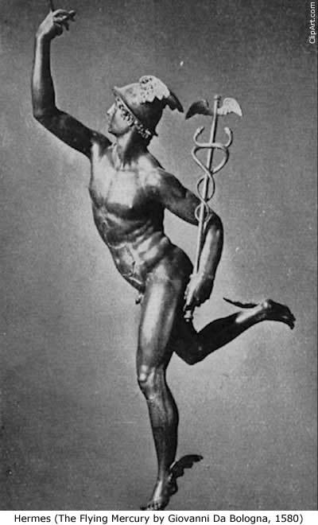

Slide 5
Punishment and Reward
The gods, due to the cruelity of the villigers to two people in need, decide to punish the village by flooding it
They only ones spared this fate were Baucis and Philemon, who because of their kindness were granted one favor from the gods
The house that the couple lived in was transformed into a temple, and for the favor, Baucis and Philemon asked to not be able to die before the other, and to be priests of the temple until the end

Slide 6
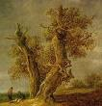
The Transformation
Baucis and Philemon lived a long life together as priests of the temple, until their time was over
However instead of dying, the couple transformed into trees, one an oak and the other a linden
So close these trees grew that they were one, as they had been in life

