Slide 1
Book 7
The Odyssey

Slide 2
Odysseus had been praying to Athene at her grove. She heard him but feared her brother if she did anything about Odysseus’ prayers.
Nausicaa goes back to her palace where her servent lays out her food and takes her clothes.
Odysseus sets off for the city, and Athene places a mist around him so that no Phaeacian will come to ask questions. When he reaches the city gates, Athene turns herself into a little girl carrying a water pitcher, and Odysseus asks her to lead him to Alcinoos’ palace.

Slide 3
Athene agrees to lead him to the palace, but she warns him not to look or talk to any Phaeacian, as they do not welcome strangers.
When they get to the house, Athene tells Odysseus a little about Alcinoos’ lineage, and about his wife, Arete, whom people look upon as a god.
As he reaches the threshold, Odysseus ponders over the house, and he notices how fine everything inside is. There are even immortal silver and bronze dogs inside made by Hephaistos himself.

Slide 4
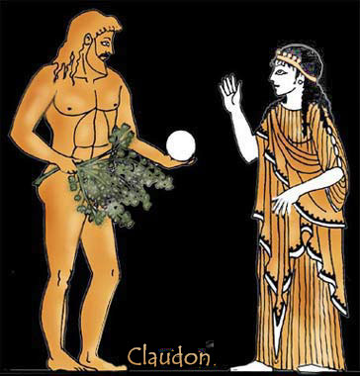
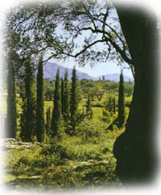
Odysseus meeting Nausicaa
Phaeacia

Slide 5
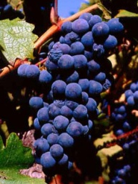
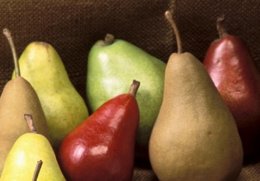
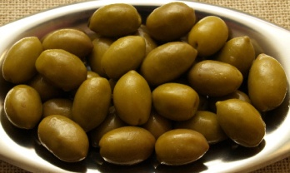
As he stands on the threshold, he can see the magnificent gardens that the gods have blessed Alcinoos with. They are filled with grapes and apples, pears and olives, and two streams, one of which spreads through the gardens and the other runs in front of Alcinoos’ house and the townspeople draw their water from it.
Odysseus goes over the threshold and walks through the hall, still shrouded in the Athene’s mist.

Slide 6
He throws himself down at Arete’s knees and pleads to her and Alcinoos. He asks for an escort so that he can go home. He then goes and sits on the hearth, and Echeneus spoke up and said that Odysseus should not be sitting on the hearth, but that he should be given a silver studded chair, with food and fresh wine.
After they have all had a bunch of wine and eaten a lot of food, Alcinoos tells them all to go home and sleep, and at dawn they will summon more elders and have a convoy to take Odysseus home.

Slide 7
Before they leave, Alcinoos wonders whether Odysseus may be a god in disguise, as the gods have never disguised themselves before. Odysseus responds that he is not a god, but that he has been plagued with woes by the gods. He asks that he be able to eat, for “nothing is more shameless than a hateful belly.”
After everyone has left, Arete realizes that she recognizes the clothes Odysseus is wearing, and questions where he got them.

Slide 8
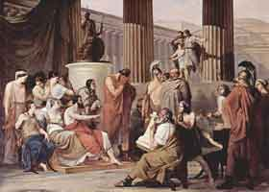
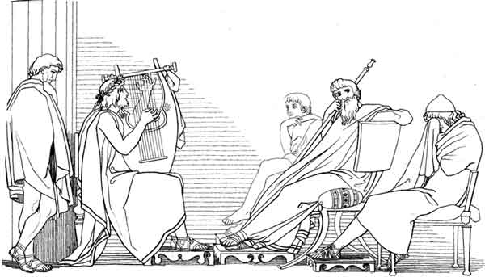
Odysseus and Alcinoos at the feast

Slide 9
Odysseus responds to Arete’s question that Zeus had sunk his ship with a thunderbolt and that his crew had perished. He alone grabbed hold of a piece of the wrecked ship and floated along for nine days. On the tenth night he passed by Calypso’s island, and she took him in.
He said that she took care of him and promised to make him immortal, but that for seven years he waited because she had not persuaded him. On the eighth year she sent him away, “because of a message from Zeus, or her mind had changed.”

Slide 10
Odysseus says that Calypso gave him a strong raft and gave him wine and bread, and sent him off on the sea. On the eighteenth day he saw the mountains of Phaeacia. However, Poseidon caused a great storm to break apart his raft, and Odysseus swam all the way to a river.
He says that he went away from the river to the bushes to sleep, and when he awoke saw Nausicaa.
Alcinoos says that Nausicaa should have brought Odysseus here herself.

Slide 11
Odysseus replies that Nausicaa did want him to follow along, but he declined because he was afraid that Alcinoos would be offended by seeing him.
Alcinoos tells him that he could call Odysseus his son-in-law if he stayed, but that he will give Odysseus a convoy for a day, for they will take him to Ithaca and back with no problem in that time.
The servents made a bed for Odysseus, and there he slept until the following dawn.

Slide 12
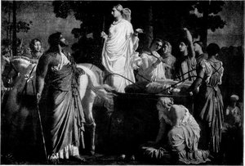
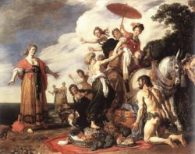
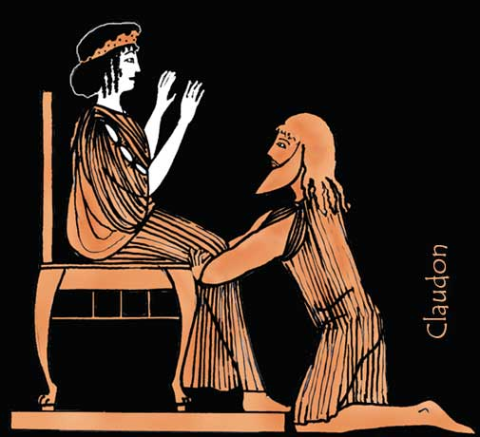
Odysseus and Nausicaa meeting
Odysseus begging for help

