Slide 1
Pygmalion
By: Kasey Kelm

Slide 2
Characters
Pygmalion – protagonist
Venus – Goddess of Love
Ivory woman – woman of ivory

Slide 3
The Story
Pygmalion was a very talented sculptor who was shocked by the way that females on his island behaved.
He made a sculpture out of ivory, and it was more beautiful than any real girl. Pygmalion fell in love with his own sculpture.

Slide 4
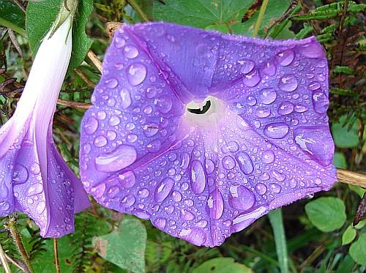
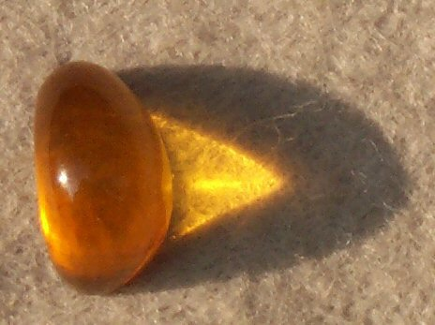
He would move his hands over her, and dressed her, and gave her presents of flowers and amber.
He even went so far as to put her on his bed, with a pillow under her head as though she could feel it.

Slide 5
Venus’ holiday began, and people were having a festival in her honor.
There were snow white heifers with gold on their horns at the alters, and Pygmalion went timidly up to one.
He made an offering, and prayed, “If you can give all things, O gods, I pray my wife be one like my ivory girl.”
Pygmalion almost said, “I pray my wife be my ivory girl” but refrained from saying.

Slide 6
Venus understood his intention and showed that she had heard, with the flame on the alter jumping three times, and Pygmalion returned to his house with his ‘ivory girl’.
He lay beside her and kissed her, and she seemed to glow. He kissed her again, and felt the ivory begin to soften.
He wonders if this is really happening and continues kissing the statue.

Slide 7
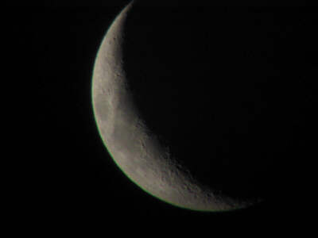
The statue has come to life, and Pygmalion praises Venus again and again.
The ivory girl opens her eyes and when they meet Pygmalion’s, Venus blesses their marriage.
Nine moons later, they have a daughter named Paphos, after whom the island is named.

Slide 8
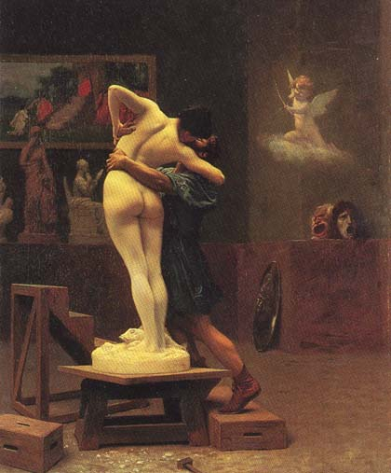
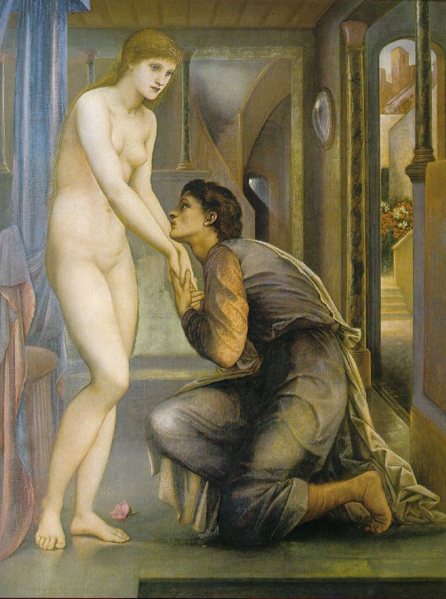
Gerome, late nineteenth century
Edward Burne- Jones, 1878

Slide 9
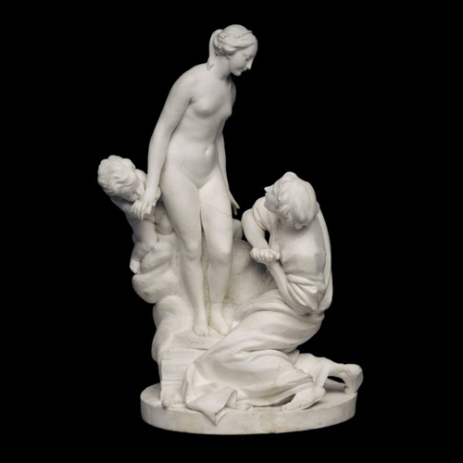

Slide 10
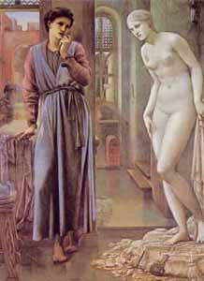
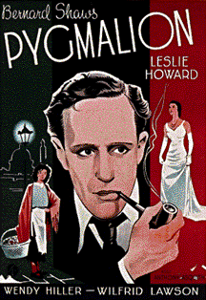
Edward Burne-Jones, 1878

