Slide 1
Lecture Notes – Introduction

Slide 2
Why is the study of the Health Care System interesting/important?
Interesting Facts
Personal health care expenditures trends (see Table 1):
17.9% of GDP in 2011
50% of per capita GDP in 2011
Part of this is caused by an increase in prices
Part is caused by an increase in real expenditures
Changing nature of the medical profession:
Move from fee-for-service care to managed care
Increases in medical malpractice
These Δs partially caused by increase in expenditures
Disease management (attempt to reduce costs by providing experts by insurance companies to help manage diseases – decrease risky behavior, increase preventative medicine.

Slide 3
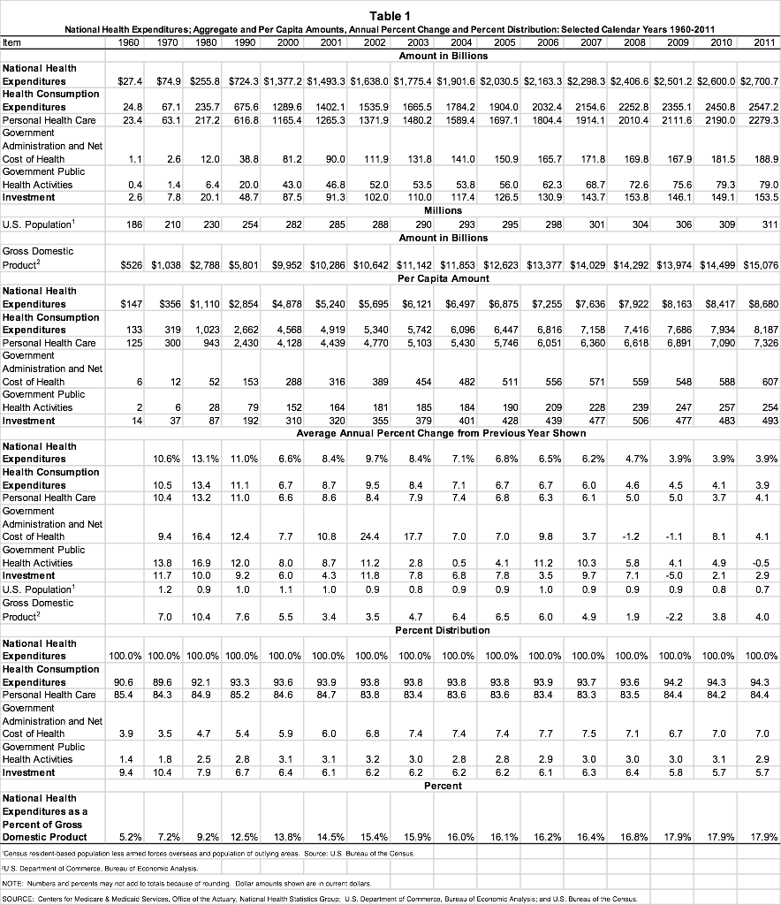
Notes:
http://www.cms.gov/Research-Statistics-Data-and-Systems/Statistics-Trends-and-Reports/NationalHealthExpendData/downloads/tables.pdf

Slide 4
How does economics help?
Positive verses Normative Issues
Positive analysis = analysis of how the world works
Objective
Factual
Testable (if true/false therefore must be positive)
Example = Is a market outcome efficient?
Normative analysis = analysis of how the world should work
Subjective or opinions
Not testable
Example = all market outcomes should be efficient.
What other important examples can you think of?
Notes:
http://www.thecrimson.com/article/1988/9/21/dukakis-unveils-health-insurance-plan-pwashington-democrat/

Slide 5
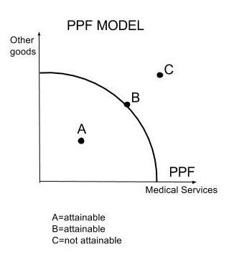
Economic Analysis
You have scarcity so you must make choices.
This concept is illustrated by the production possibility frontier (PPF) in the graph.
As you can see, an increase in medical services necessarily involves a decrease in the consumption of other goods.

Slide 6
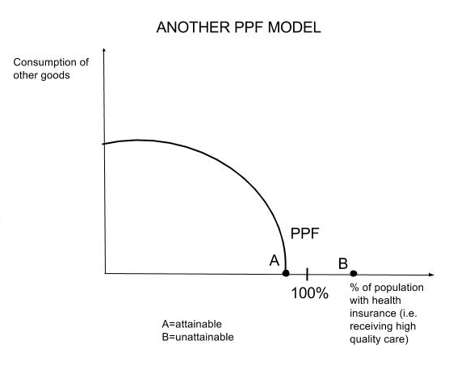
Graph 2
From Graph 2 analysis, you can conclude:
Even if you devote all resources to medical care you may NOT be able to reach 100% on x-axis (ie. intersection = point like A not B)
You cannot have both high consumption of other goods + NHI (w/ high quality care) → must be a rationing device!

Slide 7
Example: National Health Insurance in other countries
Positive Analysis: rationing is done by time rather than price as in the U.S. (or employment etc.)
Normative Analysis: they have NHI, but scarcity still exists
What are other considerations given scarcity?

Slide 8
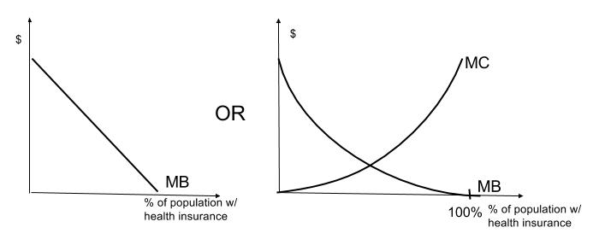
Where is the Net Benefit to Society Highest?
Consider the following:
To maximize net benefit, set % such that Marginal Benefit (MB) = Marginal Cost (MC) → setting a high % may necessarily mean setting % less than 100%. In other words, it is probable that some individuals have a benefit to society of insuring a low cost.

Slide 9
Example:
Most individuals who would benefit to society by having insurance won’t insure themselves and IF they do it will be inefficient.
How? Well, society could gain benefit by spending money on other programs such as:
Pre-natal care
Informational programs
Police protection
Food assistance
Education
→ Is such a conclusion moral?

Slide 10
The Economic Tools- A Brief Overview
4 major areas we will discuss:
Demand and Supply
Cost Curves & Π Max
Consumer Choice
Theory of the Firm

Slide 11
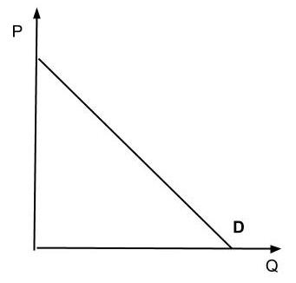
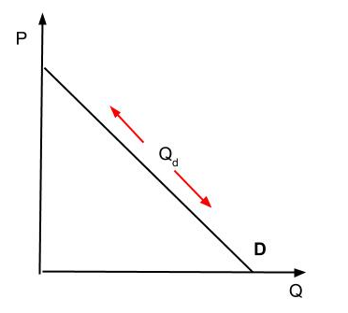
Demand
Q. What is the definition of demand?
A. The amount of a good/service a consumer/market is willing and able to buy (Q_{d}) in a given time period given the price, ceteris paribus (all else equal).
Q. What is the law of demand
A. The lower a goods price the higher Q_{d} , all else equal, and reverse.

Slide 12
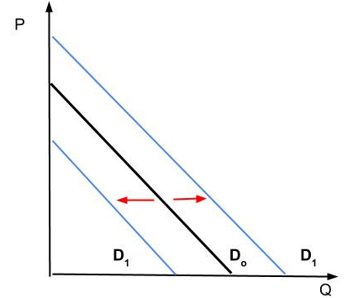
Shifts in demand caused by
changes in:
Tastes
Income
Price of related goods
# of buyers
Expectations
Make sure you know how these all work.
Notes:
Health example???

Slide 13
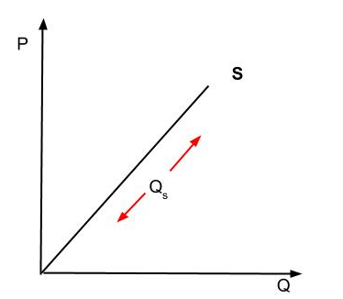
Supply
Q. What is the definition of supply?
A. The amount of a good a firm is willing and ABLE to supply (Q_{s}) given the price, ceteris paribus
Q. What is the law of supply?
A. ↑P → ↑ Q_{s ,} all else equal, and reverse.

Slide 14
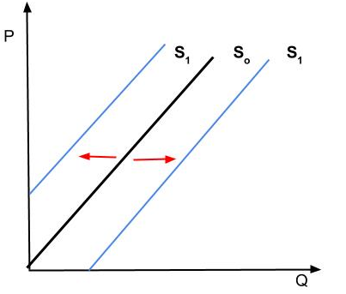
Shifts in supply caused by
Costs of production
Affected by Technology and
input prices
Price of related goods
Substitutes
Complements
Number of suppliers
Expectations
Make sure you know how all these work.

Slide 15
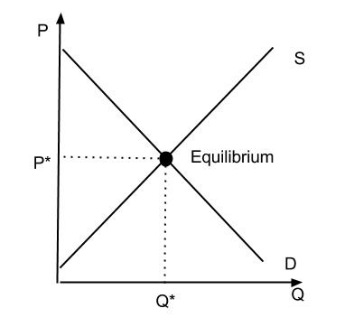
Equilibrium
What happens if
D↑ ?? → P↑ & Q↑
D↓ ?? → P↓ & Q↓
S↑ ?? → P↓ & Q↑
S↓ ?? → P↑ & Q↓
D↑ & S↑ ?? →
D↓ & S↓ ?? →
D↑ & S↓ ?? →
D↓ & S↑ ?? →
The point is to predict P and Q. Make sure you can.

Slide 16
Elasticity
Elasticity:
Similar to the concept of a rubber band
The rubber band is more elastic, for the same force applied, if the band stretches more – vice versa.
It is a measure of responsiveness
Price elasticity of Demand = η
η = (%ΔQ_{D})/(%ΔP)
Measures how responsive D is for a good to a change in the P of that good.
|η| > 1 or | (%ΔQ_{D})| > |(%ΔP) | => elastic
|η| < 1 => inelastic
|η| = 1 => unitary elastic

Slide 17
What does it mean when I say that D is relatively price elastic?
| η |>1 or |%ΔQ_{D}| > |%ΔP|
Same for other types of elasticities:
Supply elasticity
η _{s} = (%ΔQ_{S})/(%ΔP)
Income elasticity
η _{Y} = (%ΔQ_{D})/(%ΔY)
Cross-price elasticity
η _{xz} = (%ΔQ_{D}^{X})/(%ΔP_{Z})

Slide 18
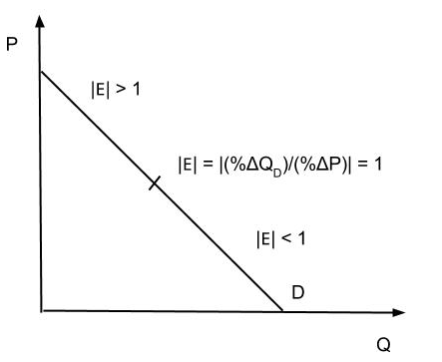
Elasticity Graph

Slide 19
Efficiency
Technological Efficiency:
A firm is able to produce the maximum output given the resources available or
Given the output produced the minimum resources (costs) are used.
Allocative Efficiency:
A firm is able to produce at an output level where P (MSB) = MC (MSB).

Slide 20
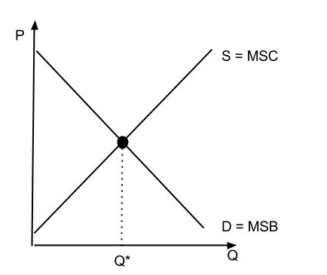
Allocative Efficiency Graph
Allocatively efficient if Q=Q* where MSB = MSC.

Slide 21
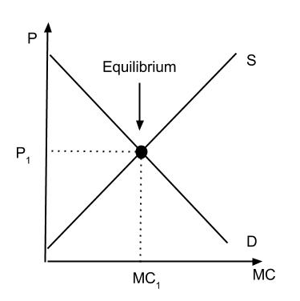
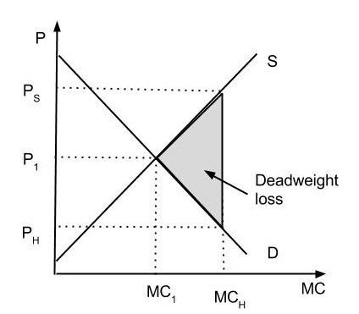
Applications of D & S
1.Without health insurance
At EQ = E₁ (P₁ , MC₁)
2. With health insurance
Deadweight loss to Society

Slide 22
With Health Insurance
What is happens to D & S?
P↓ to Consumers to P_{H}
Q_{D}↑ to MC_{H}
P↑ to Suppliers to P_{S}Q_{S} ↑ to MC_{H}
Is the market in Equilibrium?
Yes (as long as P↑ for suppliers)
Efficient? Is MSC = MSB
No=> Produce too much => Dead weight loss to society as long as D = MSB & S = MSC

Slide 23
Consumer Choice & Budget Constraints
Consumer choice model is a very simple model with only 2 goods to consume: good 1 & good 2.
Quantities = X₁ & X₂
Prices = P₁ & P₂
M = income
Budget Constraints
P₁X₁ + P₂X₂ ≤ M shows all combinations of goods 1 & 2 that are feasible. Note: P₁X₁ = $ spent on good 1, P₂X₂ = $ spent on good 2.

Slide 24
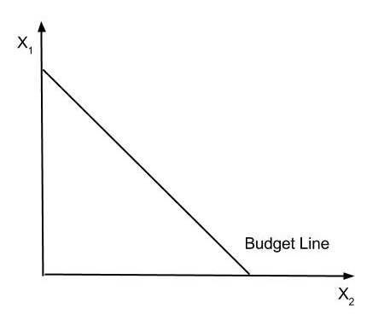
Budget Line
P₁X₁ + P₂X₂ = M , i.e. spend all your money

Slide 25
Now look at the Budget Line more closely?
What is the maximum amount of good 1 that can be consumed? = M/P1
Same for good 2 = M/P2
What is the (opportunity) cost of more X1 (or X2)?
Suppose P1 = 2 and P2 = 1. What is the cost of X1 = ? 1 more X1 => must give up 2 units of X2
Slope of Budget Line = -(P1/P2) = opportunity cost of good 1 = 1/2
What is the opportunity cost of good 2 = ? = - (P2/P1) = 2/1

Slide 26
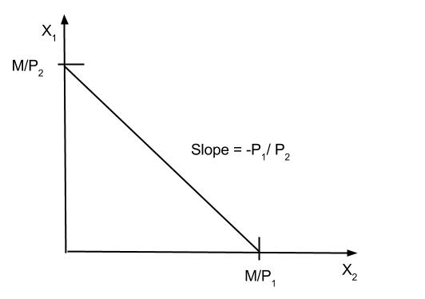
→ get:
Note: Since given by P₁X₁ + P₂X₂ = M. Put into slope intercept form by solving for X₂
→ P₂X₂ = M - P₁X₁ or
→ X₂ = (M/P₂)- (P₁/P₂) where (M/P₂) is the intercept and -(P₁/P₂) is the slope

Slide 27
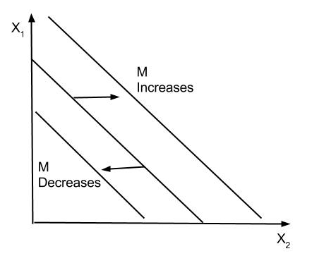
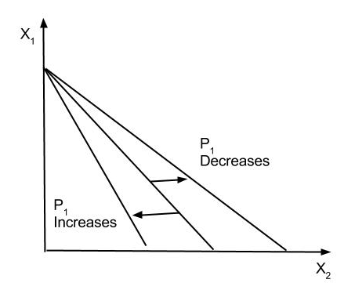
Changes in the Budget Line
Income
Prices

Slide 28
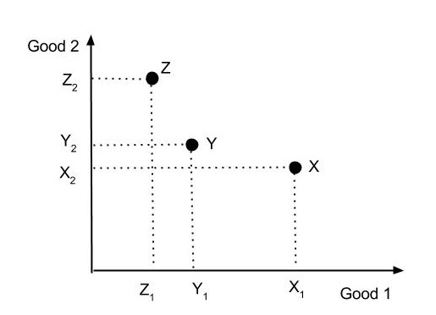
Preferences & Utility
Pick 3 consumption bundles X, Y, and Z

Slide 29
Preferences
Define preferences:
If X ≻ Y → X is ‘strictly preferred’ to Y
If X ≿ Y → X is ‘weakly preferred’ to Y
If X ∼ Y → X is ‘indifferent’ with Y
Assume individuals are rational which means:
Completeness: Either X ≿ Y or Y ≿ X
Reflexivity: X ≿ X
Transitivity: If X ≿ Y and Y ≿ Z >> X ≿ Z

Slide 30
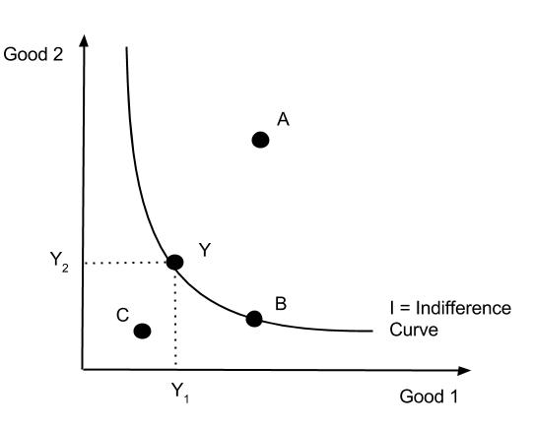
Preferences graphically:
Pick consumption bundle Y and all other bundles which are indifferent to Y
Call all these bundles together an indifference curve
3 types of points
Points like C: Y ≻ C
Points like B: Y ∼ B
Points like A: A ≻ Y

Slide 31
Individual curves facts:
Cannot cross (violates transitivity)
Infinite family of individual curves
Examples of types of individual curves:
Perfect substitutes
Perfect complements
Bads
Neutral Goods
Satiation Points

Slide 32
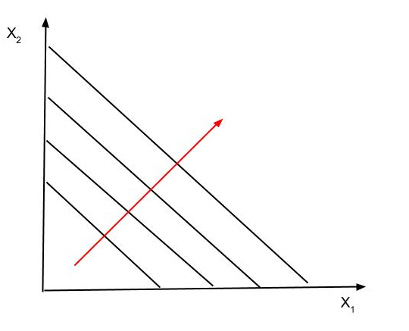
Perfect Substitutes – person views the two goods as exactly the same. Move in the direction of the arrow increases preferences.

Slide 33
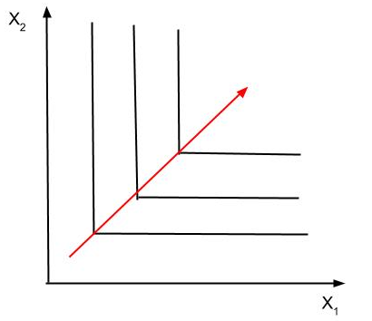
Perfect Complements – need the two goods together in a fixed ratio.

Slide 34
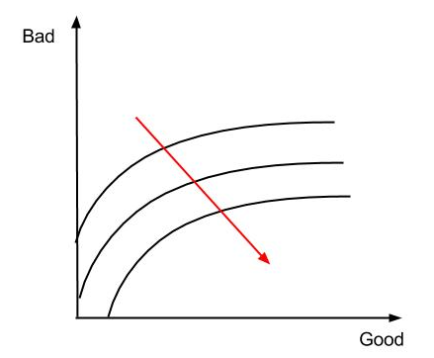
Bads – more of a bad makes one worse off

Slide 35
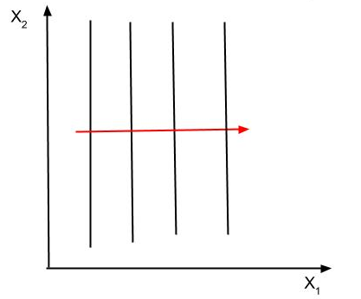
Neutral Goods – x1 good, x2 neutral – increase a neutral and neither better or worse off.

Slide 36
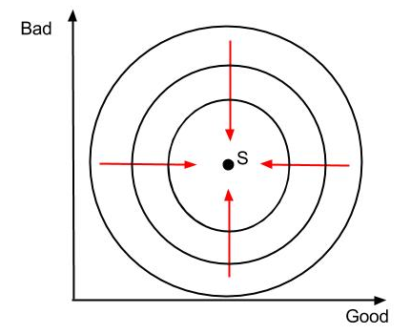
Satiation Point = S, at S each good changes between good and bad.

Slide 37
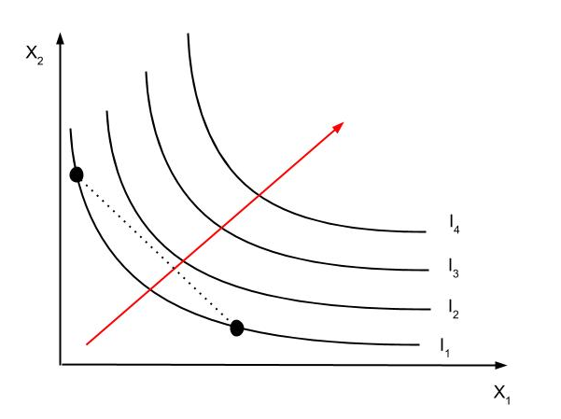
We will generally assume that preferences look like this:
i.e. Averages are preferred to extremes convexity

Slide 38
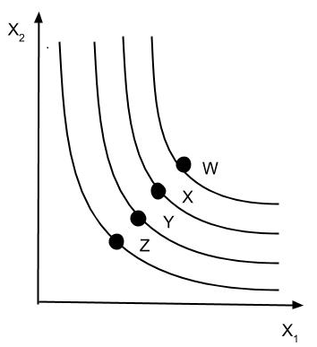
Utility
Utility assumptions:
That individuals have preferences
Utility measures those preferences in such a way that if W≻X≻Y≻Z → U(W)≻U(X)≻U(Y)≻U(Z)
What happens as we move out to higher indifference curves → utility levels ↑

Slide 39
Utility assumptions continued:
3. We assume that individuals want to maximize utility given:
Prices
Income
Preferences
4. Marginal Utility=MU
MU1= (Δ Total Utility1) / (ΔX1)
MU2= (Δ Total Utility2) / (ΔX2)
Marginal Rate of Substitution: MRS
Rate at which consumer is willing to substitute 1 good for another
slope of indifference curve
-MU1/MU2

Slide 40
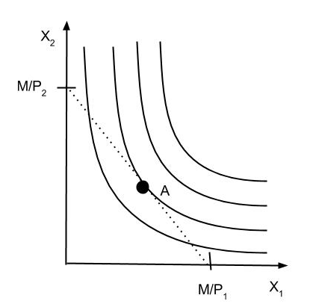
Budget Line & Preferences
Put together a budget line and preferences:
Choose point A for maximum utility. Why?
It is where -p1/p2=MRS=-MU1/MU2

Slide 41
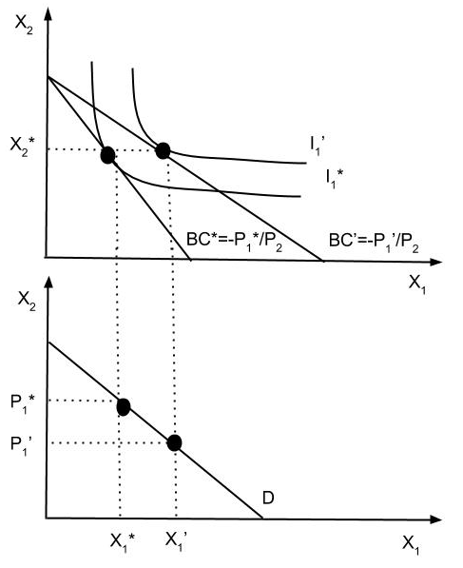
Consumer Demand
Consumer demand is derived from all the individual demands in the market for the two goods.
→ Individual demand is derived from utility analysis.

Slide 42
Example: Subsidies of health by the government
Suppose the government has 2 goals
Supply low-cost health care to the aged
Do not subsidize other goods
Now consider some different plans
1. The entire cost of medical care is paid for by all program participants.
Conclusion:
Supplies low-cost but participants over consumer i.e. choose HC until MC_{HC}=0
Does subsidize other goods. How?
Very costly

Slide 43
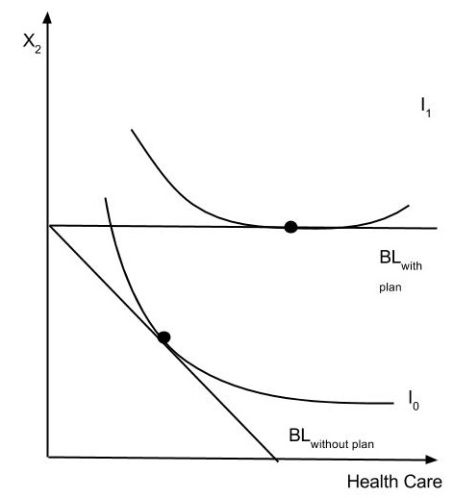
Plan 1 Graph

Slide 44
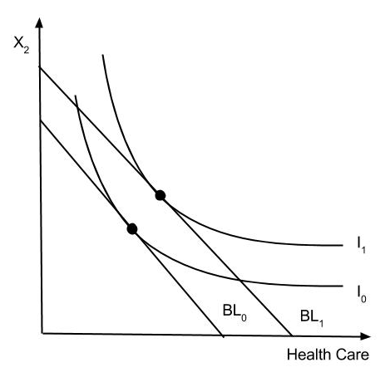
Different plans continued:
2. The government pays a lump-sum payment of $M1
Conclusion:
May supply low-cost but MC_{HC} < MC₂ → may mostly supply other goods
Cost is contained unless number of participants is high

Slide 45
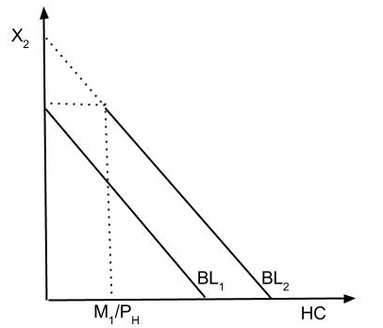
Different plans continued:
3. Lump sum payment of $M1 but must be spent on health
Conclusion:
Everyone buys at least M1/PH HC
If HC = 0 before → no subsidy of other goods
If HC > 0 before → subsidy of other goods (Why?)
Enforcement costs

Slide 46
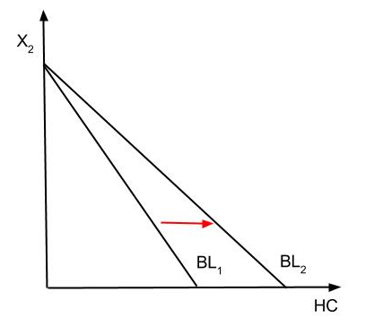
Different plans continued:
4. The government subsidizes the price of health care by paying some % of the price
Conclusion:
Even with the subsidy individuals may (depends on MC_{HC}) buy very little, if any, more HC - especially if very poor
Will subsidize other goods
Cost?

Slide 47
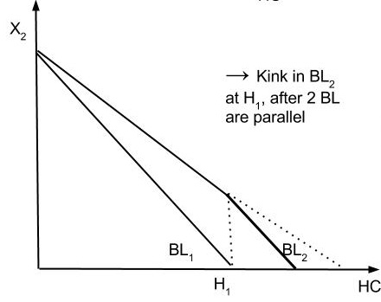
Different plans continued:
5. The government subsidizes the price but only up to max amount of health care = H1
Conclusion:
Effect depends on where you are previously
If already consuming H1 → just like 3
If not → just like 4

Slide 48
Three Questions to think about
1. Which plan is the best?
2. Are there any other programs that could be analyzed?
3. What value does the model have? OR Can you do the same thing without the model?

Slide 49
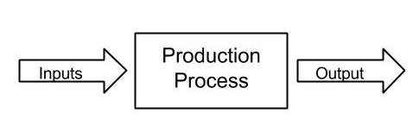
Production & Profit Maximization
What is the production process?
When inputs combined together in the production process( i.e. technology) yields an output.
Inputs include
Land- natural resources
Labor (L)
Capital (K)
Entrepreneurship

Slide 50
Production Function
The production process is often called the production function where Q(output)= f(inputs)
To make it simple and assume only 1 variable input = labor (L) and a fixed input (K)
Production function shows the relationship between labor and output
What is that relationship?

Slide 51
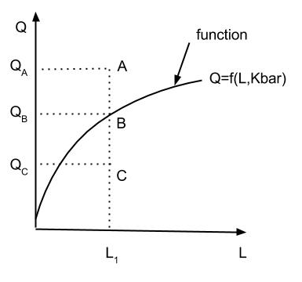
Production Function
Three types of points
A= given resources, can't produce this much
C= given resources, can produce Qc but are technologically inefficient
B= given resources, are producing the max. Output → Technologically efficient!

Slide 52
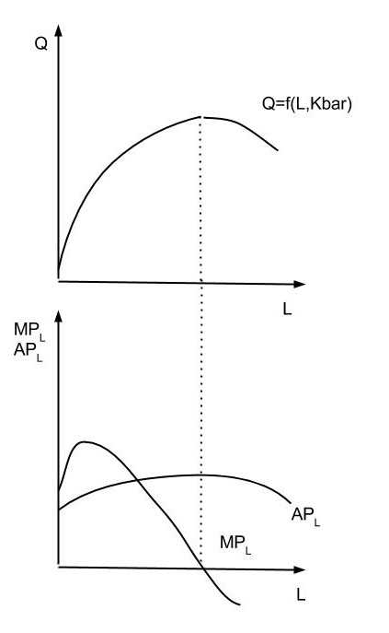
Define
MP_{L} = Δ Q/ Δ L
AP_{L} = Q/L
Note Kbar indicates capital is fixed.

Slide 53
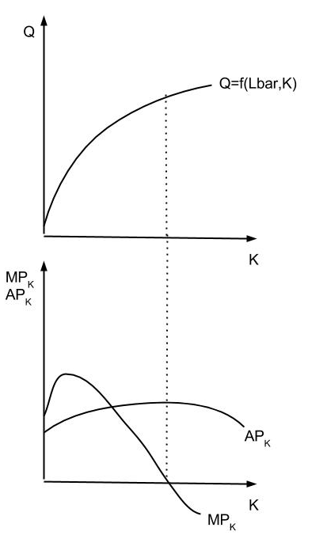
Can do the same for any other input like capital (K)
Look at the shape of the production function on the graph i.e. law of diminishing marginal productivity

Slide 54
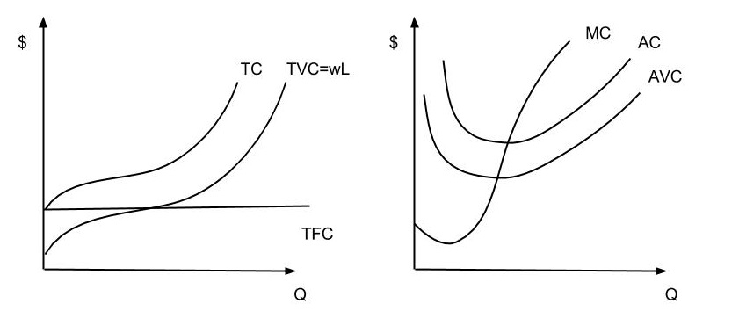
From this derive the short-run cost curves
→ get the following

Slide 55
Identities & Definitions
TC = TVC + TFC
AC = TC/Q
= AVC + AFC (from TC)
AVC = TVC/Q
AFC = TFC/Q
MC = Δ TC/Δ Q
= Δ TVC/Δ Q + Δ TFC/Q
= Δ TVC/ Δ Q
Where
TC: Total Cost
TVC: Total Variable Cost
TFC: Total Fixed Cost
AC: Average Cost
AVC: Average Variable Cost
AFC: Average Fixed Cost
MC: Marginal Cost

Slide 56
Cost Curves
Q. Why do the cost curves look as they do?
A. Assumptions about the underlying short-run production function
The main one is diminishing marginal productivity
Π maximization
Marginal revenue (MR)

Slide 57
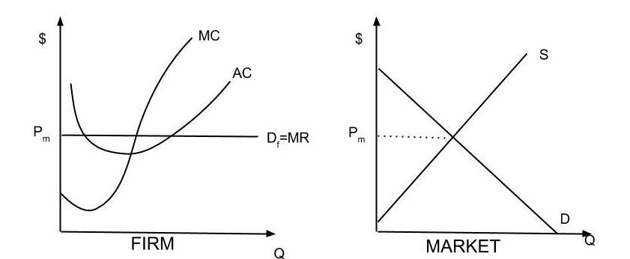
Marginal Revenue
MR= Δ TR/ Δ Q
If industry P.C. → MR = P
In the graph, see where it produces MR=MC to max Π.

Slide 58
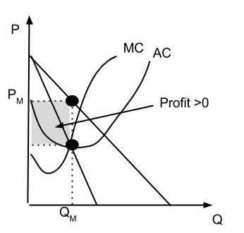
For a monopoly the cost curve is the same for all but
It only faces outline market demand
Still Π-max by producing where MR = MC

Slide 59
Main points
If on cost curves → Technologically efficient
Π-maximizing firms always on cost curves
But does the industry produce at minimum point of AC curve?
Not necessarily

Slide 60
Technological Efficiency
2 kinds of technological efficiency:
Firm is technology efficient if given output producing it at minimum cost (i.e. on the cost curves)
Industry is technologically efficient if given output
→ at minimum cost
→ producing at minimum point on AC curve

Slide 61
This analysis is short-run. Now look at long-run where all inputs are variable.
Assume 2 inputs K & L
So Q = f(K, L)
before either K = Kbar or L = Lbar
Now both are free to change
How does the firm decide how much K & L to use to produce Q?

Slide 62
Statistical Tools
Hypothesis testing
Ever heard an factual assertion and wondered if its true? Can you think of any?
For example, male wages exceed female wages
1st step in testing is to set up an hypothesis
Null hypothesis→ one we wish to disprove
W_{M} = W_{F}
Alternative hypothesis → several are possible
W_{M} > W_{F}
W_{M} ≠ W_{F}
W_{M} < W_{F}

Slide 63
How to test?
1st possibility is to look at means
Mean of distribution= Σ X_{i}/ N = $\overline{\text{X}}$
Suppose we calculate $\overline{\text{W}}$_{M} and $\overline{\text{W}}$_{F} find that $\overline{\text{W}}$_{M} > $\overline{\text{W}}$_{F}
Is the null hypothesis false? Could just be random?
Want to make sure the likelihood of this being a random outcome is low
Use a measure of dispersion:
Variance = V = $\sum{\left\lceil \frac{{\left(Xi − \overline{X}\right)}^{2}}{N}\right\rceil }$
Standard deviation = s = $\sqrt{\text{V}}$
Standard Error = SE = s/ $\sqrt{N}$ ( Actual $\sqrt{N−1}$)
Should have normal distribution – what does that mean?

Slide 64
How to use to test the hypothesis?
Calculate $\overline{\text{W}}$_{M} - $\overline{\text{W}}$_{F} / SE
Use the Combined SE or the weighted average
Weighted by sample sizes of men vs. women
Actual Formulas
S_{w} = weighted standard deviation
= [(N₁- 1)S₁² + (N₂- 1)S₂² ) / N₁+N₂ -2)]
T-statistic = [(Xbar₁- Xbar₂)/ (S_{w} ( 1/N₁ + 1/N₂)^{1/2})]
S_{w} ( 1/N₁ + 1/N₂)^{1/2} is weighted standard error OR basically measure how many standard errors +/- from 0 is the difference between the two wages.

Slide 65
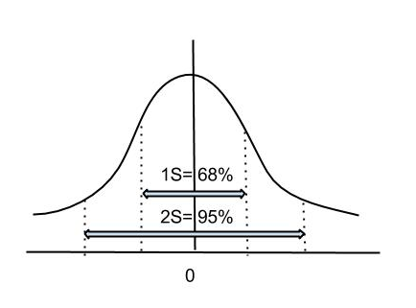
Rule of thumb = 2 S.C.
+/- means good evidence that the two means are different ( although could still happen by chance 5% of the time)

Slide 66
Regression Analysis
Suppose we find the 2 means are different. Why are the 2 means different?
Could be for a number of different reasons or variables
These reasons/variables could be continuous, that is change continuously → Regression Analysis deals with both issues
1. Deals with both continuous and discrete data
2. Controls for other variables

Slide 67
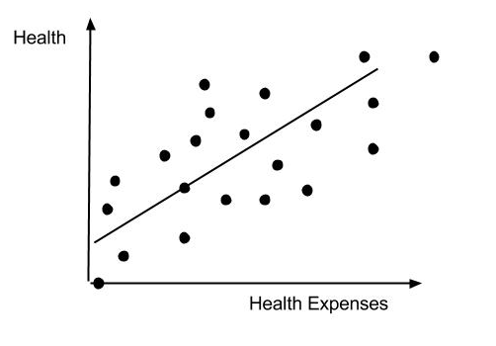
Example: Suppose you have 2 variables. Each dot in the graph below represents an observation.
What is the relationship?
A Regression fits the best line thru data points
→ yields Health = B0 + B1(H.E.) where Bo is the intercept and B1 is the sl0pe

Slide 68
Generally use OLS, Ordinary Least Squares, to estimate line
Multiple regression analysis with lots of explanatory variables
Y = B_{o} + B₁X₁ + B₂X₂ +…+ B_{n}X_{n} with all else equal
OR
Health = B₀ + B₁( H.E.) + B₂( EDUC) with all else equal
Mostly I want you to be able to interpret the coefficients, B₀ , B₁ , etc.

Slide 69
Dummy variables may also be used.
Give the observation a place holder of 0 or 1. For example, 0 for male & 1 for female.
Tests of significance
Note that here the test is whether the coefficient is zero. That is the null hypothesis is B₁ = 0; test statistic is B₁/SE = measures how many standard errors from 0 is B₁. Again, testing whether an observed B₁ that is different from 0 could have occurred randomly. Rule of thumb = 2 SE from 0 (i.e., 5% chance it happened randomly.)

Slide 70
Chapter 4- Cost/Benefit Analysis
Problem in decision making-Which is best choice?
3 approaches
CBA = cost benefit analysis = measures costs/benefits in $
Problems?
CEA = cost effectiveness analysis = measures costs/benefits in terms of “natural” measures
Problems?
CUA = cost utility analysis = changes CEA to measure benefits in terms of preferences
All trying to use society’s viewpoint to make best decisions

Slide 71
CBA
How do firms/individuals behave?
Firms → MR = MC
Marginal analysis
MSB = marginal social benefit ( Why ↓ slope? )
MSC = marginal social cost ( Why ↑ slope? )
Social optimum when MSB – MSC. Why?
Discounting
Why is it necessary? What if you pay costs up front but reap the benefits later?

Slide 72
Discounting cont.
You typically want things now rather than later because you could die tomorrow or you could invest it now and have even more money tomorrow!
Present Discounted Value
PV = Σ [( B_{t} – C_{t})/ (1+r)^{t} ]
where B - Benefits , C - Costs, r – interest rate, t - time ( i.e. years)
Cost-Benefit
Net benefit = Σ [( B_{t} – C_{t})/ (1+r)^{t} ]
OR B/C = = Σ [(( B_{t})/ (1+r)^{t} ) / (( C_{t})/ (1+r)^{t} )]
if B/C > 1 → beneficial
if B/C = 1 → waste

Slide 73
Discounting cont.
Problems
Identify B/C in $
Must include external costs
How to put $ on B/C
Project life/discount rate
What is the discount rate?
Given by the opportunities forgone in private sector by project

Slide 74
CBA in Health Care
Problems
How to value life? (↑ longevity, etc)
Difficulties in estimating cost
For 1. there are 2 approaches
Human capital approach = present value of future earning
Problems?
Willingness to pay to avoid injury
Example: CBA of screening tests for STD in women.

Slide 75
CEA
CEA or Cost Effectiveness Analysis
Basically ignores benefits and compares only costs of achieving particular objects
Advantages of CEA
Doable
1st step to CBA
Application

Slide 76
CUA & QALYs
CUA or Cost Utility Analysis
Special case of CEA uses preferences to rank alternative interventions
QALY or Quality Adjusted Life Years
= weighted average of years of life with 1 = perfect health and 0 = death
Uses health status index with weights determined by individual preferences
Example:

Slide 77
Problems with QALYs
Subjectivity - How to get preferences?
Equity issues
Distributional issues
Conclusion
CUA should use community rather than individual preferences
→ How to get preferences or weight?

Slide 78
DALY
DALY or Disability Adjusted Life Years
Start with highest achievable life
Japanese women= 89.6 years
Then subtract losses from death disability
YLL = Years Life Lost
Target – Actual for population per age
If life expectancy MUs = 76.8 → 89.6 – 76.8 = 12.8
YLD = Years Living with Disability
DW = Disability Weight
0 = no loss & 1 = death
Differs by age

